Slide 1
INTRODUCTION
FOR EDUCATORS
Notes:
Thanks so much for joining us!
I’m excited to tell you about our state’s new system for assessing and supporting student learning.

Slide 2
Introduction
Embodies Nebraska’s holistic view of students
Gives schools and districts valuable information about student learning
Helps teachers prepare students for a lifetime of success
Nebraska Student-Centered Assessment System (NSCAS)
Notes:
The Nebraska Department of Education (NDE) has begun the development and implementation of Nebraska’s Student-Centered Assessment System (NSCAS). [Pronounced, “en-skass.”]
NSCAS is a statewide assessment system that embodies Nebraska’s holistic view of students.
Today, we’ll be discussing how the system provides valuable information and supports to help you as educators prepare students for success in postsecondary education, career, and civic life.

Slide 3
About NSCAS
Provides multiple types of assessments throughout the year
Reveals in-depth information about what each student knows and is ready to learn
Empowers educators with timely and actionable insights that accelerate learning
Putting students at the center of teaching and learning
Notes:
One goal of the NSCAS system is to provide educators with multiple types of assessment for instructional purposes throughout the year.
This will enable educators to monitor student progress towards rigorous content area standards and adjust instruction in the moment, as well as track growth and target learning needs over time.
In addition to assessments provided by NDE, the system aims to include resources and professional learning around the development and use of classroom-embedded assessment strategies.

Slide 4
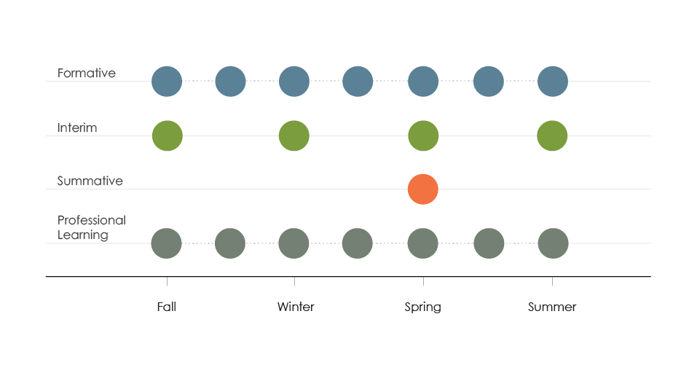
About NSCAS
Multiple measures and uses
Formative assessment to inform instructional approaches
Interim assessment to measure academic growth and identify learning needs
Summative assessment to measure student achievement
Professional learning to support effective use of data for student learning
Notes:
The NSCAS system will feature formative, interim, and summative assessment approaches to provide a holistic view of student and school performance.
As you know:
Formative assessment practices and tools are administered during the learning and teaching process to inform instructional approaches and decisions
Interim assessment is administered periodically to measure academic growth and identify student learning needs.
Summative assessment is administered in the spring to measure achievement relative to Nebraska’s content area standards.
Professional learning – NDE is adding to existing professional learning opportunities provided by districts by partnering with NWEA to offer 1) onsite workshops focused on assessment literacy, building formative practices, and applying MAP Growth results, and 2) supplemental extended learning online.
Over the next several months, NDE will engage stakeholders to determine the greatest needs within the Nebraska Student-Centered Assessment System.

Slide 5
Assessment Types

Slide 6
Assessment types
Districts/schools already provide formative assessment resources
NDE is partnering with NWEA to supplement these resources with:
Onsite formative assessment workshops
Extensive online resources for formative practice
TestWiz and the Navigate Item Bank
Formative assessment
New resources and tools
Notes:
A series of formative assessment workshops in the winter and spring led by Nebraska- certified facilitators. Cultivate your skills in developing learning targets, monitoring student progress, providing learner-focused feedback, and motivating students to sustain learning based on their individual passions and goals.
Online resources for formative practice. You have year-round access to NWEA Professional Learning Online, which includes, among other resources, extensive teacher toolkits for formative assessment.
TestWiz and the Navigate Item Bank. You have access to these tools that help you build formative assessments. Thousands of items are available with Navigate, as well as pre-built assessments that help you quickly measure student performance.
NDE will be evaluating additional formative assessment needs moving forward – e.g. are there needs in additional subjects or grades not addressed by existing formative assessment resources provided by NDE/districts?

Slide 7
Assessment Types
NDE has made MAP Growth available to NE districts at no cost
MAP Growth is already used in 95% of NE districts to:
Identify student learning needs and set goals with students
Measure academic growth within and across school years
Track growth toward proficiency and predict summative performance
Interim assessment
Notes:
As you know, interim assessments help educators measure academic growth and better understand student learning needs.
NDE is providing MAP Growth for reading, language, math, and science for grades 3-8 in all public school districts to use (optionally) with other interim assessments of their choice.
MAP Growth:
Can be administered up to four times a year (fall/winter/spring/summer)
Uses an equal-interval scale (RIT) continuous across grade levels
Enables consistent comparison of scores over time so you can see progress of individual students, classes, grade levels, schools, or the district
Supports better instruction for students
Group students with similar RIT scores for instruction
Help students understand what they need to learn and set goals
Moving forward, NDE is exploring assessment supports for content areas and grade levels not covered by the statewide summative assessment

Slide 8
Assessment Types
NSCAS Summative—replaces NeSA for grades 3–8
Deeper and more precise insight into grade-level performance
Maximizes classroom time and allows timely intervention
Provides a stable and secure testing experience
Enables students of all abilities to participate
NSCAS ACT—summative assessment for all high school juniors
Indicates college readiness
Summative Assessment
NSCAS Summative
NSCAS ACT
Notes:
The NSCAS Summative is a new, computer-adaptive statewide assessment replacing the NeSA tests in English language arts and math for grades 3 – 8 and science for grades 5 and 8.
Measures student performance against Nebraska’s content area standards
Adapts dynamically based on each student’s ability and will include innovative, interactive question formats that engage students and enable them to demonstrate higher order thinking.
Takes less time for students to complete and will provide deeper information about what they know.
Starting in 2019, results will be available shortly after the close of the testing window, enabling you (and parents) to address roadblocks to student progress in a timely fashion, ahead of the next school year.
Students of all abilities will be able to participate via accommodations and the NSCAS Alternate assessment.
The NSCAS ACT is the summative assessment in math, reading, science, and writing at the high school level and is administered in the spring to all high school juniors.
Provides more postsecondary opportunities for students in Nebraska.
Brings increased rigor, relevance, and expectations for students.
Gives a more comprehensive view of ALL Nebraska students.*
* An alternate exam will be available for the one percent of students who qualify for having significant cognitive disabilities.

Slide 9
NSCAS Summative
Nebraska educators define achievement levels per Nebraska content standards
Content specialist review ensures proper measurement and prevents bias
Independent alignment study for skills and standards measurement
Built from Nebraska Standards with help from Nebraska Educators
Notes:
The NSCAS Summative is built from Nebraska’s content area standards with help from Nebraska educators.
ELA and Math (Grades 3–8): Based on Nebraska’s College and Career Ready Standards
Science (Grades 5&8): Based on Nebraska’s legacy standards through 2020; based on Nebraska’s College and Career Ready Standards starting in 2021
In partnership with NWEA, educators have developed achievement level expectations that are specific to Nebraska’s content area standards.
Each item has been written or reviewed by Nebraska educators for alignment to the Nebraska content area standard being assessed.
Item reviewers ensure test items measure what they are supposed to and are free from bias.
An independent alignment study is also being conducted to ensure that all items effectively measure Nebraska’s content area skills and standards.

Slide 10
NSCAS Summative
Adapts dynamically based on each student’s ability
Includes engaging question formats
Challenges top performers
Doesn’t overwhelm students with skills below grade level
Deeper insight into grade-level performance
Notes:
The NSCAS Summative yields deeper and more precise insights into students’ grade-level performance by adapting dynamically based on each student’s ability.
It also includes innovative question formats that engage students and enable them to demonstrate higher-order thinking.
As a result, it challenges top performers without overwhelming students whose skills are below grade level.

Slide 11
NSCAS Summative
Adjusts to students’ abilities, measuring more in less time
Reduces test time while producing more accurate results
Starting in 2019, results available shortly after close of testing window
Maximizes classroom time + enables timely intervention
Notes:
The NSCAS Summative also helps maximize classroom time and enable timely intervention to support student learning.
Computer adaptive tests quickly adjust to students’ abilities instead of requiring responses to items across all ranges of knowledge, reducing test time while producing more accurate results.
Starting in 2019, the results of the test will be available shortly after the close of the testing window.
For the spring 2018 summative assessment, results will be available in the fall of 2018, as a standards-setting process must be completed over the summer of 2018. However, spring 2019 results will be available shortly after the close of the testing window.
The timely availability of summative results will enable educators and parents to address roadblocks to success ahead of the next school year.

Slide 12
NSCAS Summative
Operates on the NWEA Comprehensive Assessment Platform
Trusted platform (MAP Growth operates on same platform)
Supports 40 million student test events each year
Practice assessments ensure student comfort
Stable and secure testing experience reduces stress
Notes:
The NSCAS Summative provides a stable and secure testing experience, which helps reduce stress for students and educators.
It will operate on the NWEA Comprehensive Assessment Platform that 95% of Nebraska school districts already know and trust, as MAP Growth uses the same platform.
The platform supports 40 million student test events each year.
The current configuration has been certified and tested for at least 250,000 students actively testing at one time.
To ensure that students are comfortable with the new NSCAS Summative assessment experience, practice assessments will be provided to schools and districts in February 2018.

Slide 13
NSCAS Summative
Universal tools for all students
Accessibility supports—online and on paper
NSCAS Alternate assessment available for significant cognitive disabilities
Students of all abilities can participate
Notes:
All students will have access to an array of universal tools such as notepad, highlighter, eraser, zoom, strikethrough tool, and masking.
Accessibility supports – both online and on paper – will be available to support English learners and students with disabilities.
Assessments will be available in English, Spanish, Braille, and large-print. Linguistic supports and approved accommodations such as text to speech will also be available.
The NSCAS Alternate Assessment will be available to students with the most significant cognitive disabilities.

Slide 14
Assessment Types
Summative assessment in English language arts, math, and science
Administered in the spring to all high school juniors
Provides more postsecondary opportunities for students in Nebraska
Brings increased rigor, relevance, and expectations for students
NSCAS ACT
Summative assessment for all high school juniors
Notes:
The ACT college entrance exam will continue to serve as the summative assessment in English language arts (reading-English-writing), math, and science. The NSCAS ACT is aligned to the national ACT standards, and meeting expectations on the exam indicates college readiness in Nebraska students.
NSCAS ACT provides more postsecondary opportunities for students in Nebraska.
The NSCAS ACT presents equal testing opportunities for all students at the junior level.
All juniors may choose to send their scores to up to four colleges of their choice at no cost to the students.
The ACT paves the way for more college scholarship application opportunities.
NSCAS ACT brings increased rigor, relevance, and expectations for students.
All juniors take the ACT, giving a more comprehensive view of ALL Nebraska students*
ACT scores may decrease in the initial year of testing due to the larger number of students tested and the increased rigor of the exam.
As state standards are raised to meet national ACT standards, and instruction reflects those standards, scores are expected to improve in the coming years.
* An alternate exam will be available for the one percent of students who qualify for having significant cognitive disabilities.

Slide 15
Professional Learning

Slide 16
Professional Learning
Workshops led by Nebraska-certified facilitators
Assessment literacy
Formative instructional practice
Applying MAP Growth data
Year-round access to online professional learning resources
Workshops and online resources to help you use data to inform instruction
Notes:
In addition to existing professional learning opportunities and resources provided by NDE, districts, and schools, NDE is providing new professional learning opportunities to districts.
Onsite workshops help Nebraska educators for grades 3 – 8:
Increase understanding of assessment literacy
Build additional formative practices that support in-the-moment instructional adjustments focused on clearly-defined learning targets.
Strengthen their experience in applying MAP Growth data to instructional practice
Workshops are led by Nebraska-certified facilitators based on district needs/time
NDE increased Nebraska-certified facilitator capacity by 30 percent (from 50 to 65 facilitators).
Facilitators attend in-person, two-day trainings for each workshop and participate in ongoing learning opportunities. Many certified facilitators are ESU staff developers and district leaders.
Year-round access to NWEA Professional Learning Online provides Nebraska educators with supplemental extended learning content, as well as ongoing support and community.

Slide 17
Conclusion

Slide 18
NSCAS
Formative assessment
Address student learning needs in-the-moment
Interim assessment
Understand student learning needs and measure growth toward learning goals
Summative assessment
NSCAS Summative: Assesses student performance against Nebraska’s content area standards
NSCAS ACT: Assesses college readiness of Nebraska students
Professional learning
Support educators—and by extension parents – in their use of assessment data to accelerate student learning at all levels
Four core components to prepare students for a lifetime of success
Notes:
That completes our introduction to the Nebraska Student-Centered Assessment System (NSCAS)!
Let’s quickly review how NSCAS prepares students for a lifetime of success.
[Presenter reviews bullet points.]

Slide 19
Questions?
To learn more about Nebraska Student-Centered Assessment System (NSCAS), visit education.ne.gov/assessment/nscas-system
Notes:
[Presenter invites and responds to participant Qs.]

