Slide 1

Nebraska Career Education
STS Fall Workshops
2017
Notes:
Ask schools to sit together

Slide 2
Agenda
NCE and STS Updates and Areas of Focus
Programs of Study Revisit
Draft of NEW Programs of Study and Course Standards
Safety Posters
Non-Traditional Student Recruitment
SkillsUSA Update
Curriculum Initiatives
Industry Tour
Notes:
Tony
Provide instructions for lunch from 11:30

Slide 3
Safety Instructions
Restrooms
Fire
Tornado
CPR
Emergency Caller
Active Shooter
Please quiet cell phones

Slide 4
Whose Here?
Introduce yourself
Name
School
What you teach
How long you have been teaching
One hobby that you have

Slide 5
Bookmark These Websites!
https://www.education.ne.gov/STS
http://www.skillsusanebraska.org
https://www.education.ne.gov/NCE

Slide 6
Engineering Question

Slide 7
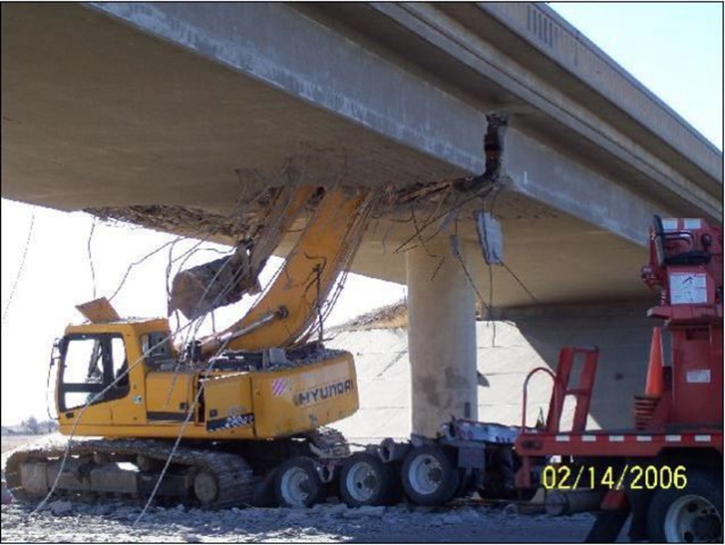

Slide 8
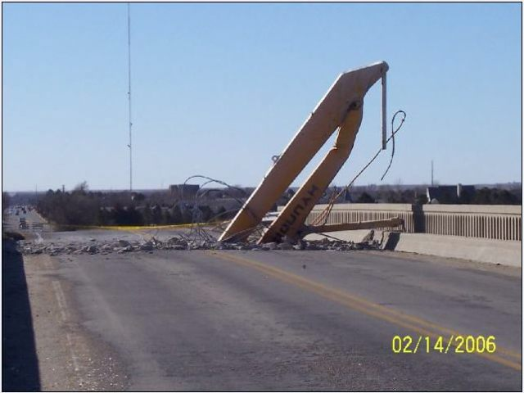

Slide 9
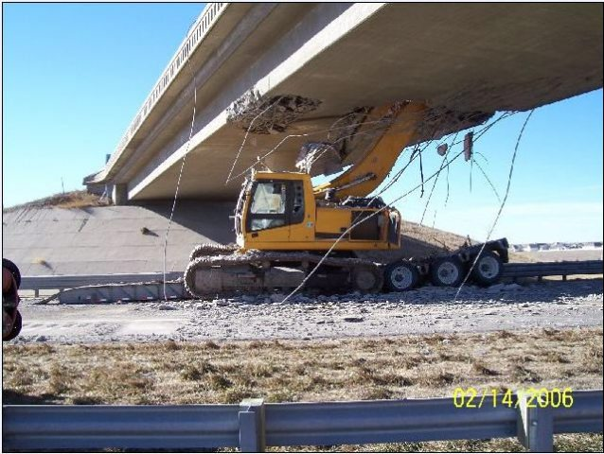

Slide 10
Safety Training
THE most important thing we teach!
http://www.education.ne.gov/sts/I_Safety_Law.html
http://www.careersafeonline.com/

Slide 11
STS Teacher Education Contacts
UNL – Eric Knoll eknoll2@unl.edu
Office: (402) 472-2470
Mobile: (402) 310-2109
WSC – Greg Vander Weil grvande1@wsc.edu
Office: (402) 375-7283

Slide 12
Career Education Permit
Permit can only be applied for by the school
Teacher can only teach in their area of expertise
Jump Start training in July

Slide 13
Gender Non-Traditional Recruitment in STS
Please welcome Charmain Satree

Slide 14
Partnerships for Innovation
Retha Dunn – Executive Director
PFI is the lunch provider

Slide 15
H3 Website
High Skill, High Wage, High Demand Jobs
Updated every Sunday
Other job information
http://h3.ne.gov/H3/

Slide 16
Let’s Get Elementary Students Involved!
Kids start figuring out what they are generally good at by 4th grade
SkillsUSA Jump Into STEM program
Have them tour your shops
Have student demos for them
Let them try a small, simple project
How many are doing this?

Slide 17
Advocacy Efforts
Make your program visible in your community
Invite media to see your program
Invite your state senator to see what is going on in your program
Have students prepared to speak

Slide 18
Initiatives
Industry tours – they want your students to see what is going on
Next Generation Industry Partnerships
reVISION

Slide 19
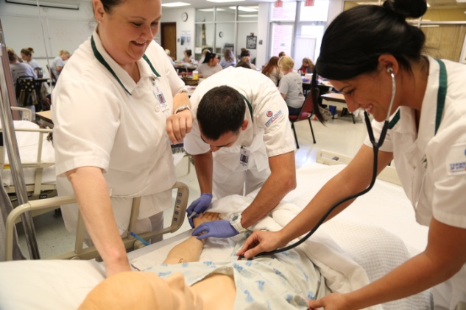


Defining Work-Based Learning (WBL)
An instructional strategy that prepares all students for success in careers through direct engagement with industry and community professionals.
http://www.nebraskaworkplaceexperiences.com

Slide 20
Career Readiness Skills
Second most important thing we teach
Checklist

Slide 21
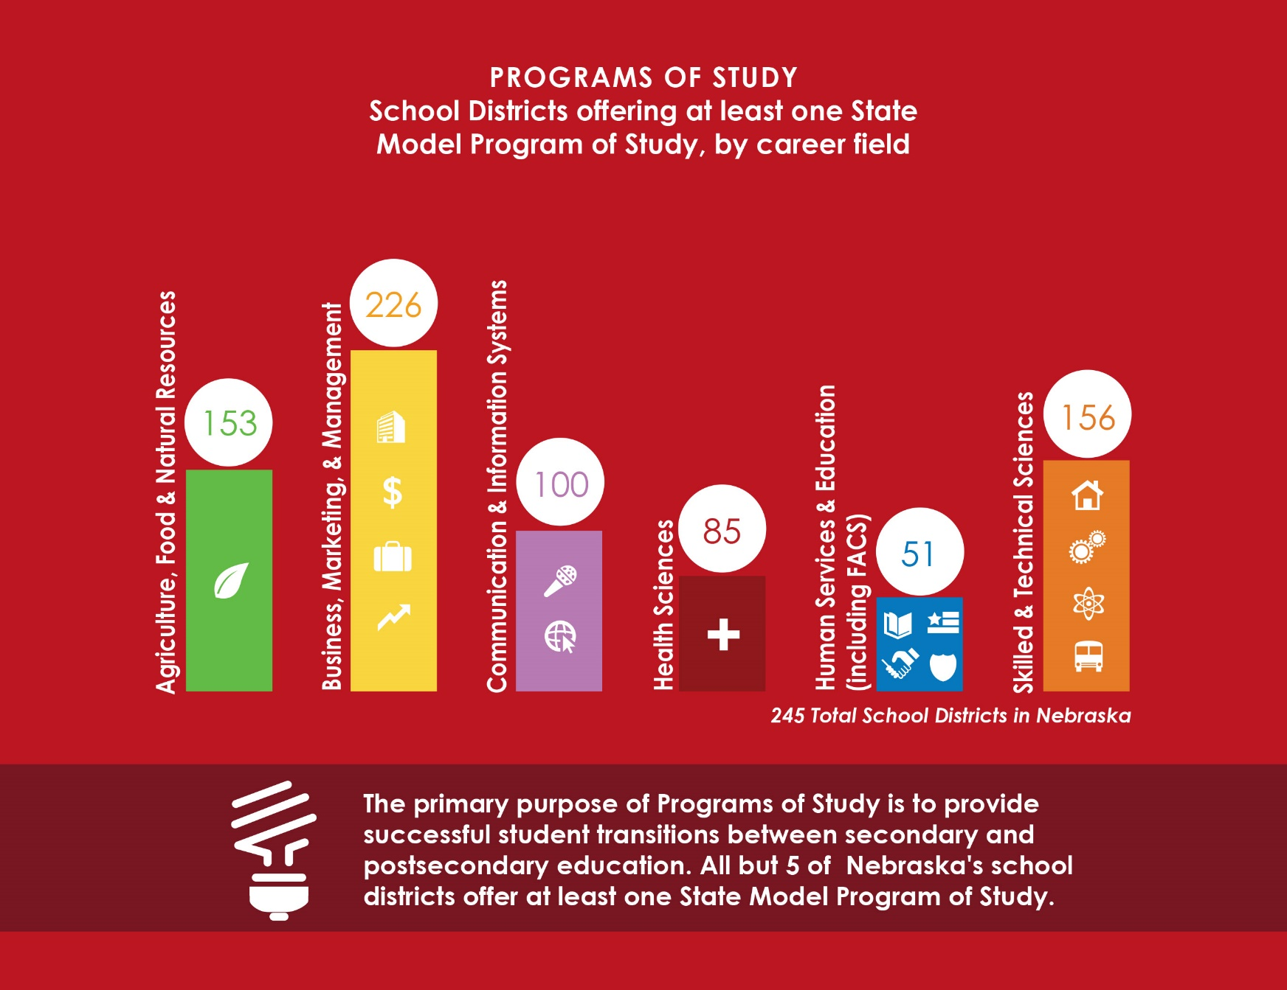
Today’s Career Education

Slide 22
Programs of Study
CTE Sequence of Courses = sequence of a minimum of 3 semester courses
Perkins legislation might dictate programs of study
Many schools are still not coding courses properly
New program of study standards for 2018-19
New course standards for 2018-19
Notes:
POS is not simply the sequence of 3 or 4 CTE courses
A viable secondary POS includes academic and other related courses in addition to effective policy and support to prepare students for the next phase of their career development process

Slide 23
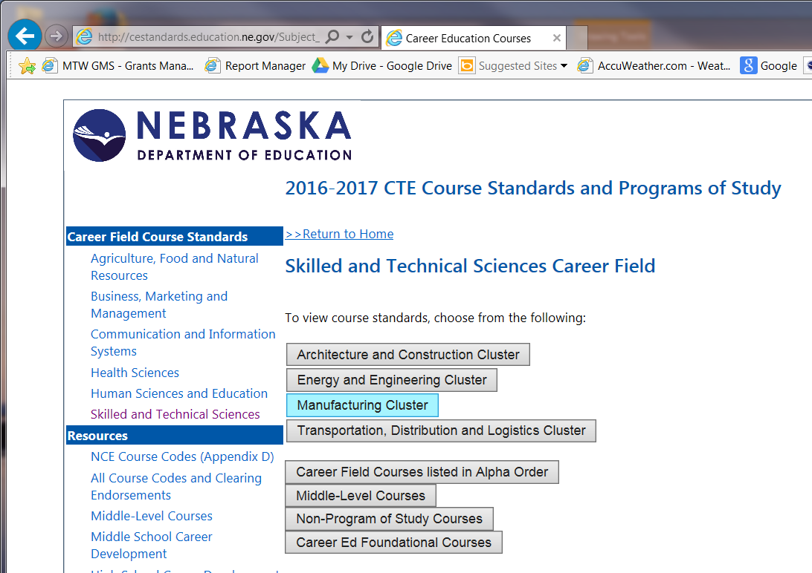
STS Programs of Study – 2017-18
http://cestandards.education.ne.gov/Subject_Link.aspx?Sub=Sk

Slide 24
Aligning the Standards
Courses must be a 90% match based on course benchmarks
Course titles may vary as course code numbers are reported to NSSRS

Slide 25
cestandards.education.ne.gov
Review sequence of courses Check off the programs of study you think your district meets
  Include academy, online and dual credit courses
  Include all STS courses

Slide 26
Review Your Course Codes
Take the time now to review and ask questions
Worksheet and STS Programs of Study
Share with your Data Steward

Slide 27
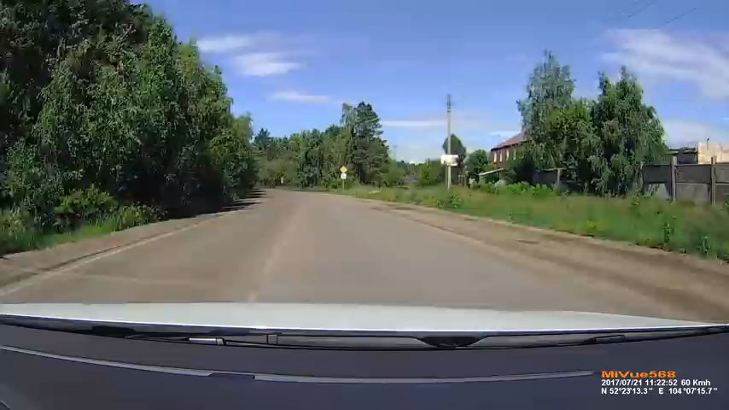
As we look to the future, have patience!

Slide 28
DRAFT of New Standards
https://www.dropbox.com/sh/84q6f4b4f1x9zh1/AABKh1tvSKbRBevkp8aNWuwUa?dl=0
We need your input! Complete the survey at: https://nde.qualtrics.com/jfe/form/SV_5tnawmT9eqAyX2Z

Slide 29


Slide 30
2017–18 Brochure
1. State officers
2. Mission Statement
3. Competitions
4. Frameworks
5. Chapter Excellence
6. Program of Work
7. Membership Handout with Chapters and Membership Numbers

Slide 31
Mission Statement
The mission of SkillsUSA is to empower its members become world class workers, leaders and responsible American citizens.
SkillsUSA is a partnership of students, teachers and industry working together to ensure America has a skilled workforce.
Notes:
31

Slide 32
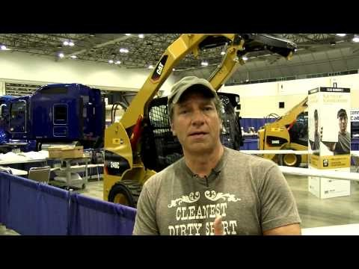
Mike Rowe Testimonials
https://www.youtube.com/watch?v=yihG89SB00g

Slide 33
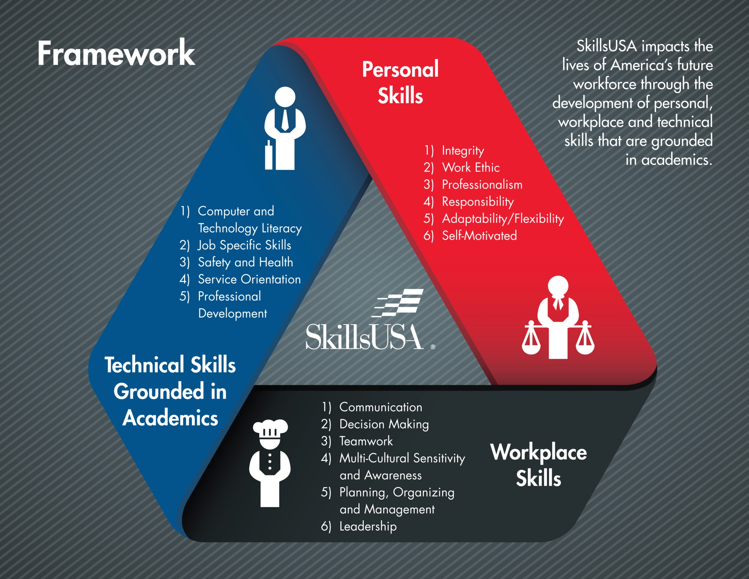

Slide 34
SkillsUSA Career Essentials: Foundations (formerly called Career Readiness Curriculum [CRC])*
SkillsUSA Career Essentials: Experiences (replaces Professional Development Program [PDP])
SkillsUSA Career Essentials: Assessments (formerly called Workforce Ready System Skill Connect Assessments)
Training for Career Essentials will hopefully happen this year

Slide 35
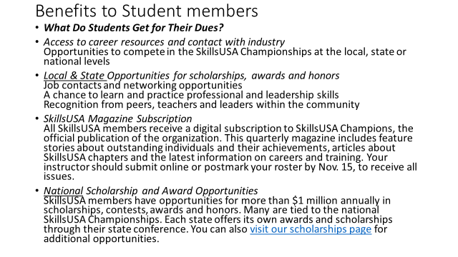

Slide 36
Benefits to Teacher members
Becoming a professional member of SkillsUSA is one of the best ways you can demonstrate to your students the importance of the organization and the opportunities that membership will provide. As a professional member, you will receive online access to the following:
2018 SkillsUSA Championships Technical Standards
Jump into STEM! curriculum
Career Essentials: Foundations
SkillsUSA professional members, as a free member benefit, receive the aforementioned items when they have submitted a current and accurate email address along with their membership details. The 2018 SkillsUSA Championships Technical Standards is available online to professional members as part of their paid membership. Once membership has been submitted, an email will be sent to the address on file which will include a pin number to access the items electronically.
As a special membership incentive, register at least 15 student members in your training program plus one or more professionals by Nov. 15, and you will receive a free educational resource item, Impact: Experiential Activities that Launch Productive Teams (value $9.95).
SkillsUSA national dues for student members are $8 plus state dues, which vary. For instructors, national dues are $20 plus state dues, which vary. Student members must meet both the state and national deadline to be eligible for national competition, serve as voting delegates or national officer candidates. The national membership deadline is March 1, but many state deadlines fall earlier. The complete listing of state dues and deadlines are available here.
To enjoy full membership services, names submitted by Nov. 15 receive all membership services for the current school year, including free teacher items when applicable. Student membership runs from Sept. 1 to Aug. 31 each year.

Slide 37
2017-2018 School Year Events Calendar
June 19 – 23, 2017 – 2017 National Leadership and Skills Conference (NLSC), Louisville, KY
September 9 – SkillsUSA Nebraska Foundation Hot Rods and Husker Tailgate – Lincoln
September 25, 2017 – SkillsUSA Fall Leadership Conference (FLC) – SCC - Lincoln
October 19 -22, 2017 – Mid-America Leadership Conference (Mid-Am) – Columbus, NE
November 13, 2017 – Commissioner’s Recognition – State Capitol Rotunda (Recognition of National Champions in June 2017)
December 8, 2017 – Middle School SkillsUSA West Conference – Career Pathways Institute - Grand Island

Slide 38
March 1, 2018 – Middle School SkillsUSA East Conference – Omaha, Metro South
April 12 -14, 2018 – SkillsUSA State Leadership and Skills Conference (SLC) – Grand Island
May 29 – June 1, 2018 - State Officer Leadership Academy (SOLA) Camp Carol Joy Holling, Ashland
June 25 - 29, 2018 – National Leadership and Skills Conference (NLSC) – Louisville, KY
Future Dates for your calendars:
SkillsUSA Nebraska SLC – April 11 -13, 2019 (Grand Island)
Mid-America Leadership Conference – October 18 -21, 2018, October 24 -27, 2019 (Columbus)
SkillsUSA NLSC – June 24 -28, 2019, June 22 – 26, 2020, 2021 – moves to Atlanta Georgia

Slide 39
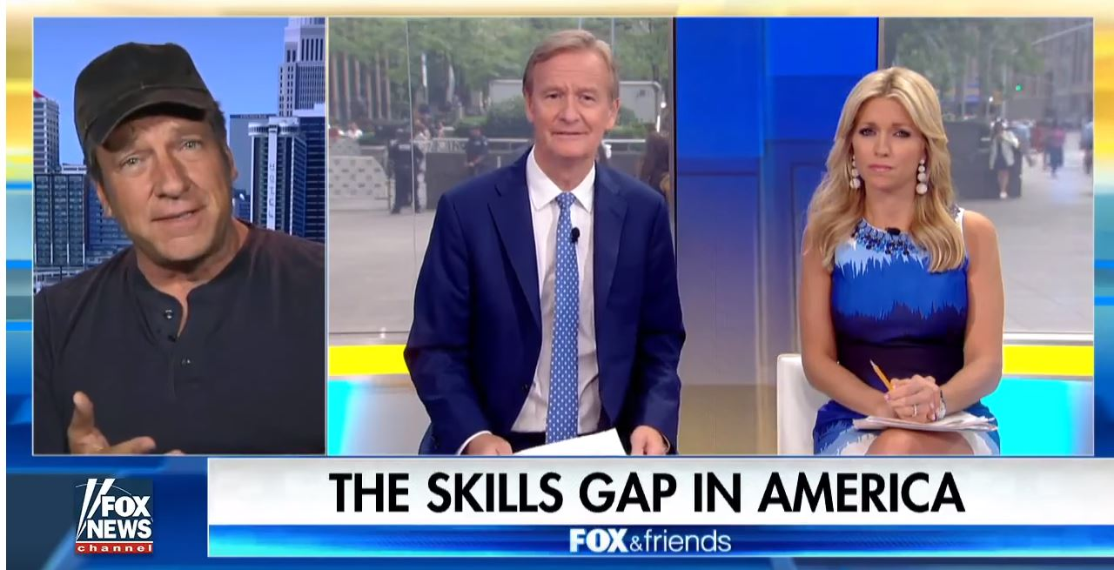
Mike Rowe at Nationals
https://www.youtube.com/watch?v=nJ8qoIOBFxM

Slide 40
Professional Membership
NASTSE
Nebraska Association for Skilled and Technical Sciences Educators
ACTE/ACTEN
ASTS
ITEEA
Links to all on the STS website

Slide 41

Monday – June 4
Opening Session 8:30-10:00
Technical Workshops (1-90 min., 2-120 min.)
All Career Field Social
Tuesday – June 5
General Session
Technical Workshops
(3-45 min.)
Career Field Social
Wednesday - June 6
General Session
Technical Workshops
(4-60 min.)
NASTSE Banquet
Thursday – June 7
General Session
Technical Workshop or Industry Tour

Slide 42
Idea Sharing
Here’s your chance to share a project or successful idea that helps your program
Ask questions for the group

Slide 43
STS Contacts
Tony Glenn
Tony.glenn@nebraska.gov
402-471-4819
Greg Stahr
Greg.stahr@nebraska.gov
402.471.0898
Eric Knoll
eknoll2@unl.edu
402.472.5863
Charmain Satree
Charmain.satree@Nebraska.gov
Resources from this presentation can be found at www.education.ne.gov/STS

Slide 44

Notes:
End no later than 2 p.m.

