Slide 1
Coping with Crisis
Chapter 16

Slide 2
Understand Crisis
Chapter 16.1

Slide 3
Concerns of Older Adults
A crisis is a situation so critical that it overwhelms usual coping methods.
People react to crises in stages.
There are a variety of resources that can be used to cope with crises.

Slide 4
What Makes a Crisis?
A crisis is a situation that has reached a critical phase
People try to cope with the stress caused by a crisis. They try to overcome the problems and difficulties
Natural causes: hurricanes, tornados, etc
Economic causes: job loss, etc
Personal causes: poor decisions, conflicts
Medical causes: disease, addiction, etc

Slide 5
What Makes a Crisis?
Not every serious problem is a crisis.
Things you do to cope with other problems do not suffice in a crisis.
They are overwhelming in nature
Hardship – greater the hardship, the greater the more apt it is to be a crisis
Resources – if you don’t have the resources, a problem can become a crisis.
Attitude – normal to be upset, but don’t let it get you down. REBOUND!

Slide 6
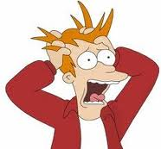
What Makes a Crisis?
Some people seem to have many crises
Crisis-prone families often don’t have enough resources to solve problems
Some families are more apt to define a problem as a crisis

Slide 7
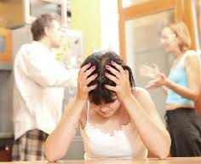
Causes of Crisis
Outside events
Natural disaster
Job loss
Accident
Changes within the family
Loss of family member (death or separation; military service; incarceration)
Unexpected addition of family members (adding grandparents, blended family, baby)
Breakup of the family unit
Not just divorce: abuse, health concerns, etc.

Slide 8
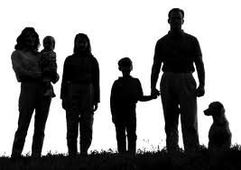
Causes of Crisis
Some crises result from a series of events
Others arise because of the needs of a family member
A crisis can strike at any stage of family development
No one is immune!
You cannot ignore a crisis
But you can be better prepared to respond

Slide 9
Reacting to Crises
Typically people react in stages:
Stage 1: Impact
Experience shock & numbness
Feel fear & helplessness
May last few hours or several days
May be too overwhelmed to function

Slide 10
Reacting to Crises
Typically people react in stages:
Stage 2: Withdrawal and Confusion
People pull back from crisis situation
Mental isolation – feel separated from others
May deny crisis
May busy themselves doing nothing
May claim there has been a mistake
Protect themselves until they can face it

Slide 11
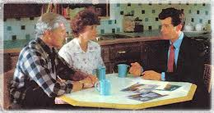
Reacting to Crises
Typically people react in stages:
Stage 3: Focus
People in this stage can focus on reality
Regain some sense of control over emotions
Begin to look at options and make plans

Slide 12
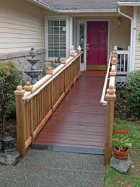
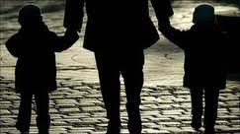
Reacting to Crises
Typically people react in stages:
Stage 4: Adaptation
Put the plans made in Stage 3 into action
In adaptation, people make changes
Life goes on, but it is different than before

Slide 13
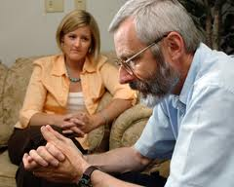
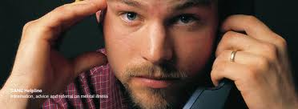
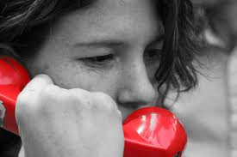
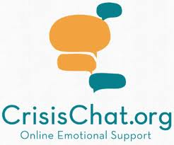
Resources for a Crisis
During a crisis, you need the help of others
Family
Friends
People in the community
Teachers and counselors
Church resources
Community and government resources

Slide 14
Chapter Summary
Section 16.1 – Understand Crisis
A crisis is a situation so critical that it overwhelms usual coping methods and causes great emotional distress.
Three factors that can make a problem a crisis are hardship, resources, and attitude.
People react to crises in a four-stage process.
First they feel the impact of it.
Then they withdraw and may act confused.
Finally they are able to focus on the crisis.
They adapt and resolve it.

Slide 15
Chapter Summary
Section 16.1 – Understand Crisis, continued
There are many resources available for those in crisis.
People usually turn first to family and friends.
School personnel and healthcare professionals can help.
Community resources include hotlines, shelters, agencies, religious group, and support groups.

Slide 16
The Crises People Face
Chapter 16.2

Slide 17
The Crises People Face
People face a variety of crises.
People can use management skills to get through crises.

Slide 18
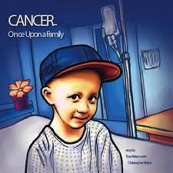
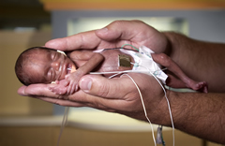
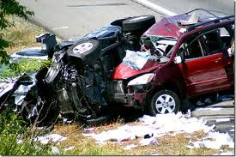
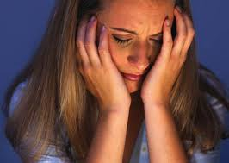
Health Issues
Health Crises
Major illnesses
Cancer
Premature birth
Car accidents
Mental illnesses
Effects on family
Financial problems
Medical insurance
Emotional effects

Slide 19
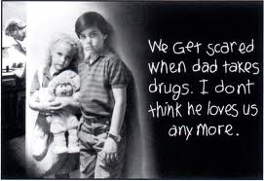
Addictions
True addictions are not a joke!
Addiction: dependence on a particular substance or action. It is a mental or physical need.
A behavior addiction is called a compulsion
Addiction to drugs (chemical substances other than food that change the way the body or mind function) cause crises for families.

Slide 20
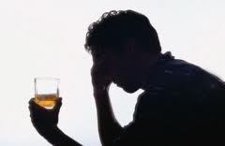
Addictions
Addictions
Alcoholism – legal drug
Takes control slowly, but surely
Abusers may drink often, sometimes alone, and use it to face certain situations
Abusers may miss commitments (work, other)
Blackouts
Families know when alcohol is a problem, but may not address it
Alcoholism is often a cause of family breakups

Slide 21
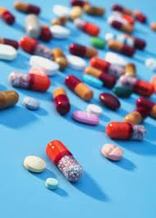
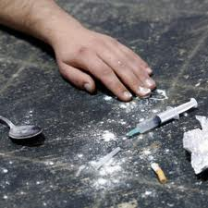
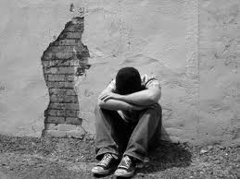
Addictions
Addictions
Other drugs
Medicinal drugs (prescriptions)
Illegal drugs
People with drug addictions may neglect their work, develop behavior problems
Result in loss of employment
Criminal prosecution

Slide 22
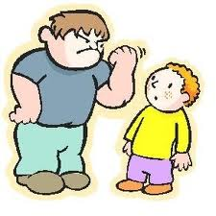
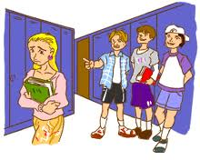
Harassment and Abuse
Harassment
Harassment – behaviors that are threatening or disturbing; not approved by society
Harassment is a power play (want power)
Bullying – by one person against another
Racial Harassment—targeted by race
Religious Harassment—targeted by beliefs
Sexual Harassment—unwanted words or actions of a sexual nature
Stalking – following and invading another’s privacy

Slide 23
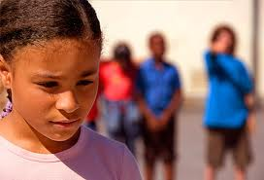
Harassment and Abuse
Harassment
Damages from harassment can be mental or emotional
Those DOING the harassment think of it as fun (and that the victim should be able to “take it”)
Harassment is NOT FUN for the victim
Harassment is NEVER right!
Some harassment can be stopped by being assertive
Sometimes harassment can be stopped by reporting it (choose your resources carefully)

Slide 24
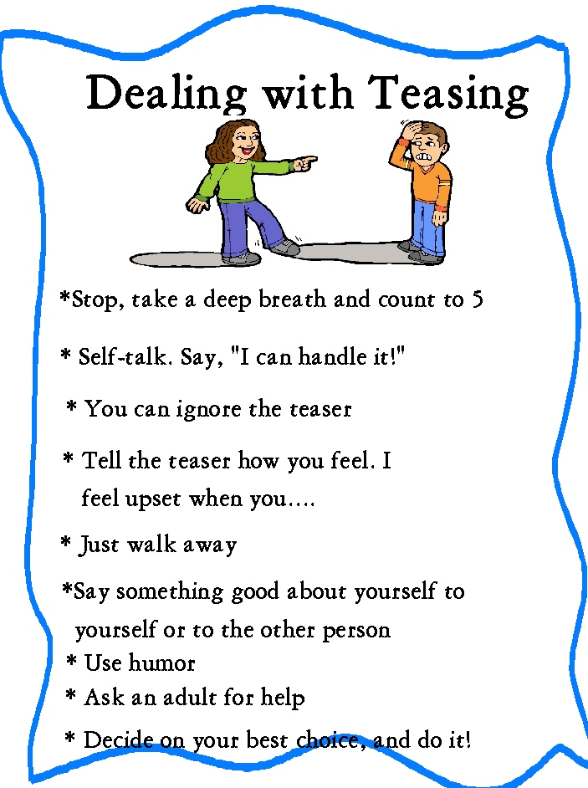
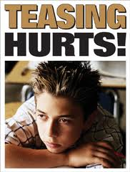
Teasing
Teasing is harassment.

Slide 25
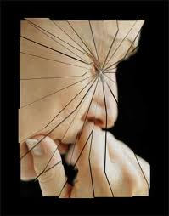
Harassment and Abuse
Emotional Abuse
Emotional abuse is wrong or harmful treatment of someone’s emotional health
Can be verbal attacks or withholding love
Types – the abuser may:
Reject – belittle or put down the victim
Terrorize – threats of extreme punishment
Ignore – be mentally unavailable to the victim
Isolate – normal contact with others not allowed
Corrupt – victim is taught to be antisocial or defiant

Slide 26
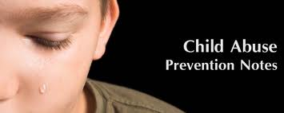
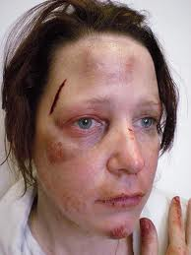
Harassment and Abuse
Physical Abuse
Some physical abuse is neglect (especially for young children and older adults)
Violence occurs when physical force is used to harm someone
Domestic violence occurs when violence happens within the home or family
Violent behavior is often learned
Can be found at home, school, work, community
Media
Gangs
We need to interrupt the cycle of violence!

Slide 27
Harassment and Abuse
Partner Abuse
This is abuse between marriage partners or dating partners
Can be either physical or emotional abuse
Can break up a relationship or become way of life
Violence between men and women: Men who abuse women may have rigid role expectations
Excessive drinking can add to partner abuse

Slide 28
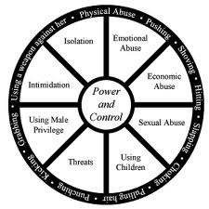
Domestic Violence
Notes:
This is one model – Outer rim is the symptoms or behaviors exhibited. Middle circle is the categories that they fall into. Inner circle is the core issue.

Slide 29
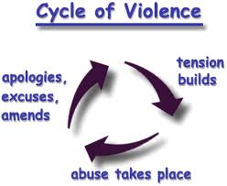
Harassment and Abuse
Partner Abuse
Often occurs in cycles:
First, the tension builds
Then something triggers the abuse
Following the abuse, there is honeymoon phase
Abuser is sorry & promises to never do it again
Partners enjoy a time of peace
Then tension begins to build again, cycle repeats
With the repeat cycle, danger of escalation!
Shelters & trained counselors are needed here!
Relationship Red Flags (handout)

Slide 30
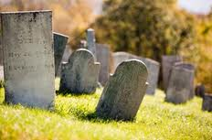
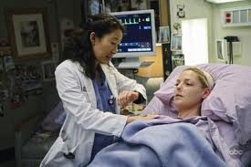
Death
Death is the natural end of a long life
Sometimes happens sooner
Death can be expected
Or it can be very sudden
Serious illness may make people think about their own death earlier than anticipated

Slide 31
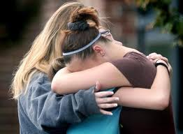
Death & Grief
People who have lost a loved one are bereaved
The feelings and emotions you experience when someone close to you dies is grief.
You can hide outward signs of grief, but the pain continues inside.
Grief is a normal reaction to death
Unresolved grief may be linked to greater problems (addiction, illness, abuse, etc.)

Slide 32
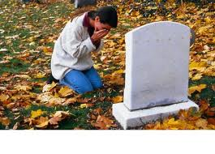
Death & Grief
Symptoms of grief:
Severe physical & emotional reactions
May not be able to eat or sleep
May feel numb all over
May become ill
Exhaustion
Emotional toll: sadness, loss, anger, fear
Caregivers may have “schedule relief” & then feel guilty
Sometimes there is “complicated grief”
Mixed emotions happen

Slide 33
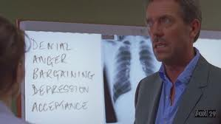
Death & Grief
Elisabeth Kubler-Ross - stages of grief, dying
Denial & isolation
Anger
Bargaining
Depression
Acceptance
Other models use more steps or different ones
There is some room for moving back & forth between different stages during grief work

Slide 34
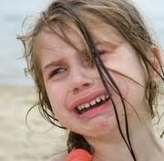
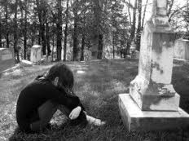
Death & Grief
Process of Grieving
Stage One: shock & numbness
Includes denial
Flurry of activity
Bargaining
Stage Two: reality sinks in
Unbearable sense of loss;
anger, depression, anxiety
Stage Three: Recovery
Accept loss as final
Adjust and go on with life

Slide 35
Death & Grief
Process of Grieving
Time for grieving varies: “It takes what it takes”
Age of person who died; relationship to them
Death of a parent – up to 2 years
Death of a spouse – up to four to six years
Death of a child – up to eight or ten years
Grief changes through this time, but not always lessened
Grieving CANNOT be rushed
Grieving CAN be supported

Slide 36
Suicide
Permanent end to a temporary problem
No problem is unsolvable! (Letter to my daughter)
Act to protect life!
Distress Signals:
Discouraged remarks (“no one understands”)
Avoidance and withdrawal from people/activities
Substance abuse & school problems
Themes of death in creative work
Purchase of a weapon or object that could be used
Giving away special possessions
Increasing depression & saying goodbyes
Extreme anger, sorrow, or despair
Sudden happiness (decision made?)
Threats and suicide attempts
Suicide is a preventable cause of death!

Slide 37
Crisis Management
Crisis Management skills are important
You may face a crisis
Or you may have to help a friend in crisis
Skills:
Decision-making skills (choices to be made)
Communication (may need to negotiate)
Conflict-resolution skills
Resource-management skills

Slide 38
Intervention
Intervention means taking direct action to cause change when someone else is in a crisis
Intervention may be formal and orchestrated with family members to help an addict recognize his/her problem
Intervention may be more informal when help is requested on someone’s behalf (harassment)
Intervention is always appropriate if you suspect suicide plans!
Intervention can be scary, but it means you care enough to try.

Slide 39
Providing Help in Crisis
You can help in crisis.
Show empathy
A touch or hug
An offer to help (suggest a specific way)
Explanations (especially at their level for children)
Knowledge – learn all you can about the situation
Openness – share feelings and encourage them to talk
Be direct – don’t beat around the bush! Talk about the problem

Slide 40
Chapter Summary
Section 16.2 – The Crises People Face
Some crises involve health issues. Disease, illness, and accidents have financial and emotional effects on families.
Addictions are mental or physical needs to have a substance or to repeat a behavior in order to function.
Harassment and abuse are behaviors that hurt others.
Abuse can be emotional or physical.

Slide 41
Chapter Summary
Section 16.2 – The Crises People Face, continued
Death is another cause of crisis.
People whose loved ones die may feel overwhelming grief.
Suicide is a common cause of death for teens and can be prevented.
Crisis management involves using skills to make decisions and solve problems.
Interventions and helping others are ways to deal with crises.

