Slide 1
Relate to Older Adults
Chapter 15

Slide 2
Concerns of Older Adults
Chapter 15.1

Slide 3
Concerns of Older Adults
Older adults have concerns such as decisions about finances and medical care.
They need to live where they will be safe and cared for.
Some societies tend to have a negative stereotype of older adults.

Slide 4
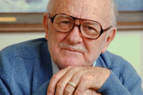
Looking at the Issues – Older Adults
Aging is a part of the individual’s natural life cycle
Aging has changed over time
In today’s society, people do not age as fast as they used to.
Longer life spans in general
Aging population is growing
Especially as baby boomers age

Slide 5
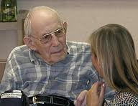
Looking at the Issues – Older Adults
But what does that mean for me???
Older people are apt to be a part of your life
The concerns of older adults affect all generations

Slide 6
Looking at the Issues – Concerns of Older Adults
Financial Concerns
Many older adults live on a fixed income (a set amount that does not change)
That amount may not cover a retired person’s expenses
Some older adults live in poverty
More likely to be female, members of a minority group, or over 85 years old
Fears of the future
Cannot predict how long they will live
May become frugal, skimping on food, heat, etc

Slide 7
Looking at the Issues – Concerns of Older Adults
Financial Concerns, continued
Government programs for older adults include Social Security and Medicare
Social Security pays a fixed amount each month to those over a certain age
Medicare helps with the cost of health care
As baby boomers age, funding of these programs may be a problem because there will be fewer workers supporting each older adult.

Slide 8
Looking at the Issues – Concerns of Older Adults
Financial Concerns, continued
Continue to work – many older people continue to work past retirement age
Part-time
Volunteer work
Less-demanding jobs than before
Some people like the interaction with others
Some people want or need the extra money
Younger people will need to take a serious look at planning for their retirement years

Slide 9
Looking at the Issues – Concerns of Older Adults
Medical Care
Aging process and illness take toll on body
Older adults may spend a lot on health care
Over-medication may be an issue (multiple doctors; body slows down and needs less)
Health care professionals need to be told about ALL medications
Any side effects should be reported

Slide 10
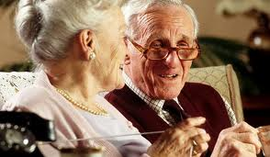
Looking at the Issues – Concerns of Older Adults
Living Arrangements
Like teens, older adults cherish their independence
Most older adults want to stay in their own homes
Safety is a concern – injuries are a major cause of death
Survey the home for hazards

Slide 11
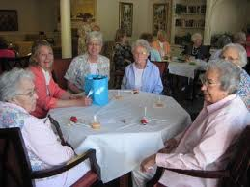
Looking at the Issues – Concerns of Older Adults
Living Arrangements
When no longer able to live at home:
Shared housing (rent out rooms to others)
Group housing (live in same building)
Live with family – adults must adapt to caring for older parents, while still caring for children or teens (sandwich generation)
Retirement Communities – may offer several levels of care, including nursing care
Nursing Home

Slide 12
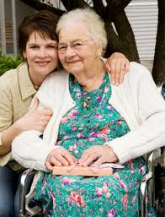
Looking at the Issues – Concerns of Older Adults
Living Arrangements
Caregivers: a caregiver is a person who provides direct care for another person
Caregivers are very busy people
Caregivers need to take care of themselves
Respite care: temporary care of the person so the main caregiver can have a break

Slide 13
Looking at the Issues – Concerns of Older Adults
Nursing Homes
May be the only option for some
People are living longer
More older people have chronic illnesses
Chronic disease is an illness or condition that occurs repeatedly or never goes away
Decision to place a family member in a nursing home is never an easy one. All members of the family should discuss this

Slide 14
Looking at the Issues – Concerns of Older Adults
Nursing Homes
Choosing a Nursing Home
Discuss possible choices with the older adult’s doctor
Ask people who have relatives in a particular home
Choose a home that is near enough to visit
Meet with the staff to find out about costs and services
Inspect the rooms (clean & odor free)
Eat a meal at the home
Notice if residents appear clean and well cared for
Observe if staff members are kind, capable & respectful
View recreational facilities and observe some activities

Slide 15
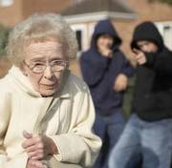
Looking at the Issues – Concerns of Older Adults
Safety
Older adults are often very concerned with their personal safety
Concerned with crime and violence
May move
Losses due to crime may hurt older adults more
Physical injuries can be life-threatening – older bodies do not heal as quickly

Slide 16
Looking at the Issues – Concerns of Older Adults
Elder Abuse or Neglect
Elder Abuse is physical abuse of aging people
Includes neglect (feeding, bathing, etc)
Sometimes by adult caregiver
Sometimes by nursing home staff
Stress of caring for person may be a trigger
Anyone who observes abuse or neglect must take action to end it.

Slide 17
Images of Aging
In some societies, people look forward to old age
In other societies, old age is feared
Look at advertising – what images do you see?
Youth is seen as desirable
Old age is not
Ageism is a bias against older adults. Feeling that older adults are not as alert, capable as younger people

Slide 18
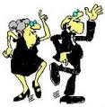
Images of Aging
What to do about these images
Move beyond stereotypes
Spend time with older adults
Resolve the issues (work with the system)
Think logically about older adults:
Focus on what older adults can do like this!
Learn more about the aging process
Recognize that older adult’s values grew out of their life experiences
Be aware of the older adult’s desire for independence
Show respect in what you say and do.

Slide 19
The Aging Process
Chapter 15.2

Slide 20
The Aging Process
People go through five stages as they age.
The last third of life is sometimes called the third age.
During the third age, older people go through many changes.

Slide 21
The Stages of Aging
Aging is a natural life process. The study of aging is called gerontology
Five general stages of life for older adults
The Honeymoon Stage (starts with retirement)
The Active Stage (person pursues new & old dreams)
The Slowing-Down Stage (pause & reflect; give up some activities or find new ones)
The Reminiscing Stage (look back and assess their life; visit past locations; observe more & do less
The Sunset Stage (putting things in order; tie up ends)
Disengagement – withdrawal from others and from activities; become less happy

Slide 22
The Third Age
Some people look at life as three long stages:
Development as a person (infancy, childhood, adolescence, young adulthood)
Focus on family and career concerns
Creative learning and personal exploration
More freedom to pursue what they want
This stage can last a long time

Slide 23
Aging
Physical changes:
Appears to shrink as tissues flatten & compress
Reactions & reflexes slow
Many internal organs and systems work at a lower level
Muscles may become weaker
Bones break more easily
Healing takes more time
Senses don’t respond like they do with younger people
Loss of hearing and vision is common

Slide 24
Aging
Physical changes:
Some physical changes may affect eating habits
Less appetite; may not eat enough, may eat more salt
More salt can lead to hypertension and heart disease
Tooth loss can interfere with eating enjoyment
Dietary needs change (less food, but more of some nutrients)
Chronic diseases interfere with life: arthritis, high blood pressure, diabetes, heart conditions, etc.

Slide 25
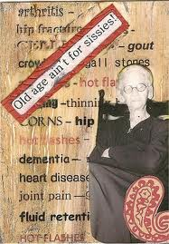
Aging
Physical changes:
Maintain Physical Health
Exercise, properly done
Good nutrition
Attitude is important!

Slide 26
Aging
Mental changes:
Mind often slows, just as the body does
Often have problems with memory
Receiving information
Storing information short-term
Storing information long-term
All three parts of memory may work, but data may not move as easily between areas
May lack speed in though processes
But logic and understanding can often improve

Slide 27
Aging
Mental changes:
Brain Disorders
Dementia – progressive decline in cognition due to disease or damage in the brain
Alzheimer’s Disease – a degenerative brain disease that is one of the most common forms of dementia

Slide 28
Aging
Mental changes:
Staying Mentally Healthy
Often decline is not due to aging
May be due to depression, grief, poor health, poverty, and a lack of effort
Use mental exercises to keep thinking skills sharp
Activities should be active, not passive
Learn new skills, join clubs, part-time job, volunteer, take classes, etc.

Slide 29
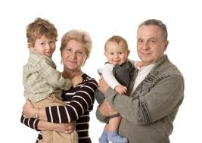
Aging
Social changes – many changes in roles and relationships
Loss of work
Loss of friends
Loss of spouse
Gains in friendships
Gains in grandchildren, great-grandchildren
Grandparent role is important
Active role longer than in the past
Stability may be needed if there is divorce or other issues

Slide 30
Aging
Emotional changes –
Depression caused by dwelling on less-pleasant aspects of aging
Some no longer see a purpose in their lives
Some older adults don’t feel needed
You can help the older adults in your life feel needed
Maintaining emotional health
Maintain contacts with friends and family members
Respect their wisdom and life experiences
Younger people can help older adults stay in touch with their communities

Slide 31
Aging
Reminisce with Older Adults–
You get a glimpse of history
Helps the older adults see meaning in their lives
How to reminisce with older adults
Ask about relationships (friends, spouse, children, etc)
Ask about life choices (what was toughest life choice?)
Ask about the good times (what was happiest time? Why?)
Ask about teen years (what do you find in common?)
Ask about the world they grew up in

Slide 32
Chapter Summary
Section 15.1 – Concerns of Older Adults
Older adults have a variety of concerns as they age.
They may have financial and health concerns.
They may also reach a point where they cannot live alone.
They may share a house, live in a group home, move in with a adult child, or live in a retirement community
Nursing homes may be used for those who need skilled care.

Slide 33
Chapter Summary
Section 15.1 – Concerns of Older Adults
Older adults are concerned about safety from crime.
Elder abuse and neglect can also be problems of aging.
Older adults are individuals and should not be stereotyped.
They are working to solve the problems they face.

Slide 34
Chapter Summary
Section 15.2 – The Aging Process
Gerontology is the study of the aging process.
There are five general stages of life for older adults.
The final years of life are sometimes called the third age.
During this time, people face many changes.
Physical changes are the most obvious.
These can be slowed by good health, nutrition, and exercise.

Slide 35
Chapter Summary
Section 15.2 – The Aging Process
There are also mental, social, and emotional changes.
Older adults who stay involved can maintain their mental skills
The biggest social change is retirement.
Many adults enjoy the role of grandparent.
Preserving emotional health is vital for older adults.

