Slide 1
Divorce and Remarriage
Chapter 14

Slide 2
When Marriages End
Chapter 14.1

Slide 3
Facing Change
Unstable couple relationships can lead to divorce.
When this happens, there are many decisions to be made by the couple.

Slide 4
Stable and Unstable Relationships
Stability is the quality of being firm and steadfast
Steadfast: faithful to someone or something
Stable Relationships:
Respect and trust each other
Good communication
Show unity
Share values and beliefs
Build strong morals
Spend time together
Establish traditions

Slide 5
Stable and Unstable Relationships
Unstable Relationships:
Respect and trust is reduced
Communicate less
Show division
Don’t share values and beliefs
Avoid spending time together
Costs begin to outweigh rewards in relationship

Slide 6
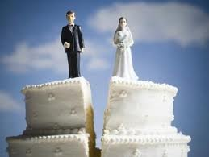
Stable and Unstable Relationships
Why marriages end:
Marriages don’t begin with the idea of divorce!
No longer have shared interests
Don’t communicate well
Outside problems intrude & wear down
Financial, sexual or role problems
Physical or mental abuse

Slide 7
Stable and Unstable Relationships
Divorce
Divorce is the legal action that ends a marriage
Leads to many changes for the family
Even cordial breakups cause pain and stress
Not every troubled marriage ends in divorce
Counseling can help to solve problems
Strong marriages can be rebuilt

Slide 8
Stable and Unstable Relationships
Divorce
Some people think society is too tolerant of divorce and that couples do not work hard enough to solve their problems. Partners thinking of getting a divorce must take it seriously.
Too many women convince themselves to proceed with a questionable marriage by using divorce as their escape route. They say, “I’ll just get a divorce if it doesn’t work out.” What they don’t realize is that a divorce isn’t that easy — even when you’re the one who serves the papers. (http://coldfeetpress.com/684)

Slide 9
Stable and Unstable Relationships
Breakups in Stages
Most breakups occur over the course of 2 years
Three basic stages:
Isolation – partners withdraw from each other
Invalidation – partners react negatively to each other; make judgments; blame each other; negative feelings build
Betrayal – feeling that trust has been broken; support that was expected is no longer there
Decision to separate is the most important act
Deciding to divorce can be harder than the divorce itself
How families handle this is VERY important, especially for children

Slide 10
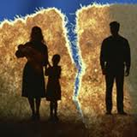
Stable and Unstable Relationships
The Legal Process
Desertion – one spouse simply leaves
but legal marriage remains
Legal end to the marriage requires:
annulment – states a marriage never took place
Legal Separation – legal agreement to live apart (half-way point for some)
Divorce – legal dissolution of marriage
No-Fault Divorce Laws – marriage has broken down, neither party is to blame

Slide 11
Stable and Unstable Relationships
Divorce Decisions
How to divide time with children
How to split personal items
Divorce judge legalizes the couple’s decisions
Or decides for them
Divorce mediation – meeting with a neutral third person to work out a solution

Slide 12
Stable and Unstable Relationships
Child Custody
Custody is the legal right to make decisions that affect children
Sole Custody – one spouse keeps all rights
Joint custody – couple shares equally in decisions
Split custody – each parent has sole custody of one or more of the children
Alternate custody – sole custody for a designated period of time; then other spouse
Third-party custody – someone else is assigned as the child’s legal guardian; sometimes relatives, sometimes foster homes

Slide 13
Stable and Unstable Relationships
Child Support
Usually the parent who does not have custody is required to make payments for child support
Set amount to be paid each month
Judge decides how much this will be
Child support tends to cover less than half the cost of raising a child
Distance – physical or emotional may lessen the sense of duty to pay child support
Government has programs to “encourage” payment of child support

Slide 14
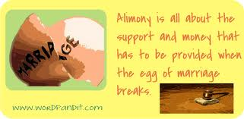
Stable and Unstable Relationships
Financial Matters in Divorce
Divorce means you have to divide property
No-fault divorce calls for equal division of property
If can’t reach agreement, judge may decide
Alimony – is the financial support of an ex-spouse. It is separate from child support

Slide 15
Manage After Divorce
Chapter 14.2

Slide 16
Facing Change
Children need stability as the divorce occurs.
Divorce can create single-parent families.
When divorced couples remarry, blended families face many challenges.

Slide 17
Children and Divorce
Studies have shown that to cope well, children must function on two levels:
Must be able to manage daily life
Must be able to live with the emotions caused by the divorce
It’s My Life PBS segment
Torn Apart segment for teens (beginning is kind of intense)

Slide 18
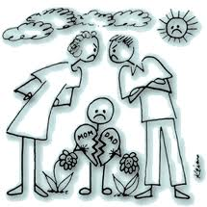
Children and Divorce
Younger children often think that divorce is their fault.
Parents need to make clear to children that they did not cause the divorce. They could not have prevented it. They also cannot make their parents reunite.
Older children realize that divorce is complex
Sometimes relief is mixed in with sorrow & guilt

Slide 19
Children and Divorce
Parents’ Attitude matters!
Children tend to model parents’ attitude
Parents can stress that divorce is the best way for all of them to have a better life
Help children see that they have two homes with loving parents
Children have a need for stability.
Keep stable, loving relationships
Don’t make children choose or take sides!

Slide 20
Children and Divorce
Effects of Divorce
Time around the separation is the hardest time for children
Child grieves for loss of intact family
Feelings of guilt, rage, rejection, helplessness
May take up to a year to sort out feelings and adapt to new life
Emotional problems caused by divorce lessen with time
Long-term effects: reluctance to marry; more likely to divorce

Slide 21
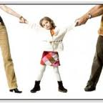
Children and Divorce
Keys for Children of Divorced Parents
Don’t blame yourself. It is NOT your fault!
Do not choose sides. Even if you feel pressure to do so. They are both still your parents.
Talk about it. Talk with parents and other trusted supportive adults.
Take care of yourself. Eat well, get exercise, get enough sleep to help manage stress
Join a support group of other children of divorce

Slide 22
The Divorced Couple
Divorce requires a period of adjustment, working to change routines and feelings to function in a new setting.
Takes from two to four years to get over divorce
Both partners have to rebuild their lives
Positive & determined attitude helps
Some people have more financial, emotional, social and community resources. That helps.
Hardest for those who withdraw from others
May affect careers
Dealing with day-to-day care of children is hard

Slide 23
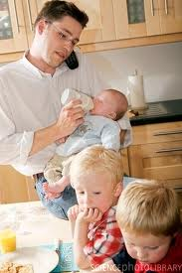
The Divorced Couple
Single Parenting
This is a HUGE task!
Can cause strain and tension for both parent and child
Money is often an on-going problem
Especially true if single parent is a woman
Gets worse if child support payments are late or unpaid
Poverty rates for female single-parents is high
Single parents need to make good use of their support systems. Exchange help and services.

Slide 24
The Divorced Couple
Remarriage
Most divorced people marry again.
Men remarry sooner than women do.
The younger the person, the greater the chance that they will re-marry
Most experts recommend waiting at least four years before re-marrying to heal the hurts from divorce
2nd marriages are most successful when partners have figured out what went wrong the first time
Having a good working relationship with former spouse is helpful in second marriage

Slide 25
Blended Families
Blended family is one where one or both spouses have been married before and includes children from previous marriages.
In a blended family, all members of the family have lost a relationship from the past.
The parent-child relationship is older than the couple relationship
In a nuclear family, the couple relationship is the first and older relationship.

Slide 26
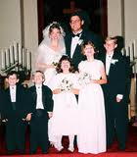
Blended Families
Challenges of blending families
Discipline issues – new rules
Resources – how do divide resources; keep clear on which is which
Values – often don’t share values because they come from different families
Former relationships – parents and children from previous marriages may not support
Roles – takes some time to define these
Child-spouse competition – parent-child bond is older and may make new spouse feel excluded
Use communication skills to successfully blend families

Slide 27
Chapter Summary
Section 14.1 – When Marriages End
When a marriage starts to come apart, it is often because a lack of communication or shared interests.
A couple starts on a process that involves isolation, invalidation, and betrayal.
This may take about two years.
The couple can end the marriage by annulment, a legal separation or divorce.

Slide 28
Chapter Summary
Section 14.1 – When Marriages End, continued
There are many decisions to be made when a divorce happens.
If there are children, custody and support issues must be settled.
Property must be divided.
Sometimes one spouse pays alimony or maintenance.
The divorce judge has the final say in what is decided.

Slide 29
Chapter Summary
Section 14.2 – Manage After Divorce
Children tend to see divorce in the same terms as their parents.
If it is presented in a positive light, they see it that way too.
Children need stability in their lives as they adjust to divorce.
This means they cope better when there are few changes in the rest of their lives.

Slide 30
Chapter Summary
Section 14.2 – Manage After Divorce, continued
There are a few long-term effects of parental divorce.
Two of these effects are a hesitation to marry and a tendency to divorce.
Divorced couples may go through a two-to-four-year adjustment period.
Being a single parent may make the adjustment more difficult.
Many people remarry.
A blended family has adjustments to make.

