Slide 1
2015-2016 NeSA-Writing Online & Paper/Pencil Test Administration Training January 4-5, 2016

Slide 2
Agenda
Testing Window & Other Key Dates
General Guidelines
Paper/Pencil Materials & Testing Procedures
eDIRECT Test Setup and Reports
Tips for Successful Online Testing & Test Security
Online Testing Procedures
Other Important Dates
Questions & Answers
DRC Customer Service Contact Information

Slide 3
WebEx Rules of Engagement
Submit questions as we go using Chat.
At the end of the session, there will be a question-and-answer period.
Use the “Raise hand” button under the participant list to indicate you have a question.
The Host will un-mute your phone in turn so you can ask your question.
NDE and DRC will use your questions to enhance these information sessions and all test administration related communication.

Slide 4
Key Dates – NeSA-Writing Test
NeSA-Writing Testing Window
Paper/Pencil Test Materials Delivered to Districts
January 4
Paper/Pencil & Online Test Administration Training
January 4-5
eDIRECT Test Setup & Student Test Tickets Available
January 4
Districts Distribute Materials to Schools
By January 6
Districts Train School Personnel
By January 11
January 18-February 5
Districts Return Secure Test Materials to DRC
By February 10
Paper/Pencil Student Responses Available in eDIRECT
March 16

Slide 5
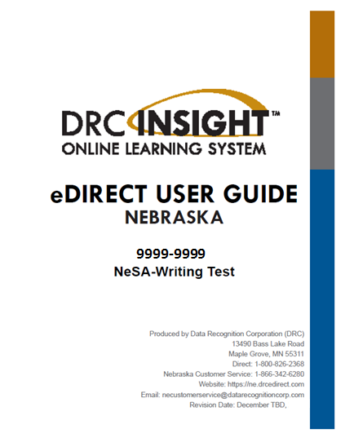
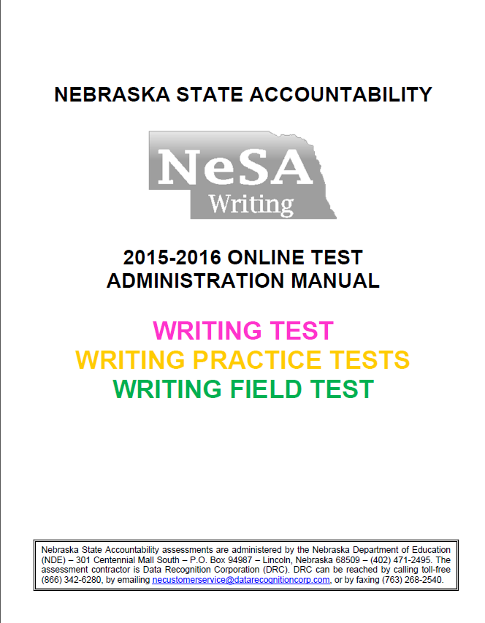
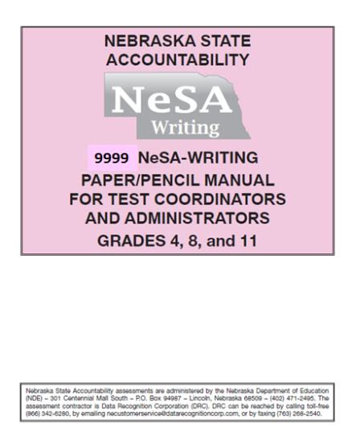
2015-2016 NeSA-Writing Manuals
Where to Find the Manuals
NDE Statewide Assessment and Accountability Website
http://www.education.ne.gov/Assessment/
DRC eDIRECT - https://ne.drcedirect.com
General Information > Documents > Administration – 2015-2016 NeSA-Writing

Slide 6
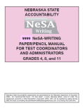
General Guidelines – Grade 4
Paper/Pencil Test
A writing booklet must be returned for all grade 4 students enrolled in the district and must contain:
a response;
indication the student was administered an Alternate Assessment; or
a reason the student was not tested.

Slide 7
General Guidelines – Grade 4
Two sessions
Two consecutive days
40 minutes each
Flexibility during the 3-week window
Recommend avoiding Mondays
Recommend scheduling early in the window
Make-ups are required

Slide 8
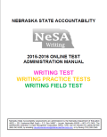
General Guidelines – Grades 8 & 11
All grade 8 and 11 students are expected to test online – except for those who:
Have an IEP or 504 Plan that requires paper/pencil testing;
Are contracted to an agency that does not allow internet access;
Are responding in Spanish, or another foreign language, or have another ELL accommodation that requires paper/pencil testing.
A test record for all grade 8 and 11 students should be returned with:
A response, an Alternate Assessment flag, or a not tested reason.

Slide 9
General Guidelines – Grades 8 & 11
INSIGHT is available for testing between 6:00 a.m. and 7:00 p.m. Central Standard Time.
One Session
Untimed
Does not generally exceed 90 minutes
Flexibility during the 3-week window
Recommend avoiding Mondays
Recommend scheduling early in the window
Make-ups are required

Slide 10
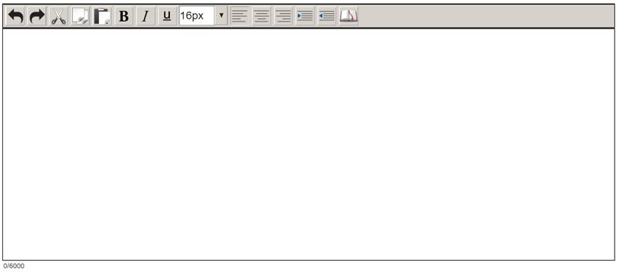
General Guidelines – Grades 8 & 11
Students testing online are presented with a character count
Replaces warning messages that appeared when students used two-thirds of their available character and all available characters
Characters used/ total characters available
6,000 character limit remains the same

Slide 11
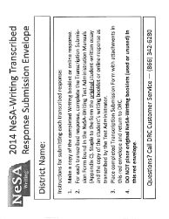
Transcription Instructions
Grades 4, 8, and 11 – Paper/Pencil or Online
DRC has provided one red envelope labeled “NeSA-Writing Transcribed Response Submission Envelope” for each district.
Complete a Transcription Submission Form (found in the backs of the Test Administration manuals) for each student paper transcribed by a Test Administrator in the INSIGHT online system (grades 8 and 11) or in a paper writing booklet (grade 4).
Carefully follow the directions included on the form for submitting transcribed responses. Do not place original NeSA-Writing booklets (used or unused) in the red Transcription Envelope.
Return red envelope to DRC whether used or unused.

Slide 12
Receiving Paper/Pencil Test Materials
District – Administrative Materials
2016 NeSA-Writing Test Administration Manual
Red Transcription Envelope
Must be returned – used or unused
Copies of School Packing Lists
School Box Range Sheet
DRC Return Shipment Labels (purple)
UPS Return Shipment (RS) Labels
Electronic list of materials (eDIRECT > Reports)
DATA RECOGNITION CORP.
DATA RECOGNITION CORP.
DATA RECOGNITION CORP.

Slide 13
Receiving Paper/Pencil Test Materials
School – Administrative Materials
2016 NeSA-Writing Test Administration Manual
School Packing List
Security Checklist
School – Secure Materials
NeSA-Writing Booklets
Spanish Translation Writing Booklets

Slide 14
Additional Materials Requests
eDIRECT > Materials > Additional Materials
Available in eDIRECT on January 6, 2016
Select 2015-2016 NeSA-Writing Administration
Select School Name in School dropdown
Click the Add Order button
Find the desired materials and enter the Requested Quantity
Click on the Submit button to submit your order to DRC

Slide 15
Labeling Writing Booklets
PreID Labels (Grade 4 Only) – plain white
Student data is taken from NSSRS.
Eliminate the need to fill in student demographic information on writing booklets.
Embedded PreID data overrides information on writing booklets.
District/School Labels – orange stripe
Intended for students without PreID Labels.
Use label and fill in demographic information on writing booklets.
Do Not Score Labels – blue stripe
Contain barcodes that indicate the used writing booklet should NOT be scored.

Slide 16
Labeling Writing Booklets
School personnel must check labels for correct information and affix labels to writing booklets.
Destroy labels containing inaccurate information before affixing to writing booklets.
Do not attempt to remove incorrect labels from writing booklets – instead cover with the appropriate label.
Do not write on labels.
If a PreID Label cannot be used, use a District/School Label and fill in the demographic information on writing booklet.

Slide 17
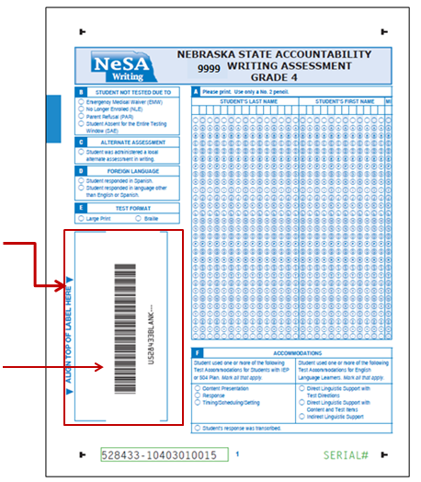
Labeling Writing Booklets
Place Student PreID Labels, District/School Labels, and Do Not Score Labels on the front of the writing booklet in the designated area ONLY.
The preprinted Blank Barcode indicates a writing booklet is completely unused.

Slide 18
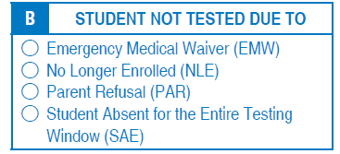
Not Tested Codes – Grade 4
Paper/Pencil
Complete the field on page one of the writing booklet indicating the reason a student was not tested.
IMPORTANT! All entries made in a NeSA-Writing booklet must be made using a #2 Pencil.

Slide 19
Alternate Assessment
The NDE does not provide NeSA-Writing alternate assessments for students with the most significant cognitive disabilities (1%).
Districts are to assess alternate assessment students locally.

Slide 20
Alternate Assessment – Grade 4
Paper/Pencil
Return a writing booklet for the student and indicate the student was administered an alternate assessment on page one of the booklet.
Make certain the student’s PreID Label is affixed to the front of the writing booklet, or affix a District/School Label and fill in the student’s demographic information on pages one and two of the writing booklet.

Slide 21
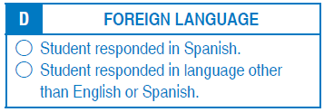
Foreign Language Responses
Grades 4, 8, and 11 – Paper/Pencil
Spanish translated writing booklets which include the test instructions, rubric self assessment tool, and the writing prompt are available from DRC.
All students responding in Spanish or another foreign language must do so in English versions of the paper writing booklets.
Complete the field on page one of the writing booklet indicating the student responded in a foreign language.

Slide 22
Test Format – Braille & Large Print
Districts are authorized to create Braille and large print versions of the NeSA-Writing tests.
Must be securely destroyed at the end of testing.
For Grades 4, 8, and 11 – Paper/Pencil testers
For a student response transcribed in a paper writing booklet – indicate student was administered the test in Braille or large print format in the Test Format field on page one of the writing booklet.

Slide 23
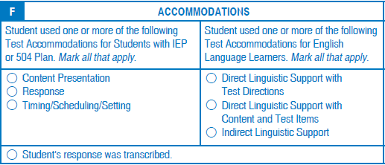
Accommodations – Paper/Pencil
Accommodations for students with IEP or 504 Plans and English Language Learners who respond in a paper writing booklet must be reported in the Accommodations field on page one of the booklet.
For Grade 4: Complete the field on page one of the writing booklet indicating the student’s response was transcribed.
NDE’s Approved Accommodations Document http://www.education.ne.gov/Assessment/pdfs/2015_NeSA_Accommodations_Final.pdf

Slide 24
Materials Return - School
Return ALL used and unused NeSA-Writing booklets including Spanish translation booklets.
Use original boxes.
Securely destroy scratch paper and manuals at the school.
Check:
All used writing booklets have labels;
No Spanish translation writing booklets are left in English version writing booklets;
No loose paper is left in writing booklets.
Retain Security Checklist.

Slide 25
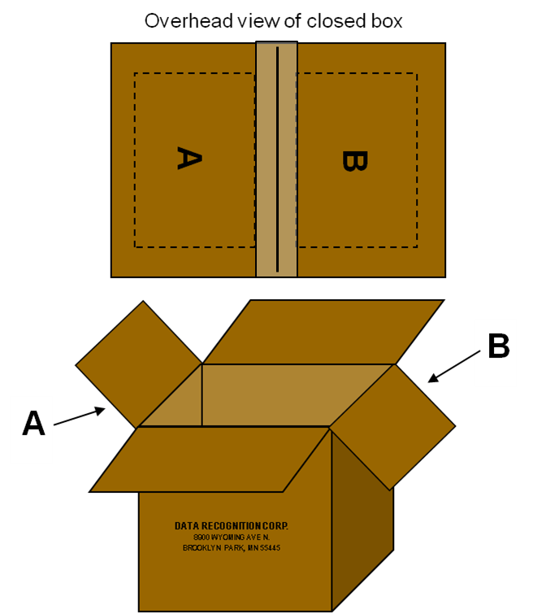
Materials Return - DAC
Condense school boxes when possible.
Grades may be combined.
Fold the outer flaps (with old shipping labels) in, exposing the A& B flaps.
Seal boxes securely.

Slide 26
Materials Return - DAC
Affix DRC Return Label (purple) to Flap A.
Affix UPS RS Label (white) to Flap B.
Record UPS tracking number.
Schedule pickup for no later than February 10, 2016.
Retain Security Checklist.

Slide 27
eDIRECT > Test Setup
DAC permissions in place.
Access to the 2015-2016 NeSA-Writing administration on January 4, 2016.
Grade 8 & 11 students pre-loaded in eDIRECT.
Student data is taken from NSSRS data file provided to DRC on December 4, 2015.

Slide 28
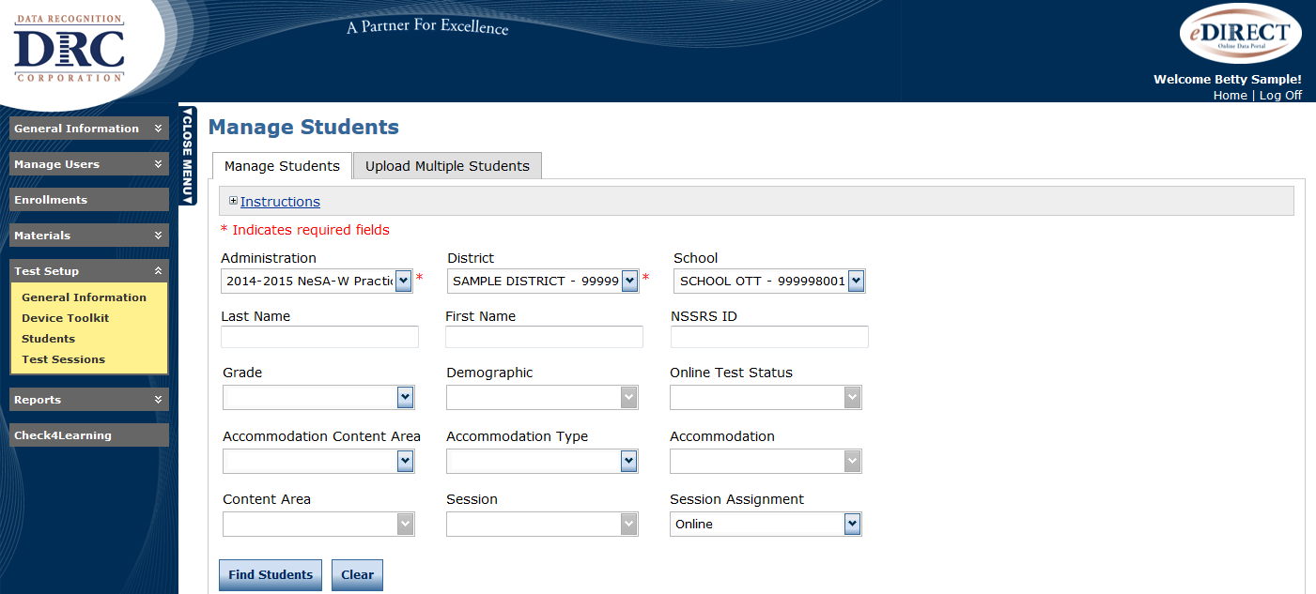
eDIRECT> Test Setup
Test Setup accessed through eDIRECT
https://ne.drcedirect.com
Available on January 4, 2016
2015-2016 NeSA-Writing permissions required

Slide 29
Test Setup> Students> Manage Students

Slide 30
eDIRECT > Test Setup > Students > Manage Students > View/Edit
Manage Students – view and edit student data
Name & NSSRS ID number
Date of Birth, Grade, Gender, Race/Ethnicity
Accommodations
Demographics – Special Education IEP, Alternate Assessment, Test Format (transcribed online)
Testing Codes – Reasons student was not tested
Students who move between schools within a district must be added as new students
Edits made in Manage Students will not update NSSRS and will not be retained for the NeSA-RMS Tests.

Slide 31
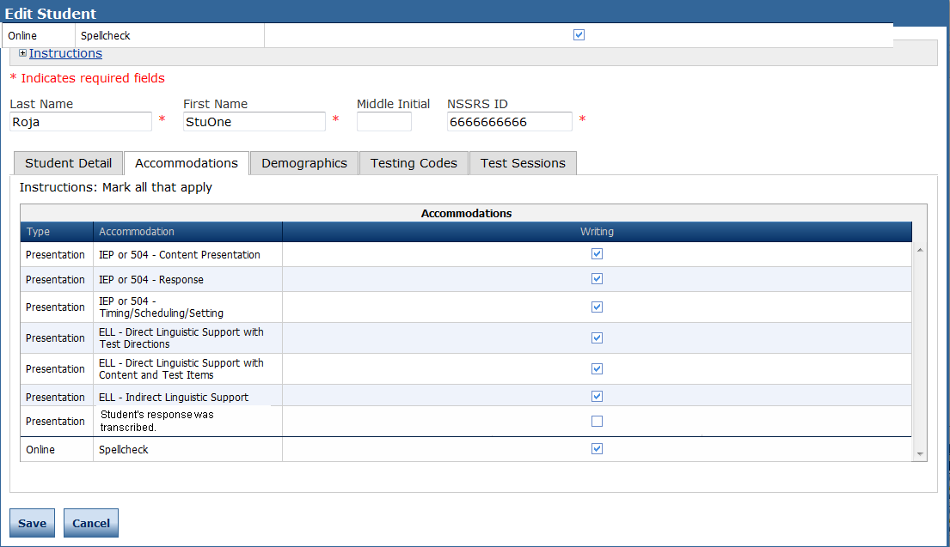
Accommodations – Grades 8 & 11
Online
Accommodations for grade 8 and 11 students with IEP or 504 Plans and English Language Learners who were tested online must be reported in eDIRECT Test Setup > Students > Manage Students > Find Students > View/Edit > Accommodations.
Grades 8 & 11: Indicate if a student’s response was transcribed.

Slide 32
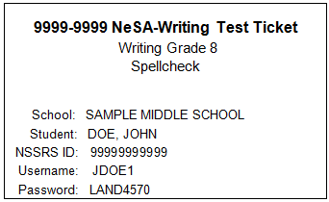
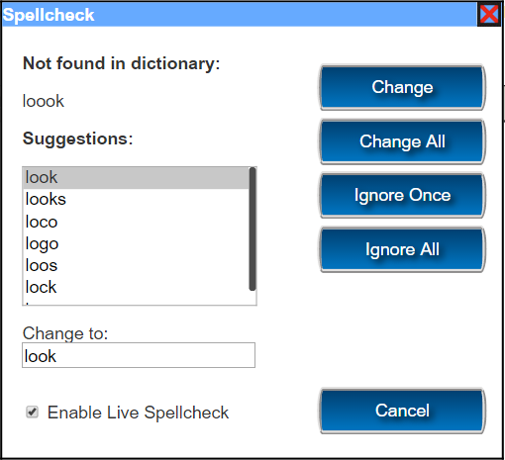
Accommodations – Grades 8 & 11
Spellcheck Accommodation
NeSA-Writing test forms that include a Spellcheck tool are available for students with IEPs or 504 Plans that allow this accommodation.
Select Accommodations tab and indicate accommodation
Be sure to Save any edits
Check Update Report after saving changes
Student Test Ticket will display “Spellcheck”

Slide 33
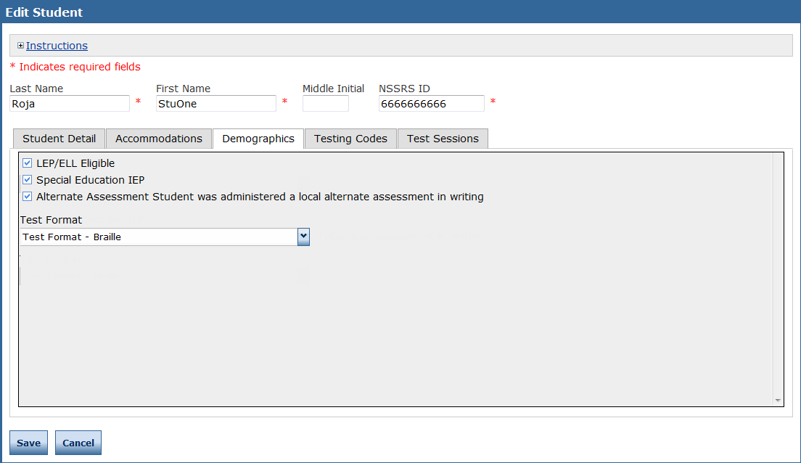
Demographics – Alternate Assessment
Online and Paper/Pencil Testers – Grades 8 and 11
Indicate a student was locally administered an alternate assessment by checking the appropriate box in eDIRECT Test Setup > Students > Manage Students > Find Students > View/Edit > Demographics.

Slide 34
Demographics –Test Format
Braille & Large Print – Grades 8 & 11 – Online
For student responses transcribed online, indicate the student was administered the test in a Braille or Large Print format by selecting the appropriate option in the Test Format field dropdown in eDIRECT Test Setup > Students > Manage Students > Find Students > View/Edit > Demographics.

Slide 35
Visual Display Settings – Grades 8 & 11
Online
Students do not need special Student Test Tickets to access visual display settings.
All students testing online have access to magnification and color chooser.

Slide 36
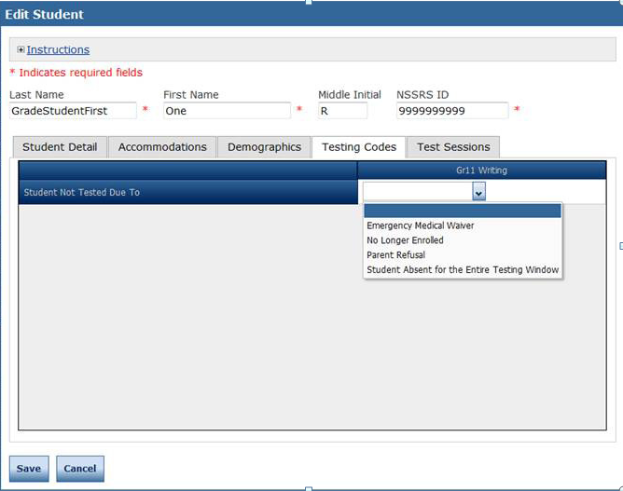
Testing Codes – Grades 8 & 11
Online and Paper/Pencil Testers
Indicate the reason the student was not tested by using eDIRECT Test Setup > Students > Manage Students > Find Students > View/Edit > Testing Codes.

Slide 37
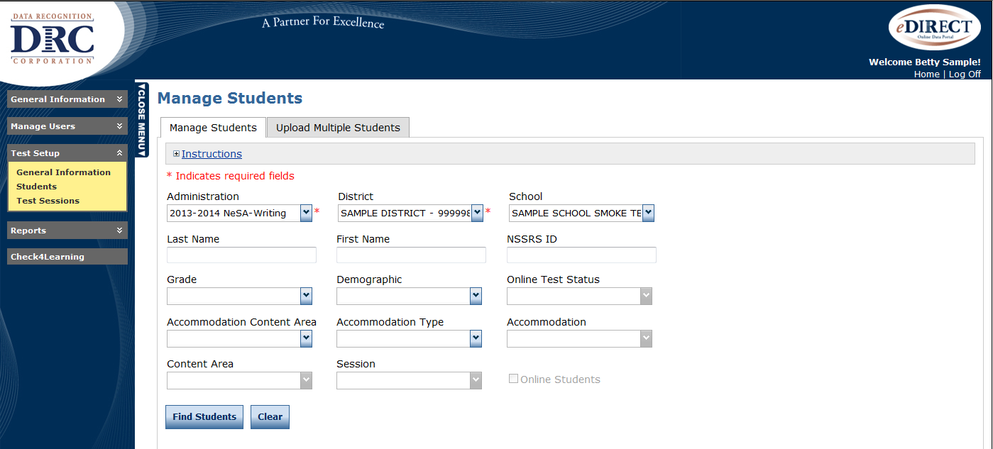
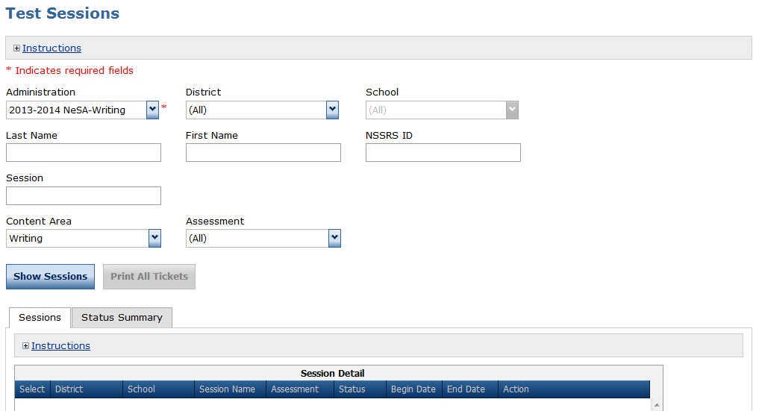
Test Setup > Test Sessions

Slide 38
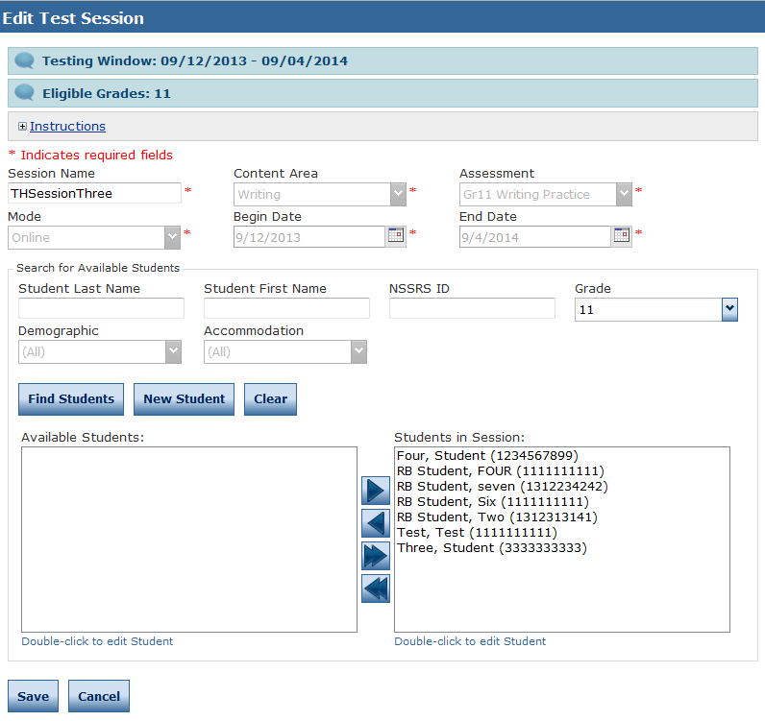
Test Setup > Test Sessions > View/Edit > New Student
View/Edit to see students in session and to add new students to a test session
Recommended method for adding new students.
Existing student information can also be accessed and then edited from this screen.

Slide 39
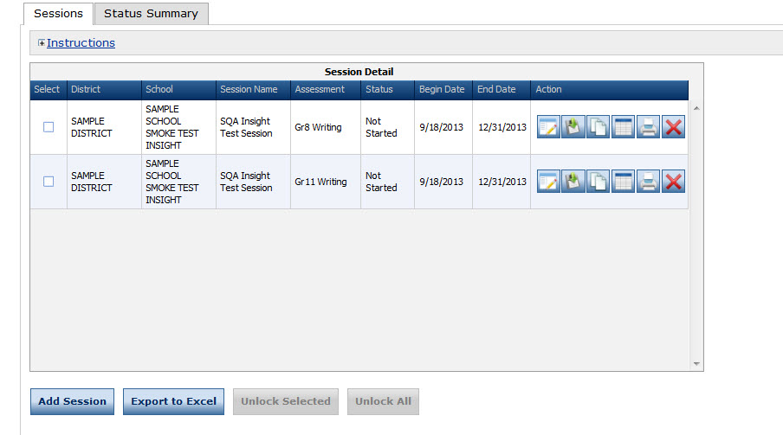
Print Student Test Tickets
eDIRECT > Test Sessions > Show Sessions >
Print tickets for all students by using Print All Tickets
Print tickets for all students or individual students by using Edit/Print Ticket Status

Slide 40
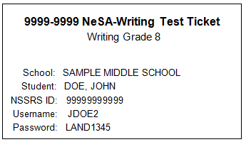
Print Student Test Tickets
Available January 6, 2016
Tickets are secure test materials
Includes Instructions, Student Test Roster, and 2015-2016 NeSA-Writing Student Test Tickets (8 per page)

Slide 41
Unlocking Student Test Tickets
Students who Pause/Exit their tests, time out due to inactivity, or are disconnected from their tests may use their original Student Test Tickets to log back into the test until 7:00 p.m. CST on the day of the original login.
Students should end tests using the Review/End Test button to indicate a “Completed” status.
Tests not ended using the Review/End Test button remain in an “In Progress” status until midnight on the day of login, then change to “Locked.”
Only the NDE can unlock a test in a Locked or Completed status. DACs may email nde.stateassessment@nebraska.gov to request that a Student Test Ticket be unlocked, if circumstances merit.

Slide 42
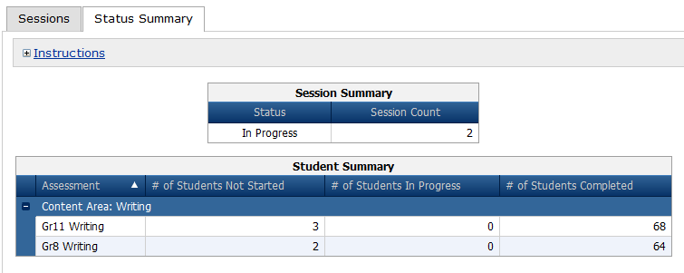
Monitor Student Testing
eDIRECT > Test Sessions > Show Sessions >
Export testing information for all students in a school/grade using Export Details
Use Status Summary to see number of students Not Started, In Progress, and Completed.
Information updates in real time.

Slide 43
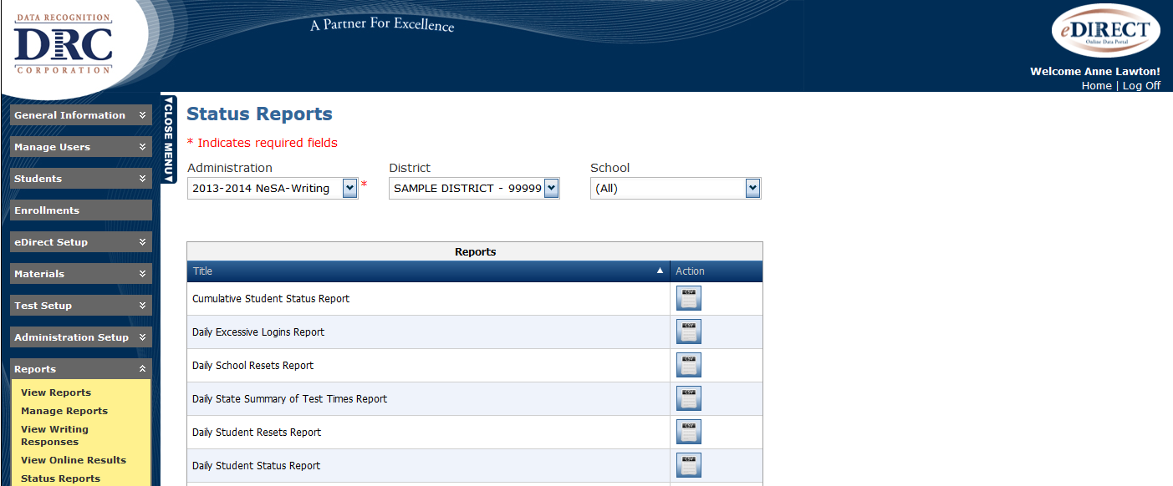
Monitor Student Testing
eDIRECT > Reports > Status Reports > Cumulative Student Status Report
Export testing information for all students in a district/school into a CSV file.
Use Cumulative Student Status Report to see number of students Not Started, In Progress, Locked, and Completed.
Information updates in real time.

Slide 44
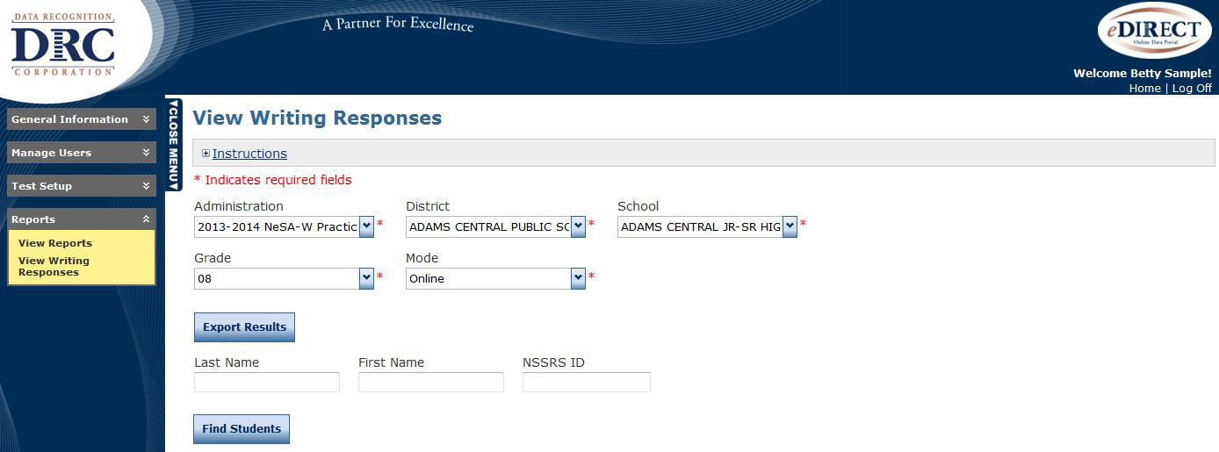
View Writing Responses
eDIRECT > Reports > View Writing Responses
View, save, or print student responses for entire school and grade, or individual students.
Responses available in HTML format.

Slide 45
View Writing Responses
Please Note
Students must End and Exit tests correctly
for responses to be visible in View Writing Responses;
for student status to be Completed.
Images of Grades 4, 8 and 11 responses submitted in writing booklets will be available in eDIRECT on March 16, 2016.

Slide 46
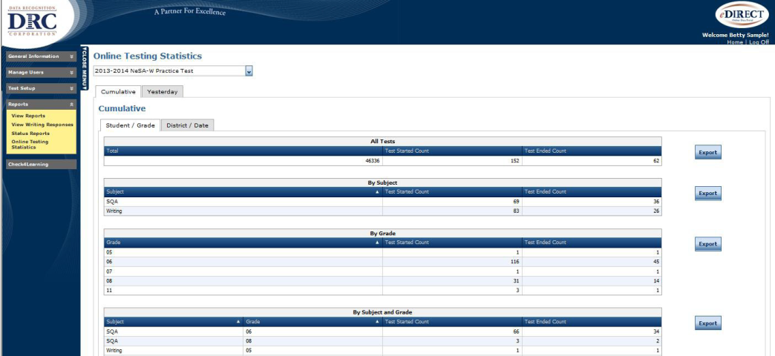
Status Reports & Online Testing Statistics
eDIRECT > Reports >
Status Reports –
Track testing activity, including excessive logins and school testing status.
Online Testing Statistics –
Track number of tests started and completed.

Slide 47
Online System Restrictions
The NeSA assessments are not to be taken on any computing device that does not allow for the locking of the desktop or operating system for test security.
The NeSA testing client should be running natively on the computing device.
Performance, security, and test validity cannot be guaranteed on virtualized desktop environments. Virtualization of a desktop is not allowed unless security settings of the computer are held intact and/or by approval of a waiver by the Nebraska Department of Education Assessment and Accountability Department.

Slide 48
Tips for Successful Online Testing
If a school did not participate in the NeSA-W Field Test during the window (November 9-December 18, 2015) or practice test before winter break, please consider administering the NeSA-W Practice Test to students so they become familiar with the INSIGHT online testing tools, and to ensure the testing software and TSM (if applicable) are working correctly.
Remind students:
They cannot Undo or Redo ANY previous actions if the test is paused and then resumed or if they hit Review/End Test then Return to Questions.
The tab key indents the first line of a paragraph. The Indent tool indents full paragraphs.
Pressing the Insert key will put typing into Overwrite mode. To turn off Overwrite mode, press the Insert key again.

Slide 49
Tips for Successful Online Testing
Make sure each student is provided his/her unique Student Test Ticket.
Instruct students to use the Review/End Test button and end their tests when finished. Student tests will change from an In Progress to a Completed status, which is important for test security and essential for responses to be available in View Writing Responses.
If using a TSM, make certain that all responses have been transferred to DRC after testing is complete. (See DRC INSIGHT Technology User Guide).

Slide 50
Tips for Successful Online Testing
If a student experiences a technical issue while testing, below are common troubleshooting steps:
Exit INSIGHT and re-launch the software.
Restart the computer and re-launch INSIGHT.
Move to a different computer.
Note the computer(s) experiencing the issue. Technical staff may need to access the specific computer(s) to investigate and resolve the issue.

Slide 51
Preparing Testing Locations
Plan ahead – check schedules.
Confirm computers used for testing have the current version of the INSIGHT Secure Browser installed.
Prepare testing location – remove visual aids/clues.
Provide blank scratch paper for students who wish to pre-write on paper.
Post a TESTING IN PROGRESS sign.

Slide 52
Test Security for Test Administrators
Test prompts are not to be viewed by anyone prior to test administration.
NeSA-Writing test prompts may not be copied.
No coaching or feedback of any kind with regard to the test content should be provided to students.
Talking or sharing of responses should be prohibited.
Move around the testing site and ensure that students are following instructions.
See test administration manual for comprehensive test security information.

Slide 53
Accessing the Online NeSA-Writing Test
Use the DRC INSIGHT Online Assessments icon on the computer desktop to access the online NeSA-Writing Test.

Slide 54
Accessing the Online NeSA-Writing Test
Students should click Test Sign In to access the NeSA-Writing Test.

Slide 55
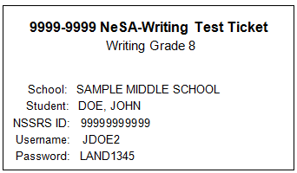
Student Test Session Ticket Login
Each student should log in using the Username and Password found on his/her unique Student Test Ticket.
Please sign in with your Username and Password your Test
Administrator has given you.

Slide 56
Other Important Dates
April 11, 2016
NeSA-Writing Reporting Recording
April 14, 2016
DACs receive access to PRELIMINARY 2016 NeSA-Writing Reports in eDIRECT
September 16, 2016
Individual Student Reports (including NeSA-Writing) delivered to districts

Slide 57
Questions
& Answers
NeSA Customer Service
Call Toll Free - (866) 342-6280
Fax - (763) 268-2540
email
necustomerservice@datarecognitioncorp.com
8:00 A.M. – 5:00 P.M. CST
7:00 A.M. – 5:00 P.M. CST (January 11 – February 12, 2016)

