Slide 1
Adolescence

Slide 2
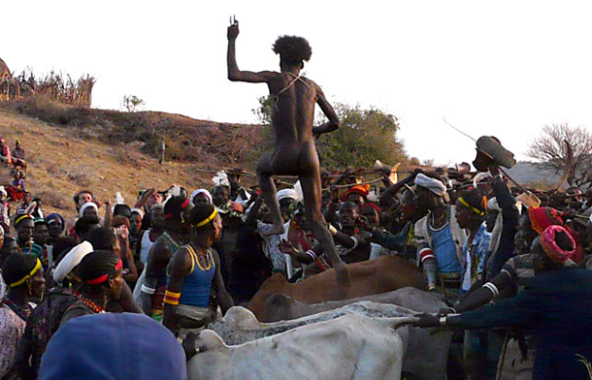
Definition of Adolescence…
Adolescence is a period of time between childhood and adulthood.
In underdeveloped nations, this period of time is relatively short, and begins when children enter their reproductive years. It may be marked by a transitional ritual called a ‘rite of passage’. That might include a name change, a ceremony or ritual of some sort, or a physical challenge.
Young girls having their first menstrual cycle may be isolated in a small hut before emerging as ‘a woman’ months later. In this picture, a young boy from an Ethiopian tribe is beaten by the males in the tribe and then must run across the backs of 4 castrated bulls before being declared ‘a man’. No societies demands that a child become an adult overnight… it is always a period of time.

Slide 3
Definition of Adolescence…
In industrialized nations, the period of time considered ‘adolescence’ is considerably longer, but still culminates in the ‘achievement’ of becoming an adult.
It is still often celebrated with some type of ceremony/ritual. In the United States, some common ceremonies have included: debutante balls, confirmation, bat or bar mitzvahs (Jewish), sweet sixteen parties, baptisms, rumspringa (Amish), graduations, and weddings.
Debutante Balls have been used around the world by affluent societies, as a way to introduce girls of ‘marrying age’ to the public.

Slide 4
Definition of Adolescence…
In the United States, adolescence is that transitional period between the dependence of childhood (age 12 in the U.S.) and the independence of adulthood.
It is the parent’s responsibility to maintain control over their adolescent child’s decision-making while they become trust-worthy and mature enough to understand the long-term consequences of their decisions.
The child, however, may not be aware of their own maturity level and ability to make good decisions. Therefore, the adolescent period becomes one of struggle: parent vs. child.
THIS IS NORMAL.
Some parents may ‘give up’, when the struggle escalates. It can drive a wedge between mothers and fathers if they don’t agree completely with each other.

Slide 5
Characteristics of Adolescence…
In the United States, the period of adolescence is characterized by 4 factors:
Adolescents tend to be age-segregated. They interact mostly with their own age group, rather than with younger children and older adults. This may be largely dictated by the organization of our educational system into ‘grades’. Although adolescents may prefer to spend their time with others of the same age proximity, it does limit their ability to guide younger people and learn from older ones.
Jobs held by teens may give them an opportunity to spend time with other age groups: babysitting or working at a daycare OR working in a retail store or fast-food restaurant.

Slide 6
Characteristics of Adolescence…
Adolescents in the United States often require a prolonged period of economic dependency, due to the financial support they need while extending their education in preparation for higher-skilled jobs.
An older child, still accepting financial support, will also have to accept the continuing control of the parents. Why wouldn’t a parent who is providing money to the child, still want to control how that money is spent?
If the older child is still living in the parent’s home, why wouldn’t they still have to live by the parent’s rules about curfews, getting a job, keeping their room clean, or helping with household chores?
This economic dependency may extend the period of adolescence for years… as long as age 24 or even 30.

Slide 7
Characteristics of Adolescence…
Adolescents are deeply affected by, and develop strong opinions about the events of the era and society in which they live. They tend to support idealism, and participate in movements toward social reform.
They may be called upon to fight in a war; the jobs available to them are strongly influenced by economic booms and downturns; they support radical political and religious movements; they volunteer and support causes; they participate in riots and protests.

Slide 8
Characteristics of Adolescence…
Adolescents are heavily targeted and influenced by mass media. With rapidly developing physical and cognitive capacities, they are especially vulnerable to the counterculture aspects of media programming. They seek excessive stimulation, as they are bombarded with images and sounds of tragedy, sexuality, and brutality via magazines, the internet, TV, video games, loud music .

Slide 9
Physical Growth…
The rapid changes of adolescent physical growth rival the rate of changes found in prenatal development and infancy.
Unlike children, however, adolescents monitor their development carefully. They constantly compare themselves with ideal standards or images, becoming embarrassed, fascinated or insecure. They then revise their self-image. How they and their parents deal with the rapid changes of adolescence will impact their overall adjustment.
WARNING: The reflection in this mirror may be distorted by socially constructed ideas of beauty.

Slide 10
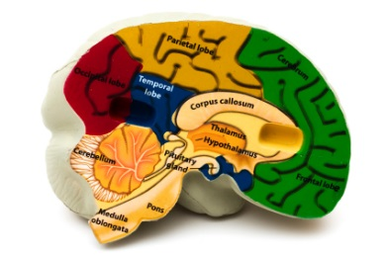
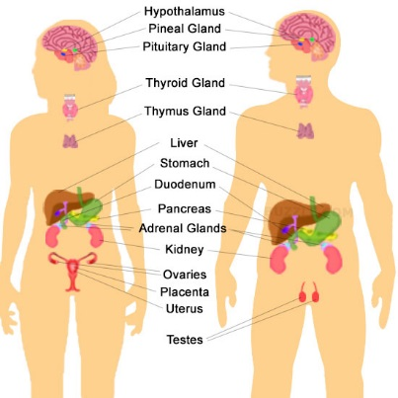
Physical Growth…
The hypothalamus is the part of the brain that controls the pituitary gland; the pituitary gland is the master gland of the body.
Since birth, the body of each individual has been producing hormones from endocrine glands. Hormones are biochemical substances that are secreted into the bloodstream. Each body, both male and female, have been producing hormones called androgens and estrogens.

Slide 11
Physical Growth…
At the beginning of adolescence, however, the pituitary gland and hypothalamus release additional hormones.
Adolescent hormones cause an…
overall growth spurt, including increased size, strength, and stamina; adolescents may experience clumsiness adjusting to rapidly growing bodies.
increased activity in sebaceous (oil-producing) glands which can cause skin
breakouts
C. Increased activity in sweat glands which can cause stronger body odor.

Slide 12
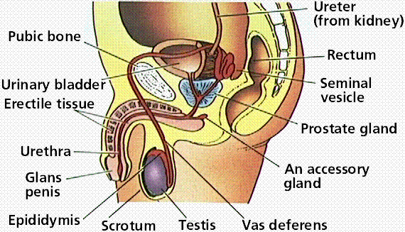
Physical Growth…
During adolescence, the testes in males start producing more androgens. The primary one is called testosterone. This affects the development of primary sex characteristics for boys, which include the enlargement of the testes and scrotum, followed about a year later by growth of the penis. The first ejaculation, (emission of semen) may be the result of masturbation or occurs during sleep (wet dream). These first emissions usually do not contain fertile sperm.
The heart, lungs, prostate gland, and seminal vesicles also increase in size; boys produce more red blood cells than girls. These changes normally begin to occur between the ages of 9-14 years and are completed between ages 12 and 16 years.

Slide 13
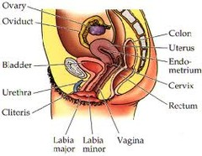
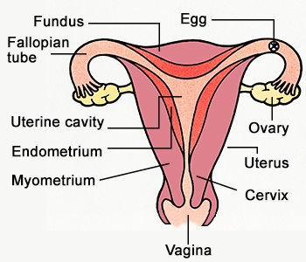
Physical Growth…
At the beginning of the adolescent period, the ovaries in females produce more estrogens. The primary one is called progesterone. This affects the development of primary sex characteristics for girls, which include the enlargement of the labia and clitoris, as well as the development of the uterus and vagina. The first menstrual cycle, or menarche occurs at the age of 12 – 12 ½. The first ovulation of an egg occurs a year or more later.

Slide 14
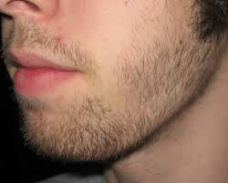
Physical Growth…
Secondary sex characteristics also develop during adolescence. These are physical changes that do not directly affect reproduction, but are associated with sexual maturation.
Secondary sex characteristics in males include pubic, underarm, and facial hair growth, deepening of the voice, and the ability to increased muscular development.
Secondary sex characteristics in females include fat deposits on breasts and hips, a widening of the pelvic bowl, and growth of underarm and pubic hair.

Slide 15
Physical Growth…
Sexual development is biological, but sexual behavior is social and emotional as well as biological. Teens struggle with their gender identity… dealing with their sexual urges, but also with the cultures expectations to exercise restraint. The media, parents, schools, and religious groups may present various attitudes toward sexual behavior.
Sexual behavior may fall within different realms: romantic (loving and/or leading toward marriage), casual (no special relationships established before having sex), manipulative (sex is offered to get what something you want), teasing (flirting with no intentions to have a relationship or sex), and exploratory (experimentation).
MANY ADOLESCENTS CHOOSE TO DELAY SEXUAL RELATIONSHIPS, AND PRACTICE ABSTINENCE.

Slide 16
Physical Growth, and Psychosexual Development…
During adolescence, the individual enters into the final stage of Freud’s Theory of Psychosexual Development:
Oral stage
Anal stage
Phallic stage
Latency stage
Genital stage
During the genital stage, sexual urges are once again awakened.

Slide 17
Physical Growth, and Psychosexual Development…
Attitudes toward sexual behavior in the United States have varied over the last 50 years. During the 1950’s and 60’s, most young people felt pre-marital sex was immoral.
There was some peer pressure that compelled adolescent boys to have sexual experience before marriage, while girls were to remain chaste (virgins). This was the basis of the popular ‘double standard’.
By the 1970’s sexual attitudes had changed, which might have been the result of the widespread distribution of reliable birth control pills, and partly because of the sexual revolution of the 1960’s. Attitudes were more accepting of casual sex, and same-sex orientation… sexual attraction toward members of one’s own sex.

Slide 18
Physical Growth, and Psychosexual Development…
By the 1980’s, attitudes toward sexual behavior in America returned to more conservative values. This may have been influenced by rising numbers of STD’s… sexually transmitted diseases. Although instances of adolescent sexual activity stayed high, sex was less casual.
Facts: Since the year 2000, about 60% of white males and females engage in sexual intercourse by the age of 18. Black and Hispanic males report sexual activity at earlier ages; Hispanic girls delay sexual activity more that other groups. Adolescent boys and girls from two-parent families have less and later sexual experience than those from single-parent families; overly restrictive and overly permissive parenting are associated with earlier sexual activity in adolescents; good academic students delay sexual activity more than poorer academic students; early sexual activity associated with more drug use and delinquency than later sexual activity.

Slide 19
Cognitive Growth…
Sometime between age 12 and adulthood, individuals reach Jean Piaget’s 4th stage of cognitive development: formal operations. (the first 3 stages were sensorimotor, preoperational, and concrete operational) Much of the research on formal operational thinking was conducted by Bärbel Inhelder… a psychologist and Piaget’s collaborator. The formal operational thinker can use theories, models, and hypotheses to create solutions to problems. Hypothetical reasoning goes beyond the confines of everyday experience to things for which we have no experience. This is reasoning that is beyond perception and memory. The formal operational thinker can also become better at planning ahead, seeing links between relationships, and can consider the differences between reality and possibility.
Inhelder
The formal operational thinker doesn’t have to get drunk to understand that drinking impairs ability and judgment.

Slide 20
Cognitive Growth…
The adolescent’s new ability to think hypothetically makes them particularly interested in science and mathematics, science fiction, fantasy, horror stories, cults, meditation, and drug-induced conditions.
An adolescents’ self-absorption in their own thoughts, attitudes, and values leads them to a state of egocentrism. They see themselves as the center of everyone’s scrutiny and attention. This is referred to as the ‘imaginary audience’… where the adolescent feels everything they say or do is on display for everyone to see and judge. This makes them particularly sensitive to criticism.

Slide 21
Cognitive Growth…
Dr. David Elkind, professor of child development, studied the adolescent ‘imaginary audience’, ‘adolescent egocentrism’, and the concept of ‘personal fable’. He found that adolescents develop a belief at some point that they are very special… a personal fable. They believe nothing bad can happen to them. They believe they will live forever; they are not vulnerable; they are immortal. These feelings lead them to taking risks.
Part of egocentrism: Although the adolescent considers themself as unique when compared to children or adults, they want to dress and think exactly like their peer group.

Slide 22
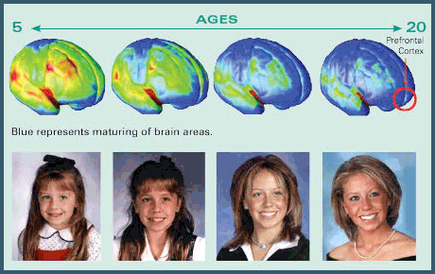
Cognitive Growth…
New technologies have uncovered information about important cognitive changes that continue to take place throughout adolescence. Neural pruning takes place until about age 25. Unused neurons (brain cells) and their synapses (connections to other neurons) are removed (this is gray matter of the brain), making the remaining gray matter more efficient. White matter actually increases until age 40 or so. This occurs as fatty myelin surrounds and insulates neurons, allowing them to conduct information faster and more efficiently.
Brain development begins in the back of the brain and proceeds toward the prefrontal cortex in the front of the brain, where decision making, problem solving, and thought occur. Cognitive skills involving judgment are among the last to develop.

Slide 23
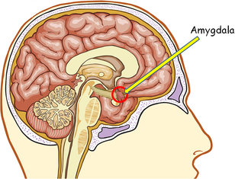
Cognitive and
Emotional Development…
The amygdala (ah MIG dull luh) of the brain is where emotions are regulated. This area is influenced heavily by hormones produced during adolescence. Risky behaviors and emotional outbursts may result.

Slide 24
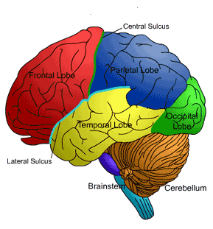
Cognitive & Emotional Development…
The frontal and temporal lobes of the adolescent brain are still developing. These are the regions of the human brain related to judgment, planning, behavioral and emotional control.
Adolescents are more susceptible to emotional highs and lows; questionable judgment, inability to plan ahead and understand the consequences of the decisions they make and actions they take today. That makes them risk-takers.
Risky behaviors occur less in adolescents with high self-esteem and a stable family with good parent-child communication.

Slide 25
Moral Development…
Most adolescents can move to Lawrence Kohlberg’s 3rd and final stage of moral development… to what he called ‘postconventional thinking’. They are able to make moral choices by relying on internalized standards of right and wrong.

Slide 26
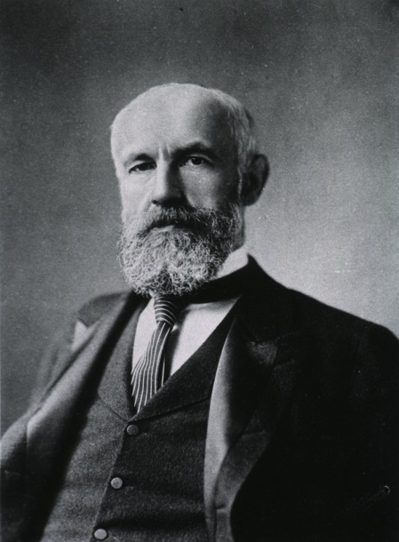
Psychosocial Development…
Psychologist G. Stanley Hall (1844-1924) was considered the father of ‘ scientific studies of adolescence’. He coined the phrase referring to the adolescent period as one of ‘storm & stress’. According to Hall, the adolescent period is full of contradictions and wide swings in mood and emotion. He considered it a turbulent time charged with conflict.
In 1964 psychologist Albert Bandura (1925- ) theorized that when society presumes adolescence to be a period of radical tension, it runs the risk of creating a ‘self-fulfilling prophecy’. He believed the adolescent experience was heavily influenced by the social and cultural environment.

Slide 27
Psychosocial Development…
Erik Erikson’s theory of psychosocial development has withstood many challenges. Earlier in their life, they should have accomplished stages 1-4: trust, autonomy, initiative, and industry; now they are ready for stage 5… IDENTITY.
Who am I? What are my strengths and weaknesses? How will I fit into society? Do I want to go to college or get a job right out of high school? What career will I pursue? Do I want to marry and have children?
Erikson referred to the time one spends in this stage as an ‘identity crisis’, and not being able to move through this stage as ‘identity confusion’.

Slide 28
Psychosocial Development…
Developmental psychologist James Marcia expanded Erikson’s identity theory. He divided this stage into 4 modes or statuses, determined by the degree a person experiences an identity crisis and whether or not they have made a COMMITMENT to the choices they’ve made. The 4 modes are:
Foreclosure status – the adolescent makes a commitment to an occupation, religious outlook, ideological viewpoint, etc. according to parent’s wishes, with little personal reflection or experimentation
Diffusion status – the adolescent lacks a sense of direction, and has little motivation to fine one; they simply experiment with various paths or choose ones that offer immediate gratification

Slide 29
Psychosocial Development…
Moratorium status – the adolescent or young adult is in an extended period of indecision about their identity; they are preoccupied with ‘finding themselves’; includes college students who still have not chosen a career path or college major, or people struggling with religious or ethical values, political philosophies, or other aspects of their future life
Identity Achievement status – people are in this status group when they have moved through an identity crisis and made a commitment; they pursue careers and other paths of their own choosing and live by their own moral code; this is usually the preferred and most mature status to have achieved

Slide 30
Psychosocial Development…
It is more difficult for identity formation in individuals that belong to groups outside the majority culture.
Examples: In a high school where nearly everyone goes to college… it is difficult to choose a career that does not require a post-secondary education
or
A gay or lesbian student whose parents and peers would judge that lifestyle as unacceptable.

Slide 31
Social Development…
Adolescents rely upon peer groups and/or cliques for some advice. Peer groups involve larger numbers of people, a crowd of 15-30, whereas cliques may have just 3-9 people. Cliques are more cohesive than crowds.
About 20% of adolescents are loners… not members of groups or cliques. When this is voluntary, it doesn’t seem to present a problem. When it is not a ‘choice’, it can contribute to difficulty in identity formation.

Slide 32
Social Development…
Initial dating gives adolescents experience without deep emotional involvement. Girls tend to start dating at earlier ages than boys. Boys tend to be more interested in sexual intimacy; girls tend to be more interested in emotional intimacy.
Dating, especially early on, is ‘practice’. The adolescent is still trying to establish their own identity, and must decide who THEY are before they are truly ready to share themselves with another.

Slide 33
Positive Coping Skills…
To support positive adolescent development, we need to support and strengthen families, provide teens with activities in which they can be successful, encourage them to look beyond their own circumstances and help others, and teach them positive coping skills.
Examples of positive coping skills: pursue hobbies, work hard at something (keep busy) or volunteer, express your feelings, state your needs and wants and develop the ability to say ‘no’, develop friendships, take advantage of community resources, set goals, plan for the future, set priorities, balance leisure and work, look at things from a different perspective, pursue physical fitness, take care of yourself (bathe, dress, rest, eat healthily), learn how and take time to relax, and/or find purpose and meaning for your life (develop spiritually, meditate).

Slide 34
Adolescence
The End

