Slide 1
Transition to College and Career Ready Assessment

Slide 2
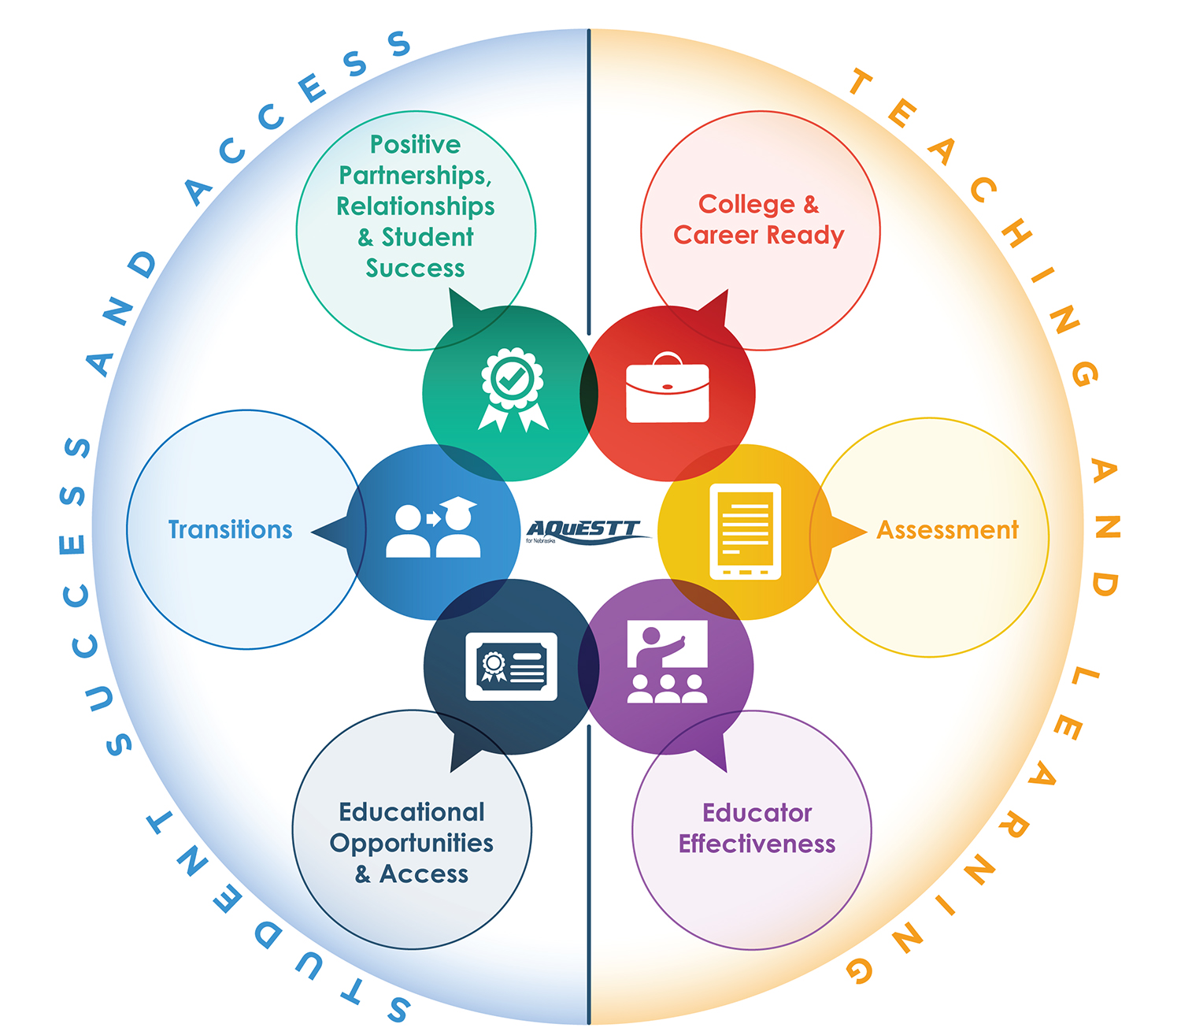
The Six Tenets of AQuESTT

Slide 3
Assessment and Accountability
Nebraska Department of Education
Director- Valorie Foy
Assistant Director- Jeremy Heneger
Writing Director- Erin Kunkle
NeSA Project Manager--John Moon
NAEP Coordinator- Kim Snyder

Slide 4
Remains the same 2015-2016
Character count Grades 8 and 11
Writing

Slide 5
Reading
English Language Arts
Matched to revised standards—College and Career Ready English Language Arts
Students will not be accountable for new standards or item types in spring 2016

Slide 6
NeSA-English Language Arts
Purpose
New Item Types
Plan for Transition

Slide 7
NeSA-English Language Arts
Purpose

Slide 8
Purpose of NeSA-ELA Item Types
Reading and writing
College and career readiness
Text
Complexity
Higher order thinking skills
Closer construct between valuable classroom instruction/activities and NeSA testing
Student engagement in assessment

Slide 9
NeSA-English Language Arts
New Item Types

Slide 10
Evidence-Based Selected-Response (EBSR)
Respond to informational or literature passage
Two Points
Part 1
Part 2
Analyzes passage
Chooses single correct answer from four answer choices
Elicits evidence from passage
Selects one answer based on response provided in Part 1

Slide 11
Constructed-Response
Auto-Scored
Constructed Response (ASCR)
Text-Dependent Analysis (TDA)

Slide 12
Auto-Scored Constructed Response (ASCR)
Technology-Enhanced Test Questions
Higher-level thinking skills without use of hand-scored test questions
Drag-and-drop
Hot-spot highlighting
Selection of multiple answers from drop-down menus

Slide 13
Text-Dependent Analysis (TDA)
Read text- Informational or Literature
Respond to a writing prompt based on the passage(s)
Draw on basic writing skills while inferring and synthesizing information from passage(s) to develop a comprehensive response
Provide evidence from the passage(s) to support response
Notes:
Standard LA.3–11.2.2.d, “Provide evidence from literary or informational text to support analysis, reflection, and research” [or “to support ideas or opinions” at grade 3], and it is required in order to measure the important writing component of the Nebraska ELA standards.

Slide 14
Text-Dependent Analysis Item

Slide 15
Writer’s Checklist

Slide 16
Text-Dependent Analysis Item Grade 3
1299/6000

Slide 17
Text-Dependent Analysis (TDA)
Scored with a rubric
Analysis of Text
Writing Skills
Notes:
Standard LA.3–11.2.2.d, “Provide evidence from literary or informational text to support analysis, reflection, and research” [or “to support ideas or opinions” at grade 3], and it is required in order to measure the important writing component of the Nebraska ELA standards.

Slide 18
Advantages of new ELA assessment for Nebraska students
Students will experience innovative assessment that—
-Includes questions more closely tied to instruction in classroom
-Asks students to support response by answering
What the student knows
How the student knows
Notes:
When asking students in the classroom about why something occurs, students will be required to cite information from actual text that supports understanding

Slide 19
Nebraska educator role in development of new ELA assessment
Diverse groups of educators from across Nebraska will continue to give their expertise to
Secure item writing
Table of Specifications(TOS) development
Scoring rubric development
Prompt development
Rangefinder selection
Standard setting
Check4Learning item development
Notes:
Nebraska will continue to be leader in this area, engaging Nebraska educators
See list from vision of NE educator groups

Slide 20
NeSA-English Language Arts
ELA Transition Plan

Slide 21
Reading
English Language Arts
Grades 5-8 and 11
Two-Year Transition Plan

Slide 22
2016 Transition Test- Grades 5-8 and 11
All Multiple Choice | Items match to legacy and Revised CCR standards
Embedded Field test Grades 5-8 and 11 | Multiple choice New item types Text Dependent Analysis | Revised CCR standards
2017-Fully transitioned NeSA-English Language Arts

Slide 23
Reading
English Language Arts
Grades 3 and 4
Three-Year Transition Plan

Slide 24
2016—Transition Test-Grades 3 and 4
Multiple Choice | Items match to legacy and Revised CCR standards
Embedded Field test Grades 3 and 4 | Multiple choice New item types No Text Dependent Analysis | Revised CCR standards
Spring 2016 Pilot test available | Text Dependent Analysis and other item types

Slide 25
2017—Partially Transitioned Test Grades 3 and 4
Multiple Choice New Items Types No Text Dependent Analysis | Items match revised CCR standards
Embedded Field test Grades 3 and 4 | Multiple choice New item types Text Dependent Analysis | Revised CCR standards
2018-Fully transitioned NeSA-English Language Arts
Spring 2016 | Transition test |  | Items match to legacy and Revised CCR standards
 | Multiple Choice |  | Field tested-Revised CCR standards
Spring 2017 | NeSA-ELA Fully transitioned test | Multiple choice and new item types | Revised CCR Standards

Slide 26
English Language Arts
All online
Same exceptions for online testing as currently allowed
Notes:
Make table-smart art

Slide 27
Current NeSA-Reading test
All Multiple Choice Items
Projected time = 90 + 90
Real time =
Approximately 40 + 40

Slide 28
NeSA-English Language Arts
Multiple Choice
Evidence Based Selected Response
Auto-Scored Constructed Response
Text Dependent Analysis
Projected time spring 2016 = 90 + 90

Slide 29
NeSA ELA Transition Information at NDE Assessment Website- www.education.ne.gov\assessment

Slide 30
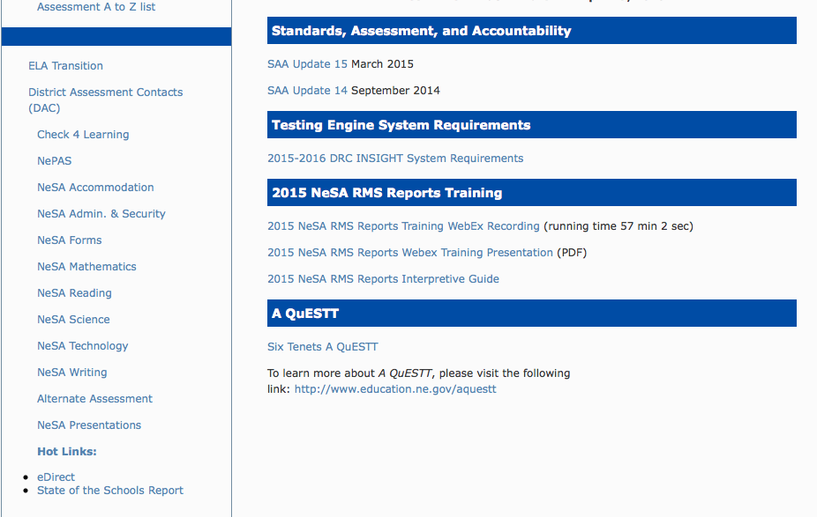
ELA Transition

Slide 31
NeSA-English Language Arts
Professional Development Opportunities

Slide 32
Professional Development Opportunities for NeSA-ELA
Two-day event
October 8 and 9- Gering Civic Center- Gering
October 12 and 13- Lancaster Event Center- Lincoln
October 14 and 15- Ramada Plaza- Omaha
October 19 and 20- Nielsen Community Center- West Point
October 21 and 22- Ramada Inn- Kearney

Slide 33
Professional Development Opportunities for NeSA-ELA
Two-day participation
Each district can send up to three people—Recommend District ELA Curriculum Leader attend
Registration is currently open to DACs
Registration fee (for lunch)$42.00 per participant for both days
Allowed for extra participants

Slide 34
Professional Development Opportunities for NeSA-ELA
Familiarity with new item types.
Standards Crosswalk-legacy and new ELA.
Opportunity to write items to match the standards—allowing a deep dive into what students will need to know to demonstrate knowledge of standards.

Slide 35
Professional Development Opportunities for NeSA-ELA
NDE will make items available to participating districts after review and edit.
Plan to add items to Check for Learning in 2016-2017
Districts that plan to sign the MOU and join C4L for 2015-2016 must send at least one representative.

Slide 36
Professional Development Opportunities for NeSA-ELA Text Dependent Analysis
November 11th- Scottsbluff 8:30-12:30
November 12- Kearney 8:30-12:30
November 13- Norfolk 8:30-12:30
November 16- Lincoln 11:30-3:30
November 18- Omaha 8:30-12:30

Slide 37
Professional Development Opportunities for NeSA-ELA Text Dependent Analysis
Review Sample Text Dependent Analysis Prompts
Review Scoring Rubric
Review and discuss sample rangefinders
Score and discuss sample student essays
Review Writer’s Checklist

Slide 38
NeSA-English Language Arts Transitions
Support Materials
November 2015 | NeSA-ELA Grade-Level Item Samplers Available to Districts
December 14, 2015- June 30, 2016 | NeSA-ELA Practice Test—online tools training, and guided practice tests also available. New item types; TDA will save. Administration Available in eDIRECT and INSIGHT, including Test Setup
December 2015 | Revised Tutorials Available
April 18-May 6, 2016 | NeSA-ELA Text Dependent Analysis Pilot for Grades 3 and 4

Slide 39
Assessment Windows 2015-2016
NeSA-Writing-
January 18-February 5
ELPA 21-February 8-March 18
NeSA RMS- March 21-May 6
NeSA 3rd and 4th grade TDA Pilot-
April 18-May 6
Notes:
Word art-table

Slide 40
English Language Arts Alternate
2015-16 Assessments will be based on the same standards
Reading Test will have new field test items
All Multiple Choice

Slide 41
English Language Arts Alternate
2016-17 NeSA-AAR will be aligned to the new extended indicators
Paper/pencil only
Only multiple choice item/three answer options
New Table of Specifications (TOS) will be patterned after the new TOS for the general NeSA
Include some writing skills

Slide 42
Director: Valorie Foy valorie.foy@nebraska.gov Assistant Director: Jeremy Heneger jeremy.heneger@nebraska.gov Writing Director: Erin Kunkle erin.kunkle@nebraska.gov NeSA Project Manager: John Moon john.moon@nebraska.gov NAEP Coordinator: Kim Snyder kim.snyder@nebraska.gov
Questions?

Slide 43
^{THINK BROADER}
^{Holistic view of each student}
^{Equal access to information}
^{Collective impact}
^{EXPERIENCE BOLDER}
^{New system for measurement}
^{Customized for Nebraska}
^{Outcome-based approach}
^{BE BETTER}
^{Continuous improvement}
^{Sharing of best practices}
Focused on every student, every day

