Slide 1
Student-Friendly Standards

Slide 2
Welcome!
Introductions
Setting of Norms and Purpose
Phones on silent or vibrate, please
When working in groups, please consider all opinions before moving forward
Please take breaks as needed if we haven’t declared an official break
Notes:
This slide can be removed/customized according to District protocols and norms.

Slide 3
Student-Friendly Standards
Process began in March, 2011 as an outgrowth from the Nebraska Literacy Plan
Aligned to the NE Language Arts Standards
K-12 for all standards and indicators
Notes:
Bullet 1- the Nebraska Literacy Plan is references in this slide as well as in slide 5. Slide 5 contains a link to the Plan if more information is desired.

Slide 4
Why Use Student Friendly Standards?
Increase motivation and engagement
Better define learning targets (Marzano and Stiggins)
Help students set clear, achievable goals
Better define standards for families

Slide 5
How do the Student-Friendly Standards relate to the Nebraska Literacy Plan?
They fit into 4 areas of the model:
Standards-Aligned Curriculum (Pre-K–12)
Universal Instructional Design Principles
High-Quality, Balanced System of Assessments
Family, Community, and School Collaboration

Slide 6
Why Write Student-Friendly Standards?
D. Royce Sadler stressed in his foundational model of learning that in order for students to be successful they must monitor their own learning. But in order to do that, they must:
Possess a concept of the standard (or goal)
Be able to compare their current level of performance to the standard
Engage in appropriate action with leads to some closure of the gap
(Sadler, 1989)

Slide 7
Classrooms where students understand the learning outcomes for daily lessons see performance rates 20 percent higher than those where learning outcomes are unclear.
Marzano, 2003

Slide 8
Additional Incentives:
They provide scaffolding, not just for the learning of content, but for the learning of how to learn.
Teachers assume the role of facilitator and guide while teaching students to evaluate their own progress.
They also encourage students to grow their self-esteem and self-efficacy by taking responsibility for their learning..

Slide 9
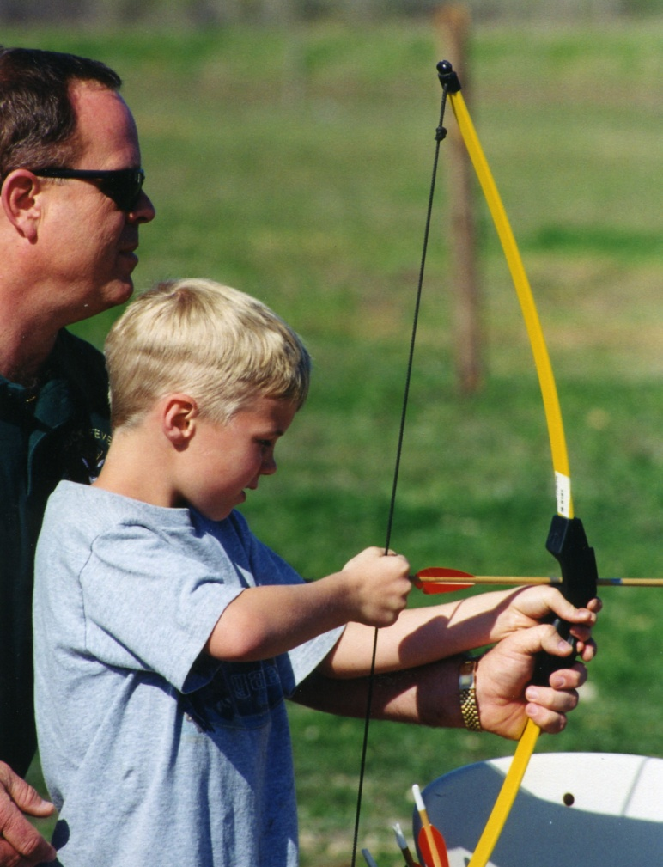
This is not a removal of the teacher from the evaluation process…
rather, it is the inclusion
of the student in their
own learning and assessment in order
to boost student achievement.

Slide 10
5 Critical Features of Formative Assessment Formative Assessment for Students and Teachers (FAST) State Collaborative on Assessment and Student Standards (SCASS)
In addition, the FAST SCASS identified five critical features intended to guide educators toward an effective use of formative assessment:
learning progressions
learning goals and success criteria
descriptive feedback
self- and peer-assessment
collaboration
(CCSSO, 2010)

Slide 11
Rick Stiggins on Writing Student-Friendly Standards
Writing student-friendly learning targets simply involves beginning each target with an approachable phrase like “I can” or “I am learning to,” defining uncommon words in an age‐appropriate way, and including an action that can be observed.
(Stiggins et al., 2006)

Slide 12
How Can Student-Friendly Standards Be Used?
To help students understand their learning goals
To help parents understand what we expect of their students
To help us sharpen our focus when designing learning activities and progressions

Slide 13
What Applications Might They Have?
Use in gathering evidence for portfolios
Use for student-led conferences to help parents understand not just what students are learning, but to what depth they are learning it
To help with assessment and grading (standards-based grading)
To prepare for assessment

Slide 14
Samples from School Districts Nationwide

Slide 15
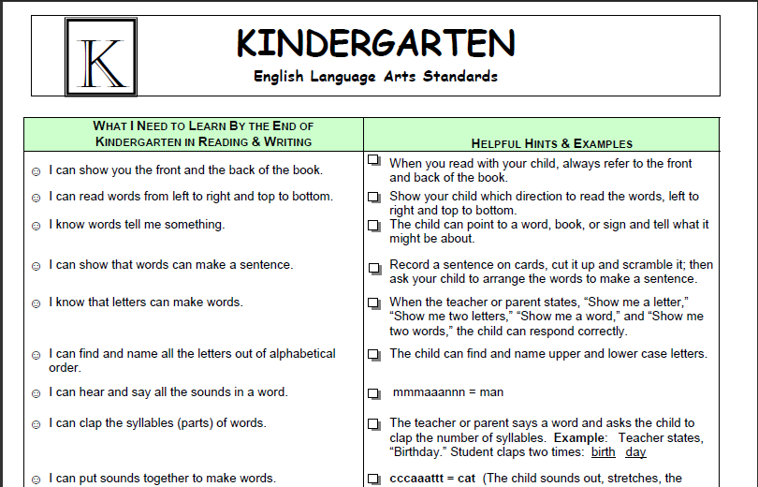
Modesto Public Schools, CA

Slide 16
Parkside, IL

Slide 17
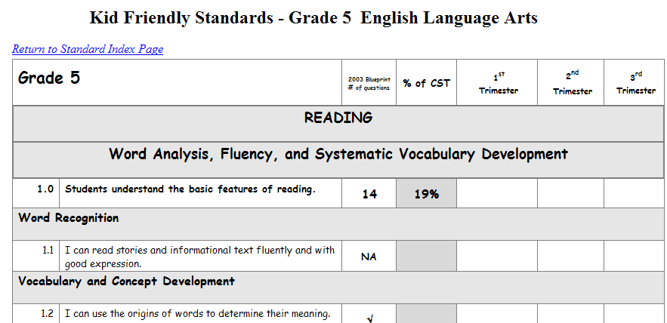
Travis USD, CA

Slide 18
Samples of the Nebraska Student-Friendly Standards

Slide 19
Notes:
This is a sample of the kindergarten student self-tracking sheet. It is not reasonable to expect a kindergartener, or any other student for that matter, to entirely track their own progress. However, a few standards may be highlighted by the teacher to discuss with the student(s) and to be targeted for growth. The smiley faces help younger students to better understand the levels of achievement.

Slide 20
Notes:
This is a sample of the high school tracking sheet. High School students may well be responsible for tracking a certain subset of course-based standards. The tracking sheets at all levels can be downloaded in excel format and customized with school colors, logos, mission statements, etc.

Slide 21
Notes:
This is the parent brochure that accompanies the student-friendly standards. There is a brochure for each grade level.

Slide 22
Notes:
The nomenclature was removed leaving only the student-friendly wordings for parents. This can be extremely helpful to a parent who is questioning if their student is on target for their grade level. Parents should be reminded that these are end-of-year competencies, and that they shouldn’t be discouraged if their student hasn’t yet mastered these skills.

Slide 23
“There are no magic bullets…only magic BBs.
But, if you give magic BBs to teachers who want to hone their craft, great things can happen."”
-Dr. Robert Marzano

Slide 24
For More Information:
Tricia Parker
Director of Language Arts Education
(402)471-4336
tricia.parker@nebraska.gov
http://www.education.ne.gov/read/StudentFriendlyStandards/StudentFriendlyStandardsMain.html

Slide 25
