Slide 1

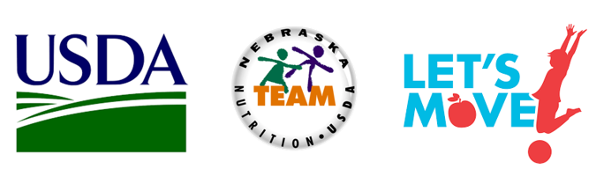

Local School Wellness Policy-Monitoring & Evaluation Webinar
November 2nd, 2016
Zainab Rida, PhD, RD, LMNT
Director, NE Team Nutrition Program
Zainab.rida@Nebraska.gov
Notes:
Good afternoon, Welcome, everyone. Thank you for joining us for our final webinar. My name is Zainab Rida and I am the director of NE TN program at the department of Education.
I am very pleased to present our final SWP webinar. I hope you have found these serious of webinar helpful for you with revising your school wellness policy.
Before proceeding, I would like to review some logistics of the Webinar. All participants have been placed in listen only mode and this presentation is being recorded for the future dissemination. A link to the recorded webinar along with a deck of slides of this presentation will be shared with you via a follow up email from me. If you have any questions during the presentation, please type them into the question box in your control panel. I will bring them up at the end of the webinar and try to answer your questions.
You can also email your question directly to me That email address is zainab.rida@Nebraska.gov

Slide 2

Outline
Summary of the all of SWP elements
Final provision of the Monitoring /Evaluation
Best Practices on Monitoring/Evaluation
Administrative Review & Monitoring/Evaluation
Resources on Monitoring/Evaluation
Next Step
Notes:
The outline of today webinars is to
Provide a summary of all the seven previous webinars
Introduce the final provision of the evaluation and monitoring
Identify best practices regarding this element
Highlight some of the administrative review questions regarding this element and provide some possible answers for these questions
Share some of the great TN resources to help schools to evaluate and monitor their SWP.
And finally, I will conclude our webinar with your next step on revising and developing your SWP.

Slide 3
Public involvement
Nutrition Guidelines
Public Notification
Monitoring & Evaluation
Nutrition Promotion
Nutrition Education
Physical Education
Physical Activity
School Wellness Policy
Notes:
As you all know, On July 29, 2016, the USDA Food and Nutrition Service (FNS) finalized regulations to create a framework and guidelines for written wellness policies established by Local educational agencies LEAs. The final rule requires LEAs to begin developing a revised local school wellness policy during School Year 2016-2017. LEAs must fully comply with the requirements of the final rule by June 30, 2017.
The new regulations require districts to include all these 8 elements.
Public involvement
Nutrition Guidelines
Nutrition Education
Nutrition Promotion
Public notification
Physical activity and Education
Monitoring and evaluation.

Slide 4
Wellness Policy Requirement Overview
Public Involvement
Nutrition Guidelines
Nutrition Education
Nutrition Promotion
Physical Activity
Physical Education
Public Notification
Monitoring and Evaluation
Notes:
So far we have addressed the public involvement. The finals rules of the first element indicates that each LEA must allow parents, students, representatives of the SFA, teachers of physical education, school health professionals, the school board, school administrators, and the general public to participate in the development, implementation, and periodic review and update of the local school wellness policy.
The final rule of the nutrition guidelines which would require that the local school wellness policy include nutrition guidelines for all foods and beverages available to students on each participating school campus under the LEA during the school day. This requirement, ensures that policies include guidance about foods and beverages available for sale that is consistent with the regulations governing school meals and competitive foods for sale in schools , and also encourages districts to establish standards for foods made available, but not sold, during the school day on school campuses.
We have also highlighted The final of NUTR Education. The final rule are now required to include goals for nutrition education and promotion that promote students wellness. In developing these goals, LEAs must review and consider evidence-based strategies and techniques that link education with school environment.
we have also introduced the nutrition promotion. LEAs are now required to include goals for nutrition promotion to improve the nutrition environment:
we have also introduced the final provision on PE and PA. LEAs are now required to include goals for physical activity, PE and other school-based activities to promote student wellness
Last week we shared about the public notification. The final rules indicates that LEAs are now required to inform and update the public about the content and implementation of local wellness policies.
Today we will be focusing on the last element of SWP, Monitoring and Evaluation .

Slide 5

Monitoring and Evaluation
Policy
LEAs must assess compliance with the local wellness policy requirements as a part of the general areas of the administrative review every 3 years. The extent to which the local education agency’s local wellness policy compares to model local school wellness policies, and the progress made in attaining the goals of the local wellness policy, and make this assessment available to the public.
Notes:
The final rule requires State agencies to assess compliance with the wellness policy requirements as a part of the general areas of the administrative review which is every 3 years.
LEAs must conduct an assessment of the wellness policy every 3 years, at a minimum. This assessment will determine:
• Compliance with the wellness policy,
• How the wellness policy compares to model wellness policies, and
• Progress made in attaining the goals of the wellness policy.
As far as Documentations needed for the review
The State agency will examine records during the Administrative Review, including:
• Copy of the current wellness policy,
• Documentation on how the policy and assessments are made available to the public,
• The most recent assessment of implementation of the policy, and
• Documentation of efforts to review and update the policy, including who was involved in the process and how stakeholders were made aware of their ability to participate.

Slide 6
Monitoring and Evaluation
Sample Policy Language
The District will compile and publish an annual report to share basic information about the wellness policy and report on the progress of the schools within the district in meeting wellness goals. This report will include, but is not limited to:
The website address for the wellness policy and/or how the public can receive/access a copy of the wellness policy; and
A description of each school’s progress in meeting the wellness policy goals;
Information on how individuals and the public can get involved with the DWC or SWC.
Notes:
Here are some sample of policy language that help meeting the monitoring and evaluation component.
The District will compile and publish an annual report to share basic information about the wellness policy and report on the progress of the schools within the district in meeting wellness goals. This report will include, but is not limited to:
The website address for the wellness policy and/or how the public can receive/access a copy of the wellness policy;
A description of each school’s progress in meeting the wellness policy goals;
And Information on how individuals and the public can get involved with the DWC or SWC.

Slide 7
Monitoring & Evaluation
(AR 1002)
When and how does the review and update the Local school Wellness Policy occur?
Provide documentation to support the response or appropriate web address.
At least once every three years, the District will evaluate compliance with the wellness policy to assess the implementation of the policy and include:
The extent to which schools under the jurisdiction of the District are in compliance with the wellness policy; and
A description of the progress made in attaining the goals of the District’s wellness policy.
The position/person responsible for managing the triennial assessment and contact information is ______________________ (list the person responsible here, their title, and their contact information).
The DWC, in collaboration with individual schools, will monitor schools’ compliance with this wellness policy.
The District [or school] will actively notify households/families of the availability of the triennial progress report.
Notes:
Here are a couple of questions schools will be asked during the administrative review.
When and how does the review and update the Local school Wellness Policy occur?
And the second question, Provide documentation to support the response or appropriate web address.
Here are examples of responses to these questions
At least once every three years, the District will evaluate compliance with the wellness policy to assess the implementation of the policy and include:
The extent to which schools under the jurisdiction of the District are in compliance with the wellness policy; and
A description of the progress made in attaining the goals of the District’s wellness policy.
The position/person responsible for managing the triennial assessment and contact information is ______________________ (list the person responsible here, their title, and their contact information).
The DWC, in collaboration with individual schools, will monitor schools’ compliance with this wellness policy.
The District [or school] will actively notify households/families of the availability of the triennial progress report.

Slide 8
5 WH Questions
WHAT are we going to do?
WHO is going to be responsible for the activities?
WHEN do we want this to be completed?
HOW are we going to do these activities?
BY HOW MUCH: %, #
Notes:
LEAs must also formally assess their policies to ensure that goals and objectives are being met.
So LEAs need to develop measurable objectives to help with monitoring and evaluating SWP. Your objectives should address the 5 WH questions.
WHAT are we going to do?
WHO is going to be responsible for the activities?
WHEN do we want this to be completed?
HOW are we going to do these activities?
And it is very important to include an indicator to measure your success. And this can be done by setting a percentage or numbers as a benchmark to compare before and after implementing a policy. And I will share with you an example in the next slide. Usually, your objective should include BY HOW MUCH: %, # how would you measure your success?

Slide 9
Measurable Objectives
When
Who
What
How Much
By May 2017, we will increase PA for students by 60 minutes/week by offering PA breaks in classes.
What: increasing PA
When: By May 2017
How: Offering PA breaks in classes.
Who: Schools
How Much: 60 minutes/week
How
Notes:
Let’s take a look at this objective. By May 2017, we will increase PA for students by 60 minutes/week by offering physical activity breaks in classes.
So increasing the PA is the what
By May 2017 is the when
Offering PA breaks in classes is the how
Schools is who
And 60 minutes per week is how much

Slide 10
Monitoring and Evaluation
Assess and evaluate compliance
Student health trends, e.g. fitness tests, nutrition habits
Time spent on physical activity
Nutrition education and PA programs conducted
Financial impact, e.g. cafeteria a la carte sales, vending machines
Notes:
Schools can do this a number of ways such as:
Evaluating health trends through fitness testing or nutrition habits through surveys
Assess time spent on physical activity
Track how many nutrition education programs were conducted in a certain time period
- And also Evaluating the financial impact- monitoring a la carte sales etc.

Slide 11
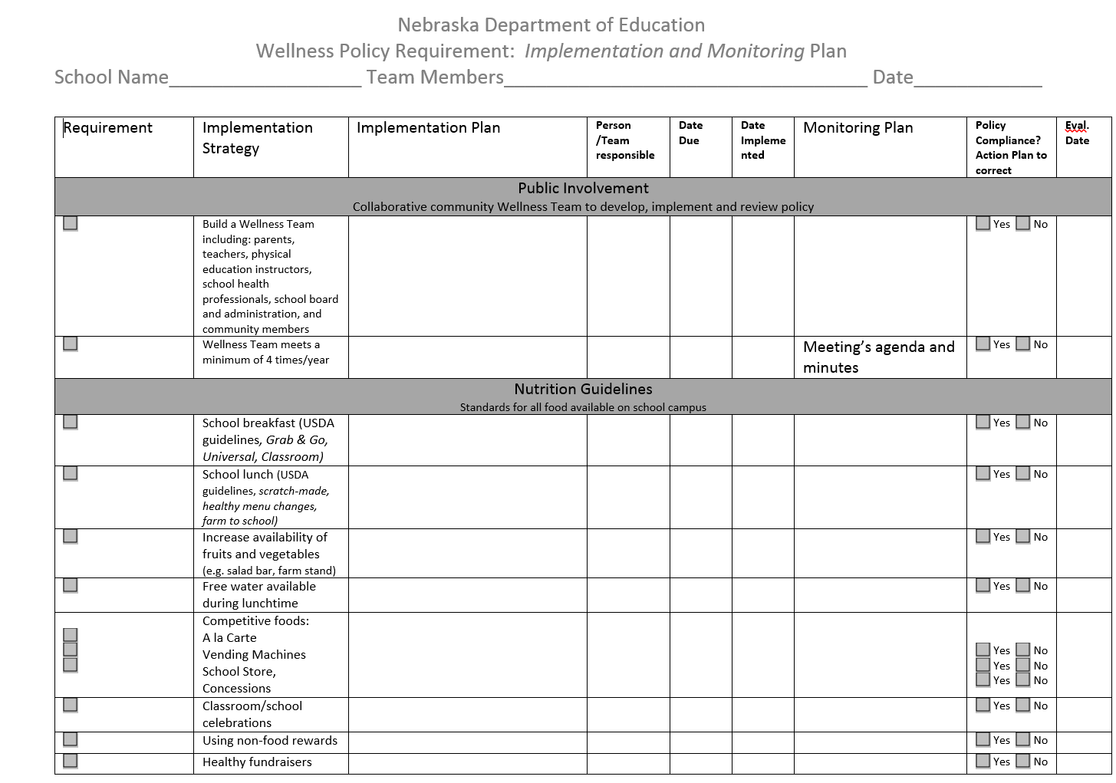
What
Who
When
How
Notes:
This document help schools with the implementation and monitoring their school wellness policy by identifying the what, when, who and how. It includes all the 8 elements of SWP and suggest an implementation's strategy and measureable objective for each strategy. As I just mentioned earlier and Under the final rule, schools must also inform and update the public about the content of their policies and the status of policy implementation. LEAs must also formally assess their policies to ensure that goals and objectives are being met. With greater transparency on the effectiveness of these policies, parents and other community stakeholders will be better informed and positioned to improve the school nutrition and wellness environment.

Slide 12
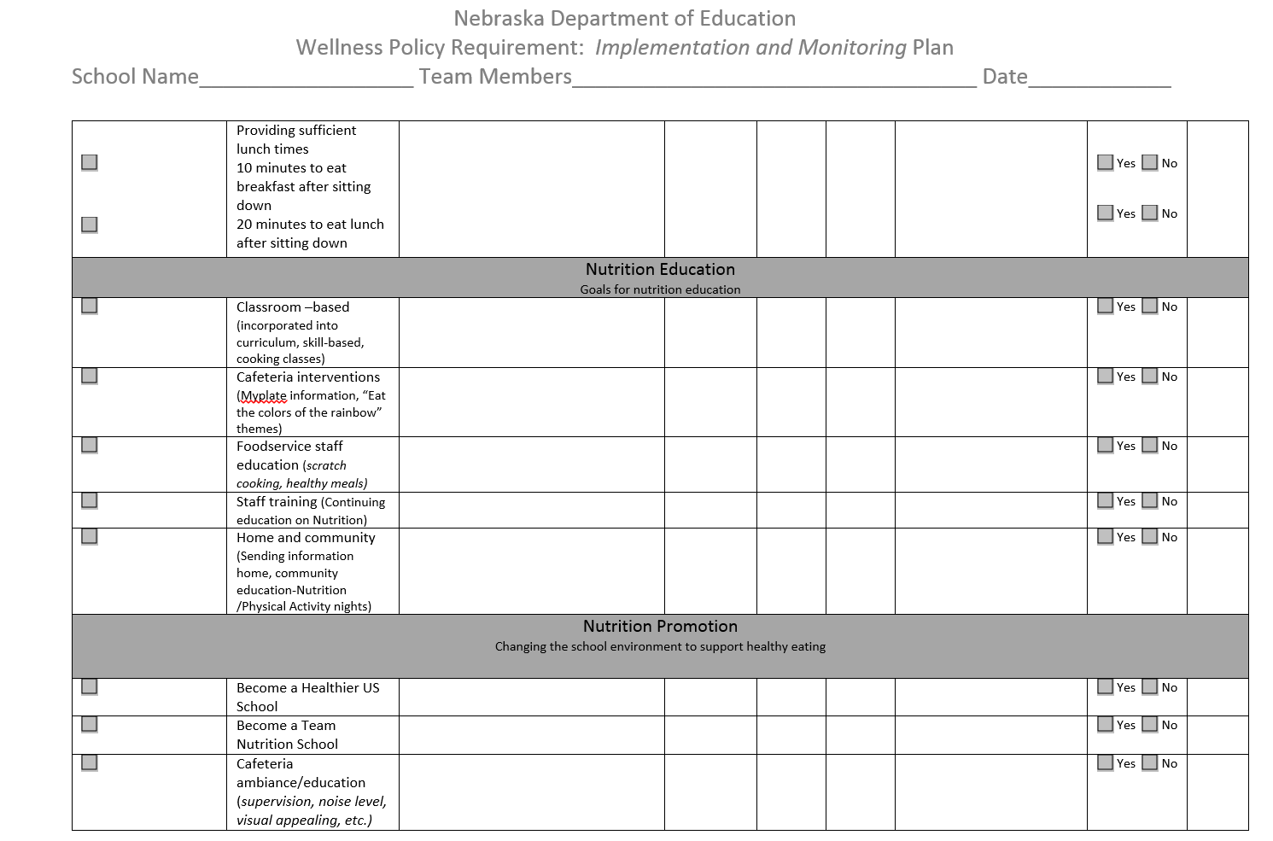
Notes:
I will share this document with you when I sent you a link to this recorded webinar. It includes all the 8 elements and suggested strategies on implementing each element.

Slide 13
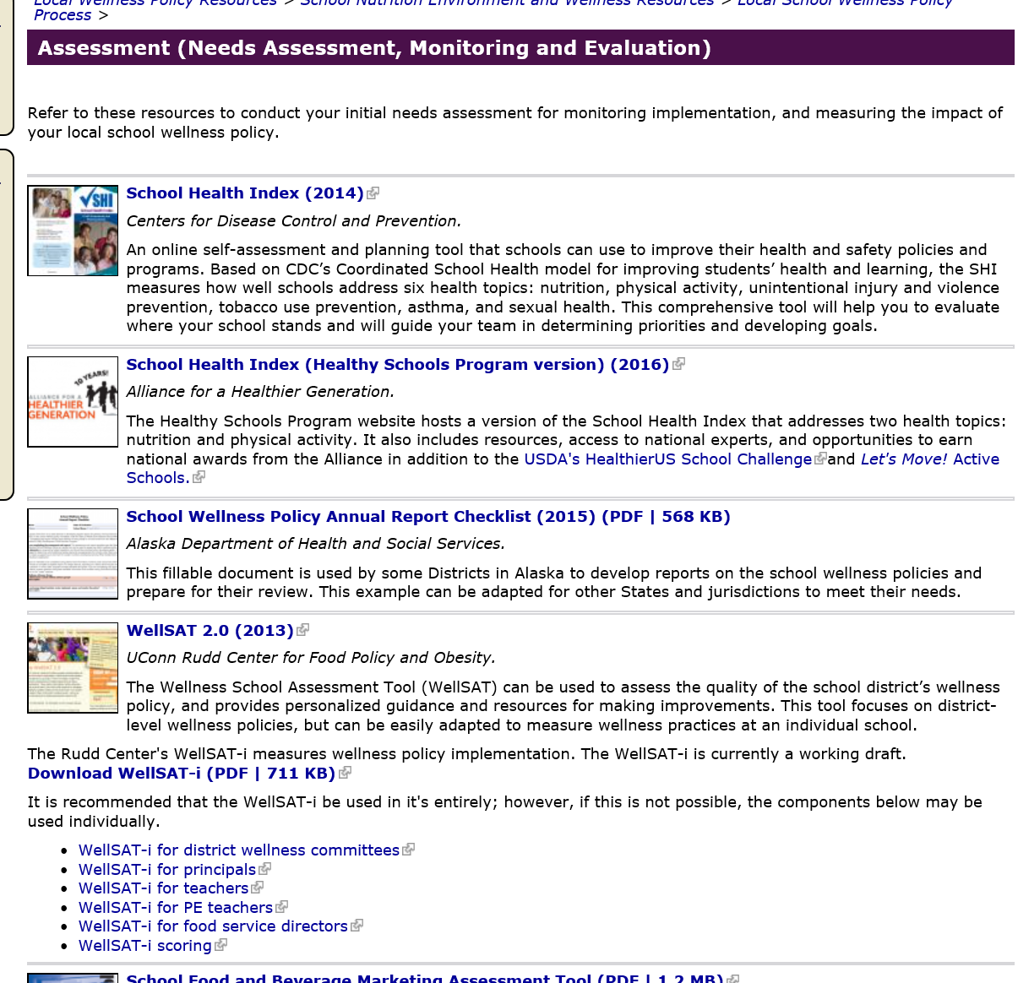
Team Nutrition Resources
https://healthymeals.fns.usda.gov/local-wellness-policy-resources/local-school-wellness-policy-process/assessment-needs-assessment
Notes:
There are a variety of methods that LEA may employ to assess compliance by schools and determine progress toward benchmarks, objectives, and goals.
Developing a wellness policy with measurable objectives, and realistic annual benchmarks will help when it is time to evaluate progress.
Additionally, the local school wellness policy team and leadership can be assets in conducting periodic assessments.

Slide 14

Team Nutrition Resources
Notes:
Various resources have already been identified or developed to support LEAs with the wellness policy process. These resources can be accessed at USDA’s School Nutrition Environment and Wellness Resources website including resources to support LEAs with assessing implementation of their local school wellness policy
I will highlight two great tools that we have been utilized here in NE.

Slide 15
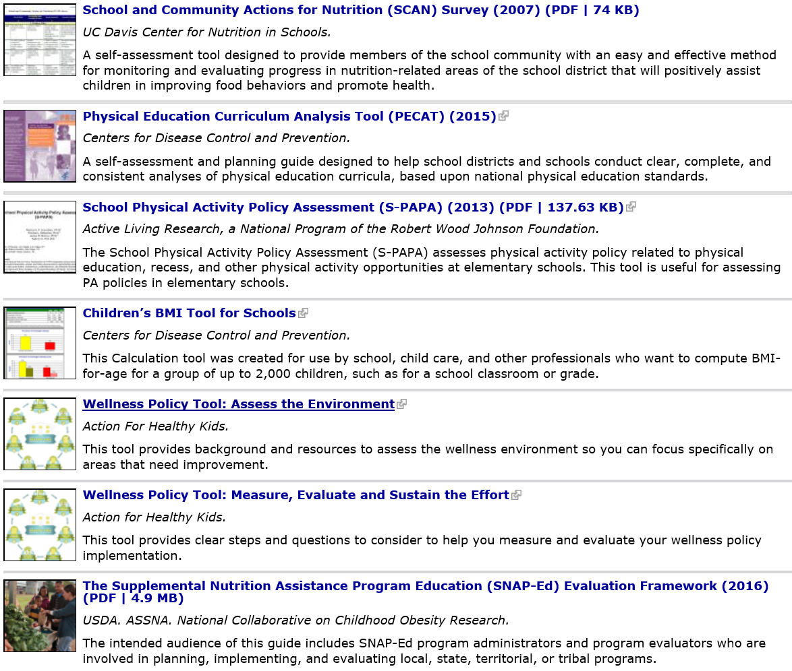
Team Nutrition Resources
Notes:
The list is very long list and I really encourage you to visit TN website to explore the best assessment tool for your school.

Slide 16

School Health Index
The SHI was developed by CDC in partnership with school administrators and staff, school health experts, parents, and national nongovernmental health and education agencies to
Enable schools to identify strengths and weaknesses of health and safety policies and programs
Enable schools to develop an action plan for improving student health, which can be incorporated into the School Improvement Plan
Engage teachers, parents, students, and the community in promoting health-enhancing behaviors and better health
The SHI is based on CDC’s research-based guidelines for school health programs, which identify the policies and practices most likely to be effective in reducing youth health risk behaviors.
Notes:
One of the assessment tools that we have used with coordinated school health is the School Health Index (SHI): it is a Self-Assessment & Planning Guide. It is an online self-assessment and planning tool that schools can use to improve their health and safety policies and programs. It's easy to use and completely confidential.
The SHI was developed by CDC in partnership with school administrators and staff, school health experts, parents, and national nongovernmental health and education agencies. The goal is to
Enable schools to identify strengths and weaknesses of health and safety policies and programs
Enable schools to develop an action plan for improving student health, which can be incorporated into the School Improvement Plan
Engage teachers, parents, students, and the community in promoting health-enhancing behaviors and better health
The SHI is based on CDC’s research-based guidelines for school health programs, which identify the policies and practices most likely to be effective in reducing youth health risk behaviors.

Slide 17

WellSAT:2.0
An assessment tool produces scores from 0 to 100 for both comprehensiveness and strength of the overall SWP.
Nutrition Education
Standards for USDA School Meal
Nutrition Standards
PE & PA
Wellness Promotion & Marketing
Evaluation
Notes:
The second tool is The Wellness School Assessment Tool or we call it (WellSAT) can be used to assess the quality of the school district’s wellness policy, and provides personalized guidance and resources for making improvements. This tool focuses on district-level wellness policies, but can be easily adapted to measure wellness practices at an individual school.
It is an online self assessment, free and very confidential. This tool produces scores from 0 to 100 for both comprehensiveness and strength of the overall SWP. It focuses on 6 components.
Nutrition Education
Standards for USDA School Meal
Nutrition Standards
PE & PA
Wellness Promotion & Marketing
Evaluation

Slide 18
Public Involvement
Annual Report Check List School Wellness Committee | Yes | In Progress | No
Does the district have a school wellness committee? If not, please explain:
Has your work group helped maintain, revise, implement, assess, and monitor the policy?
Participation in wellness committee is promoted to: Students Parents School food service personnel School Administrators School Health Professional PE teachers
Notes:
I also put together a checklist for SWP annual report when you are getting ready for your review. The checklist covers all the elements required to be included in your SWP.
So for the public involvement, you need to report on the following components.
Does the district have a school wellness committee? Yes, NO or in progress
If not, please explain:
Has your work group helped maintain, revise, implement, assess, and monitor the policy? Yes, NO or in progress
Participation in wellness committee is promoted to:
Students
Parents
School food service personnel
School Administrators
School Health Professional
PE teachers

Slide 19
Nutrition Guidelines
Annual Report Check List Nutrition Guidelines | Yes | In Progress | No
All food and beverages sold during school between 12 am and 30 min after the conclusion of the school day comply with Smart Snack requirements.
The following venues currently comply with Smart Snack requirements: Vending School stores Fundraisers Concessions A la Carte
All foods and beverages provided through NSLP & SBP meet nutritional requirements of the NSLP Act.
Notes:
In regards to the nutrition guidelines elements, you need to report on the following components:
All food and beverages sold during school between 12 am and 30 min after the conclusion of the school day comply with Smart Snack requirements.
The following venues currently comply with Smart Snack requirements:
Vending
School stores
Fundraisers
Concessions
A la Carte
All foods and beverages provided through NSLP & SBP meet nutritional requirements of the NSLP Act.

Slide 20
Nutrition Education
Annual Report Check List Nutrition Education | Yes | In Progress | No
Students receive nutrition education that teaches the skills needed to adopt healthy eating behaviors
Classroom nutrition information is reinforced in the school cafeteria setting as well as in the classroom
Describe your overall goals/priorities for nutrition education and promotion:
Describe your progress towards district nutrition education ( e.g. classroom instruction, parent education) goals/priorities:
Notes:
For Nutrition Education element, your report should include information on how
Students receive nutrition education that teaches the skills needed to adopt healthy eating behaviors
Classroom nutrition information is reinforced in the school cafeteria setting as well as in the classroom
Describe your overall goals/priorities for nutrition education and promotion:
Describe your progress towards district nutrition education ( e.g. classroom instruction, parent education) goals/priorities: measurable goals and objectives

Slide 21
Nutrition Promotion
Annual Report Check List Nutrition Promotion | Yes | In Progress | No
All foods available during the school day are offered to students with consideration for promoting health and reeducating childhood obesity.
Food and beverages are not offered as a reward for student’s performance or behavior.
Describe your overall goals/priorities for nutrition promotion and promotion:
Describe your progress towards district nutrition promotion ( e.g. Smarter Lunchroom techniques, increasing school lunch and breakfast participation, advertising healthy foods) goals/priorities:
Notes:
Same as the Nutrition Education element, your report should include information on nutrition promotion.
All foods available during the school day are offered to students with consideration for promoting health and reeducating childhood obesity.
Food and beverages are not offered as a reward for student’s performance or behavior.
Describe your progress towards district nutrition promotion ( e.g. Smarter Lunchroom techniques, increasing school lunch and breakfast participation, advertising healthy foods) goals/priorities:

Slide 22
Physical Activity
Annual Report Check List Physical Activity | Yes | In Progress | No
We currently provide________ minutes of recess each day and _______ total minutes of PA each day for our s students
Recess in held outdoors, when partial
Describe your overall goals/priorities for physical activity and promotion:
Describe your progress towards district physical activity goals/priorities:
Notes:
For Pa and Education:
We currently provide____Number of ____ minutes of recess each day and _______ total minutes of PA each day for our students
Recess in held outdoors, when partial
Describe your overall goals/priorities for physical activity and promotion:
Describe your progress towards district physical activity goals/priorities:

Slide 23
Public Notification
Annual Report Check List Public Notification | Yes | In Progress | No
We regularly, at least annually, inform and update the public about the content, implementation of, and progress towards goals in our wellness policy.
Our last update was on _____________________ Specific cate
The District will use electronic and non-electronic mechanisms including: Email District’s website Newsletters Presentations to parents
Notes:
For public notification:
we regularly, at least annually, inform and update the public about the content, implementation of, and progress towards goals in our wellness policy.
Our last update was on _____________________ Specific date
The District will use electronic and non-electronic mechanisms including:
Email
District’s website
Newsletters
Presentations to parents

Slide 24
Monitoring & Evaluation
Annual Report Check List Monitoring & Evaluation | Yes | In Progress | No
Our superintendent or designee (name:______) ensures compliance with established district-wide nutrition and PA wellness policies
We send an annual summary report on district-wide compliance with the established nutrition and PA policies to the School Board. Our latest summary was sent on______________ (specific date)
Describe your progress towards district goals/priorities in other school based activities that promote student nutrition and physical activity:
Notes:
As far as the monitoring and evaluation component,
Our superintendent or designee (name:______) ensures compliance with established district-wide nutrition and PA wellness policies
We send an annual summary report on district-wide compliance with the established nutrition and PA policies to the School Board. Our latest summary was sent on______________ (specific date)
Describe your progress towards district goals/priorities in other school based activities that promote student nutrition and physical activity:

Slide 25
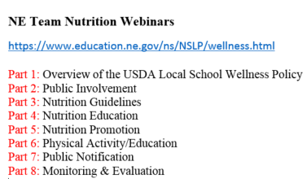
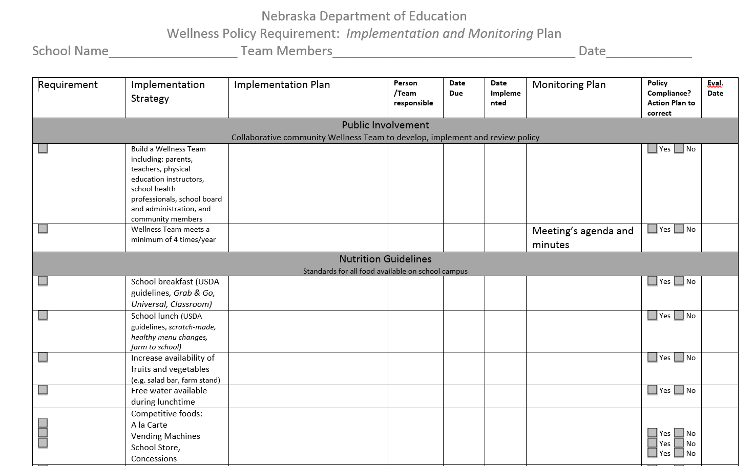
What’s Next?
Part 8
Assess
Revise
Implement
Develop
Evaluate
Monitor
Communicate
Sample Policy Language
Sample Policy Language
Part 2, 3, 4, 5 & 6
Part 2, 3, 4, 5 & 6
Part 2, 3, 4, 5 & 6
Part 2, 3, 4, 5 & 6
What
When
Who
How
Team Nutrition Resources
Part 8
Part 8
Website
Email
Letter
Part 7
Notes:
So, what’s our next step. Do we need to start from scratch? How do I get started?
I put together a flow chart to help you get started on revising your SWP.
The first step is to assess your SWP and see if you have all the required component.
I just introduced a couple of self assessment tools that you can utilize.
Bring members of your school wellness committee together and discuss what your school is already doing to promote good health and to identify strengths and weaknesses.
For example , School health index allows you to assess the extent to which your school implements the types of policies and practices recommended by CDC.
Please refer to this webinar to help you select the right tool to assess your SWP.
Now, Based on your assessment, then you decide if you want revise your policy if it is already in place or develop a new one if it is not included in your SWP. We have introduced many resources, tools, sample of policy language in our previous webinars specifically part 2, 3, 4, 5 and 6. and I listed all the recorded webianrs here and I will share with you at the end of this webinar how to locate these recorded webinars.
After developing or revising a policy, now it is time to implement it. Again, our webinars provided with many resources that help you with the implementations.
After the implementation, you need to monitor the progress of the policy implementation by identifying your strategy (the what), who is responsible of implanting this policy, by when and how? Please refer to the handout that I provided to help you with the implementation and monitoring.
With greater transparency on the effectiveness of these policies, parents and other community stakeholders will be better informed and positioned to improve the school nutrition and wellness environment which is your last step. You can notify the public via school’s website, emails, letters and other avenues that we provided in our webinars.

Slide 26
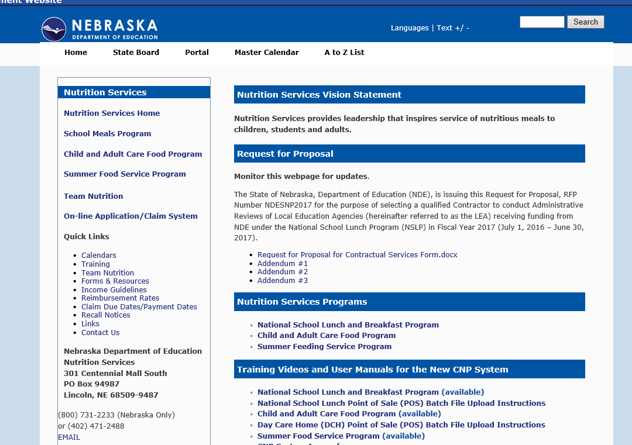
NE Team Nutrition Website
Notes:
If you would like to access all the recorded webinars, slides and narrative of the webinars, please visit NDE website/Nutrition services. On your left, click on TN then it would take you to the TN webpage.

Slide 27
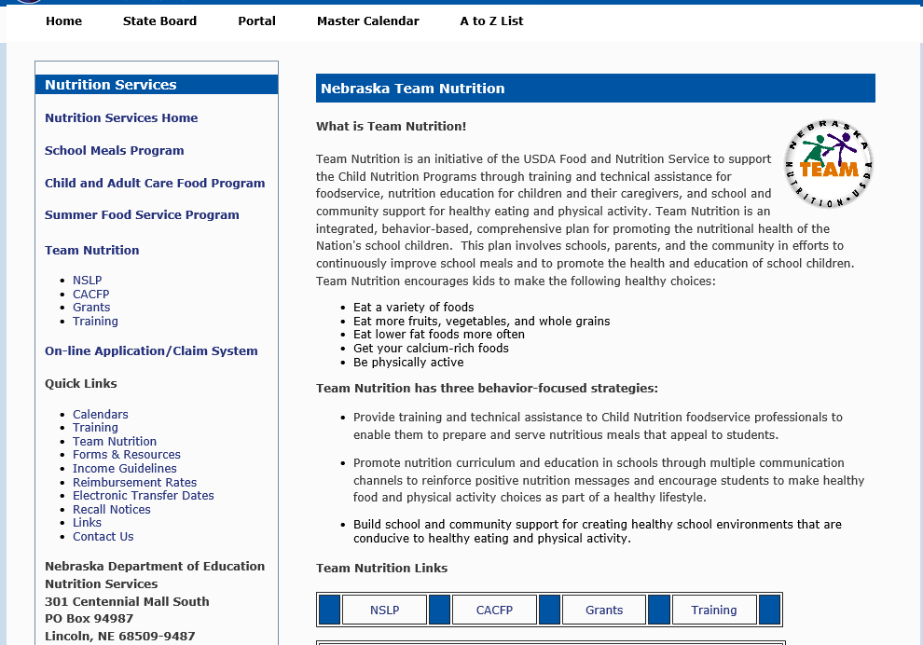
NE Team Nutrition Website
Notes:
Click on the NSLP link and it would take you to many projects under NE TN

Slide 28
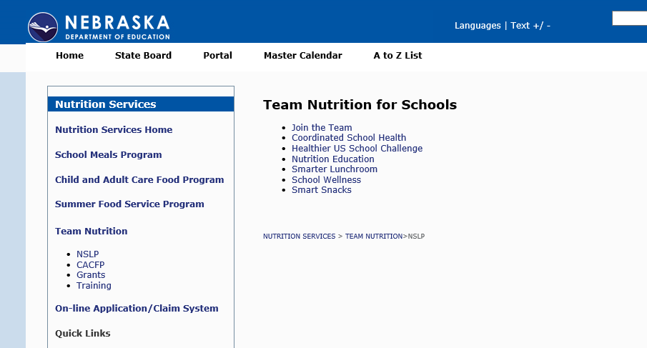
NE Team Nutrition Website
Notes:
Click on SWP

Slide 29
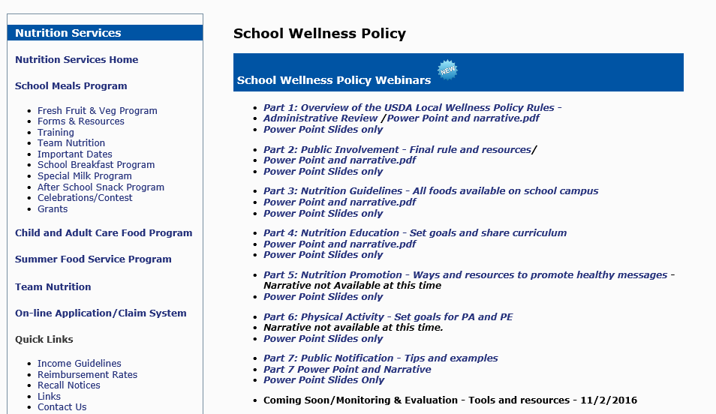
NE Team Nutrition Website
Notes:
And you will see all the recorded webinars, slides and narrative.

Slide 30
Local School Wellness Policy Webinars
Zainab Rida, PhD, RD, LMNT
Director, NE Team Nutrition Program
Zainab.rida@Nebraska.gov
Notes:
OK, This will conclude our final webinar and We will go ahead and take some time for questions. Just a reminder, please be sure to type your questions into the question box in your control panel.
I will send a follow up email once we type the narrative of the webinars and send a link of this recorded webinar along with the slides.
Thanks again for joining us today and I hope you found these serious of webinars helpful for your schools. Please don’t hesitate to contact me at Zainab.rida@Nebraska.gov. Thanks and have a good day!

