Slide 1
Online
2014 NeSA-Reading, Mathematics, and Science
Test Administration Training
February 25-27, 2014

Slide 2
Agenda
Introductions
General Guidelines
Testing Procedures
Reporting
Questions & Answers

Slide 3
Finding the Answers to Your Questions
NeSA Customer Service
Call Toll Free - (866) 342-6280
email
necustomerservice@datarecognitioncorp.com
8:00 A.M. – 5:00 P.M. CST
7:00 A.M. – 5:00 P.M. CST (March 18 – May 8, 2013)

Slide 4
2014 NeSA-RMS Training
Test Administration WebEx Training
Online – February 25 and 27
Paper/Pencil and Alternate Assessment – February 25 and 26
NeSA-RMS Reporting WebEx Training
July 7-9

Slide 5
Test Administration Manuals
2013-2014 NeSA-Reading, Mathematics, and Science Test Administration Manual – Available now!
eDIRECT User Guide: 2013-2014 NeSA-Reading, mathematics, and Science – Available March 3.
NDE Statewide Assessment Website
http://www.education.ne.gov/Assessment/
DRC eDIRECT - https://ne.drcedirect.com
General Information > Documents > Administration – 2013-2014 NeSA-RMS

Slide 6
2014 NeSA Testing Window
March 24 – May 2, 2014
The window is the same for online and
paper/pencil administrations, including the
NeSA-Alternate Assessments

Slide 7
2014 NeSA Key Dates
Test Administration Training
February 25-27
eDIRECT Test Setup/Student Test Tickets Available
March3
Identify students using Spanish or Text-To-Speech in eDIRECT
March 3-7
One Week Prior to Test Window
Districts Train School Personnel & Distribute Materials
NeSA-Reading, Mathematics, and Science Window
March 24 – May 2
Last Day for UPS to Pick Up Test Materials from Districts
May 7
NeSA WebEx on Reporting
July 7-9

Slide 8
Online Testing – All Students
All students will be tested online – except those who
Have an IEP or 504 Plan that requires paper/pencil testing;
Are English Language Learner (ELL) students with an accommodation that allows paper/pencil testing (not necessarily a Spanish translation of the test – as Spanish is also available online);
Are contracted to an agency that does not allow internet access;
Are administered the NeSA-Alternate Assessment for Reading, Mathematics, or Science.

Slide 9
Scheduling the Test
NeSA-Reading, Mathematics, and Science
Two sessions for each subject
Untimed
Do not generally exceed 90 minutes
Flexibility during the 6-week window
Make-ups are required
Recommend scheduling early in the window
Recommend avoiding Mondays
Be certain Test Administrators understand the key dates and the district’s testing schedule.

Slide 10
Accommodated Materials
Online versions of the NeSA-Reading, Mathematics, and Science tests are available in Spanish.
Spanish translations of NeSA-Reading, Mathematics, and Science paper/pencil test booklets are available.
Text-To-Speech (TTS) audio versions of the NeSA-Reading, Mathematics, and Science tests are available for online administration.
Braille and large print versions of the test booklets are available for NeSA-Reading, Mathematics, and Science.

Slide 11
Accommodations
Accommodations for students with IEP or 504 Plans and English Language Learners must be reported in eDIRECT > Test Setup > Students
See NDE website for the Approved Accommodations Document.
http://www.education.ne.gov/Assessment/pdfs/2013_NeSA_Accommodations.pdf

Slide 12
Procedures for Districts with Some Paper/Pencil Testers
All students contained in the NSSRS file will be loaded into eDIRECT > Set Setup. Students flagged as Alternate Assessment will not be added to Test Sessions, and no Student Test Tickets will print for them.
Do NOT edit/change online records for students taking a paper/pencil test – complete applicable fields on their answer sheets.
Do NOT distribute Student Test Tickets to students taking the paper/pencil test – if printed, destroy them securely.

Slide 13
Prepare Students for Testing
Inform students of the scheduled test sessions in advance.
Explain to the students why they are being given the test and how the results will be used.
Students should realize that doing their best is important.

Slide 14
Prepare Testing Location
Plan ahead – check schedules.
Organize test materials.
Provide a testing location with good lighting and comfortable seating and as free of outside disturbances as possible.
Remove visual aids/clues.
Post a TESTING IN PROGRESS sign.

Slide 15
Test Security
Tests are not to be viewed by anyone prior to testing.
No screenshots or video recordings may be made of the NeSA-Reading, Mathematics, and Science online tests.
No coaching or feedback with regard to content.
Student talking or sharing of responses should be prohibited.
Move around the testing site and ensure that students are following instructions.

Slide 16
Test Security
Restrict electronic devices (e.g., smart phones, cell phones, iPods, PDAs, wristwatches with electronic displays, calculators, MP3 players, etc.)
Recommend one assistant/proctor per 12 students, in addition to Test Administrator.
Students must not be left alone with test.
Students cannot take test materials out of the testing site.
See test administration manual for comprehensive test security information.

Slide 17
Online System Restrictions
The NeSA assessments are not to be taken on any computing device that does not allow for the locking of the desktop or operating system for test security.
The NeSA testing client should be running natively on the computing device. Performance, security, and test validity cannot be guaranteed on virtualized desktop environments.
Virtualization of a desktop is not allowed unless the security settings of the computer are held intact and/or by approval of a waiver by the Nebraska Department of Education Assessment Department.
The NeSA testing software does not support touch screen functionality.

Slide 18
Supported Operating Systems
Complete information regarding supported operating systems and system requirements can be found in the DRC INSIGHT Technology User Guide.
Access the guide through eDIRECT > General Information > Documents.
The guide is also posted the NDE’s Statewide Assessment Website. http://www.education.ne.gov/Assessment/pdfs/2014_INSIGHT_WBTE_UG_NE_02_17_14.pdf

Slide 19
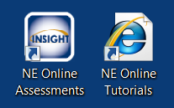
Online Tutorials and Practice Tests
Online Tools Training, Practice Tests, and Guided Practice Tests are currently available to students by clicking on the INSIGHT – NE Online Assessments desktop shortcut.
Spanish Translations of the Online Tools Training and Practice Tests are also available.
Make sure students have practiced using software and tools.
NE Online Tutorials are also available to students by clicking on the NE Online Tutorials desktop shortcut.

Slide 20
Online Tools Training, Practice Tests, and Guided Practice Tests
Access Online Tools Training, Practice Tests, and Guided Practice Tests by selecting Online Tools Training in the NeSA-RMS column of the home page.

Slide 21
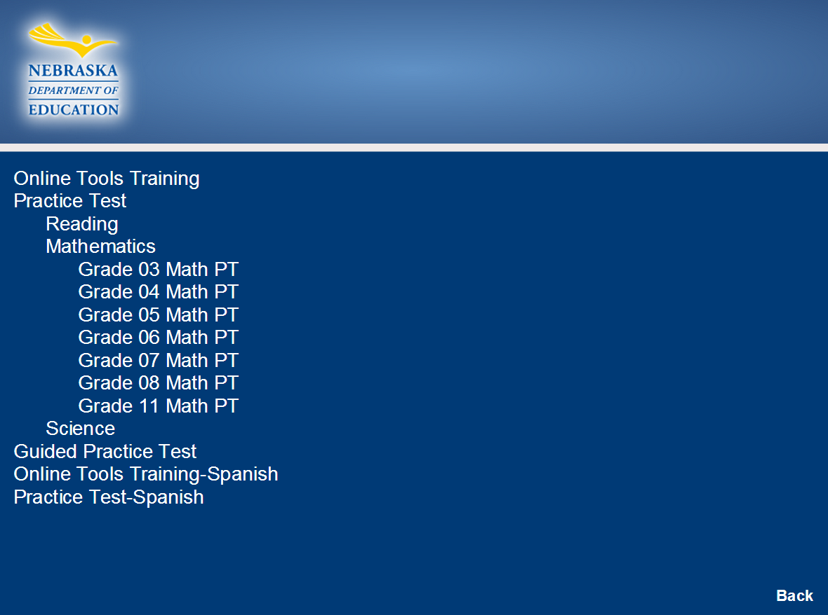
Practice Tests
Online Tools Training, Practice Tests, and Guided Practice Tests
Select the appropriate content area and grade level for Online Tools Training, Practice Tests, or Guided Practice Tests.

Slide 22
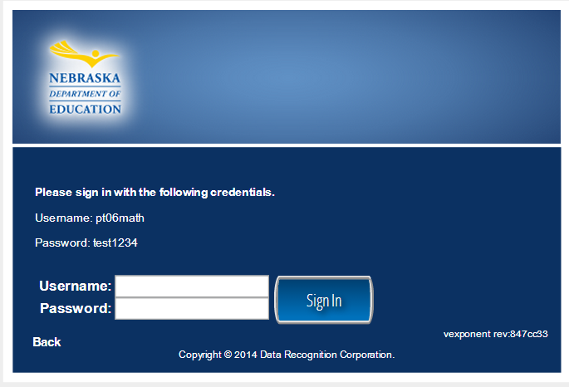
Practice Tests
Logging into Online Tools Training, Practice Tests, and Guided Practice Tests
Enter Username and Password provided on the screen.
Press the Sign In button.

Slide 23
eDIRECT Test Setup
Accessed through eDIRECT
https://ne.drcedirect.com
Available on March 3
2013-2014 NeSA-RMS Permissions Required

Slide 24
eDIRECT Test Setup Permissions
New Permissions for 2013-2014 NeSA-RMS
Test Setup – Primary Window
View Online Results
Note: Test Session – Search/View must be assigned to users to use any other Test Session or Test Ticket permission

Slide 25
eDIRECT Test Setup > General Information
Access Software Downloads
DRC INSIGHT Installers
Windows
Mac
Linux
Testing Site Manager (TSM)
Windows
Mac
Linux
Capacity Estimator

Slide 26
eDIRECT > Test Setup > Students
To Find Students
Select administration 2013-2014 NeSA-RMS
You may apply any applicable filters to narrow search
Last Name
First Name
NSSRS ID
Grade
Demographic
Race/Ethnicity
LEP/ELL Eligible
Special Education IEP
Alternate Assessment

Slide 27
eDIRECT > Test Setup > Students
Apply any applicable filters (con’t)
Accommodation Content Area
Accommodation Type
Presentation
Online – Audio or Spanish
Accommodation
Note: Once Accommodation Content Area or Accommodation Type is selected, all three Accommodation filters become required fields as noted by the red asterisk.

Slide 28
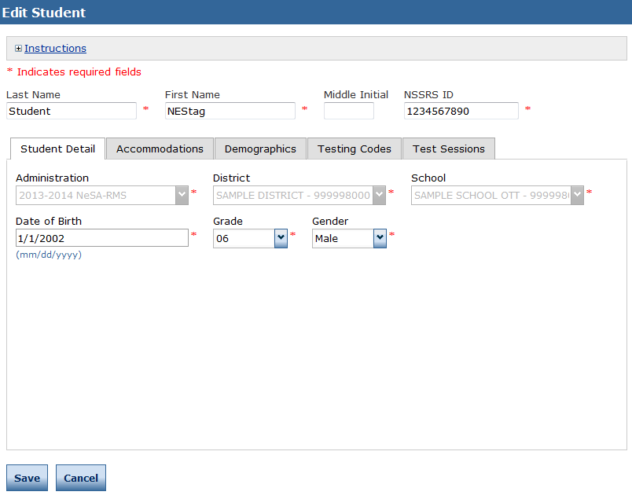
eDIRECT > Test Setup > Students >Edit Students > Student Detail
To View/Edit Student data
Click on Action Icon – View/Edit
You may edit student’s name, NSSRS ID number, Date of Birth, Grade, or Gender
Students who have moved between schools within the district must be added as a new student at the appropriate school
Be sure to Save any edits.

Slide 29
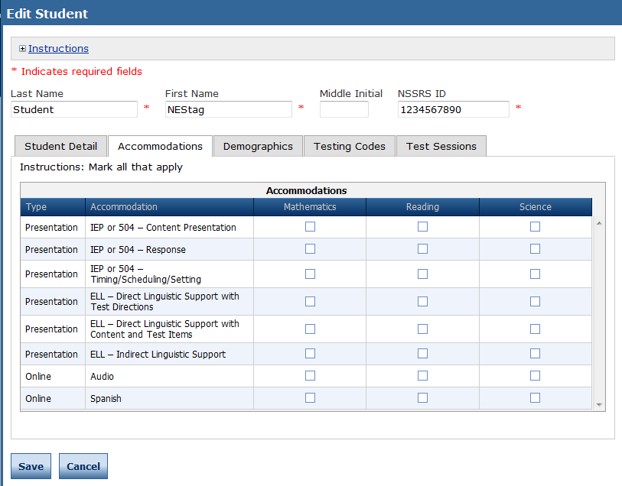
eDIRECT > Test Setup > Students >Edit Students > Accommodations
Accommodations
Select the Accommodations tab
Flag all accommodations by content area
Be sure to Save any edits

Slide 30
eDIRECT > Test Setup > Students >Edit Students > Accommodations
Online – Audio or Spanish
Flag students who need Audio or Spanish accommodations by content area March 3-7, prior to printing Student Test Tickets
Be sure to Save any edits
Reprint Student Test Tickets for students with these accommodations starting March 14
After March 7, contact DRC Customer Service to change audio or Spanish settings. Test Tickets for these students must be regenerated prior to printing of tickets

Slide 31
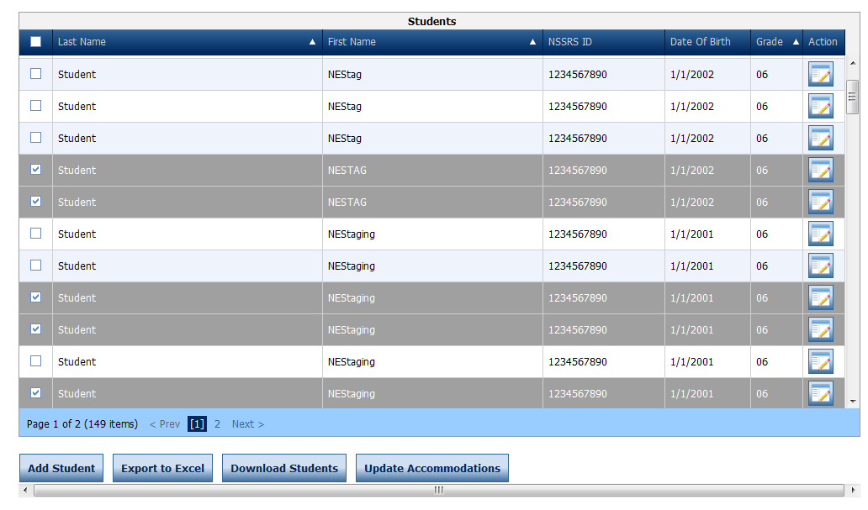
eDIRECT > Test Setup > Students Update Accommodations
Updating Accommodations for multiple students
Add or remove accommodations flags for multiple students receiving the same accommodations by using the Update Accommodations button on the Manage Students screen
Select Students

Slide 32
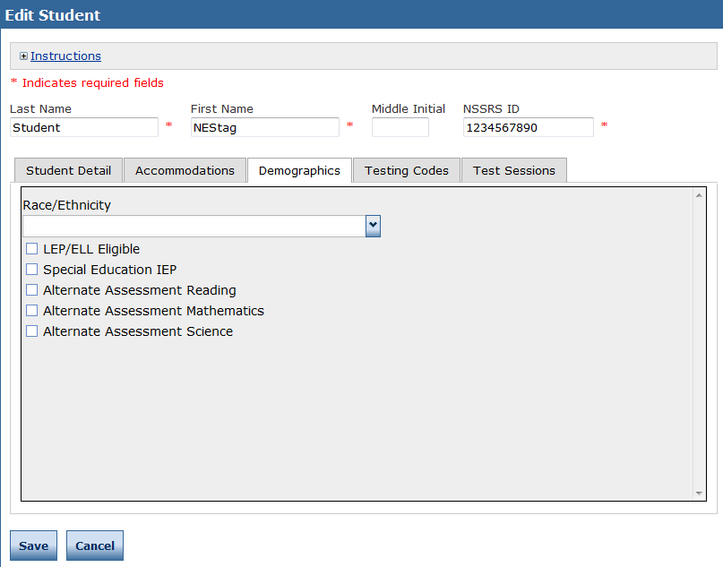
Online Testing > Management Tools > Data Tools > Add a Student
eDIRECT > Test Setup > Students >Edit Students > Demographics
Demographics
Select the Demographics tab
Edit Race/Ethnicity, LEP/ELL Eligible, Special Education IEP, Alternate Assessment by Content Area
Be sure to Save any edits

Slide 33
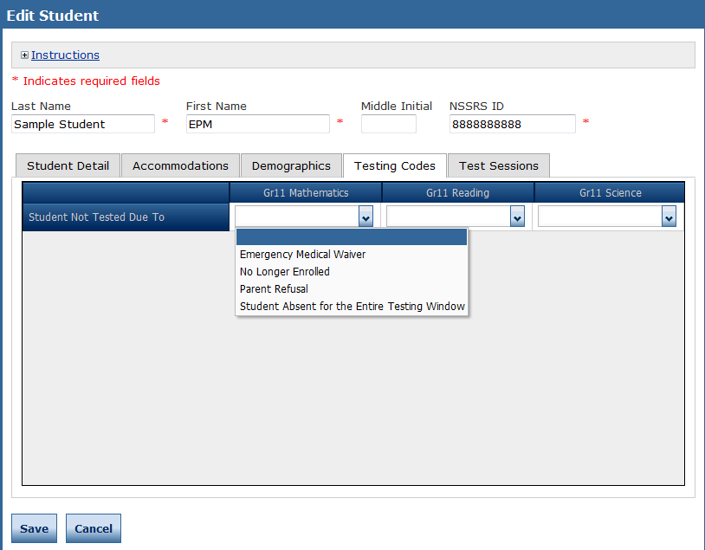
Online Testing > Management Tools > Data Tools > Add a Student
eDIRECT > Test Setup > Students >Edit Students > Testing Codes
Testing Codes
Indicate reason student was not tested by content area
Student must be in a test session to assign a Not Test Code
Be sure to Save any edits

Slide 34
Online Testing > Management Tools > Data Tools > Add a Student
eDIRECT > Test Setup > Students >Edit Students > Test Sessions
Test Sessions
View which test sessions a student is in
View Status of test sessions

Slide 35
eDIRECT > Test Setup > Test Sessions
Show Sessions
Select 2013-2014 NeSA-RMS Administration
Select District/School
You may apply any applicable filters to narrow search
Student Name and/or NSSRS ID
Content Area
Assessment
Sessions tab
List of test sessions by District or School
Status Summary tab
Number of sessions Not Started, In Progress, or Complete
Number of students by session with status of Not Started, In Progress, or Complete

Slide 36
eDIRECT > Test Setup > Test Sessions > Export Details
Use the Export Details icon to download a spreadsheet with student detail including:
Student Date Started and Completed
Accommodations
Not Test Codes flagged for students
User Names and Passwords – Must be kept secure!
Information updates in real time

Slide 37
eDIRECT > Test Setup > Test Sessions > Edit Print Ticket Status
Use the Edit/Print Ticket Status icon to:
Print tickets one or more selected students
View Student Test Status
Information may be viewed for Session 1 or 2 by selecting the session in the Status by Module dropdown.

Slide 38
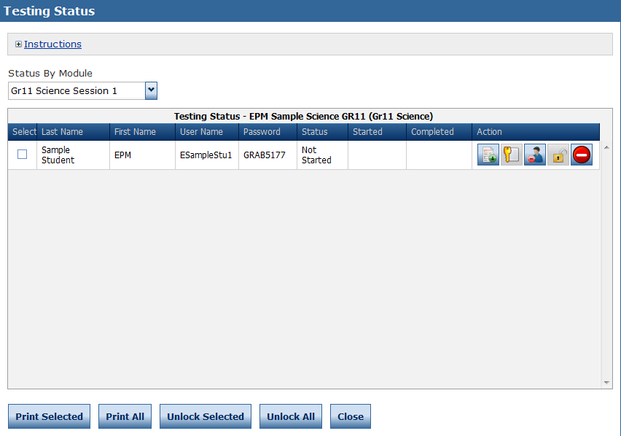
eDIRECT > Test Setup > Test Sessions > Edit Print Ticket Status
Use the Edit/Print Ticket Status icon to:
Print tickets for one or more selected students
View Student Test Status
Information may be viewed for Session 1 or 2 by selecting the session in the Status by Module dropdown.

Slide 39
eDIRECT > Test Setup > Test Sessions > Print All Tickets
Use the Print All Tickets icon to:
Print tickets for all students in Test Session
Opens pdf containing
Instructions for handling Student Test Tickets
Student Test Roster for Session 1
Student Test Tickets for Session 1
Student Test Roster for Session 2
Student Test Tickets for Session 2
Student Test Rosters and Tickets contain User Names and Passwords and must be kept secure

Slide 40
Unlocking Student Test Tickets
Only the NDE can unlock Student Test Tickets “next day.” If DAC believes circumstances merit the Student Test Ticket be unlocked, contact the NDE by emailing request to nde.stateassessment@nebraska.gov .
Students “kicked out” of the system may log back into the test on the same day using their Student Test Ticket, and resume testing.

Slide 41
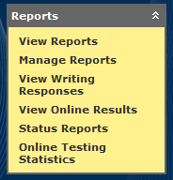
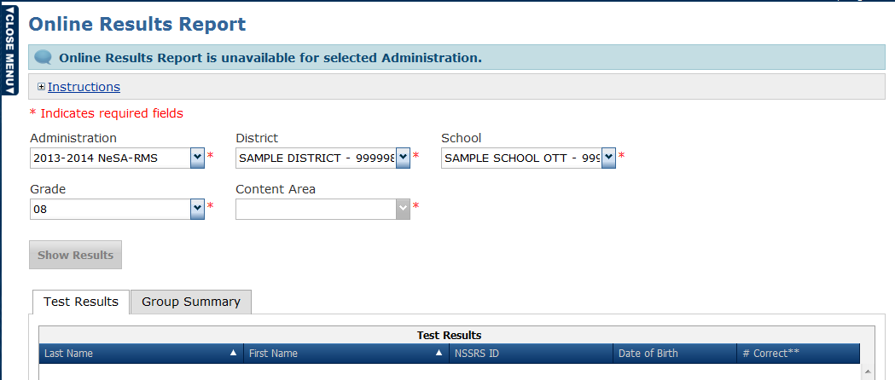
eDIRECT > Reports > View Online Results

Slide 42
eDIRECT > Reports > View Online Results
Test Results – A basic student roster showing the number of operational test items answered correctly.
Group Summary – Summary statistics for the part of population that tested online.
Students must complete both sessions of the test to appear in Online Results.
Online Results may be exported as PDF or CSV files.
Results should be considered preliminary.

Slide 43
eDIRECT > Reports > View Reports
2014 NeSA-RMS Reports posted to eDIRECT – July 9
Student Data File
Performance Level Summary (State, District, School)
Reading and Mathematics Indicator Summaries (State, District, School)
Science Grade Level Standard Summary (State, District, School)
District Report of School Performance
School Student Roster
Individual Student Report also available online

Slide 44
eDIRECT > Reports > Status Reports & Online Testing Statistics
Status Reports
Track testing activity, including excessive logins and school testing status
Online Testing Statistics
Track number of tests started and completed

Slide 45
Tips for Successful Online Testing
Make sure each student is provided his/her unique Student Test Tickets.
Instruct students to End their tests and Exit the INSIGHT Online Testing Software correctly in order for testing statuses to show as Complete.
If a disruption occurs, always try to have student log in on the same computer first. If a student is “kicked out” of a test, exit the software completely before trying to log in again.

Slide 46
Online Testing Wrap-Up
If using a TSM, make certain that cached responses have been transferred to DRC after testing is complete.
Disposal of Test Session Tickets
Tickets are secure materials and must be distributed and collected as such.
School Test Coordinator to collect and securely destroy Test Session Tickets.

Slide 47
Questions
& Answers
NeSA Customer Service
Call Toll Free - (866) 342-6280
Fax - (763) 268-2540
email
necustomerservice@datarecognitioncorp.com
8:00 A.M. – 5:00 P.M. CST
7:00 A.M. – 5:00 P.M. CST (March 17 – May 9, 2014)

